Slide 1
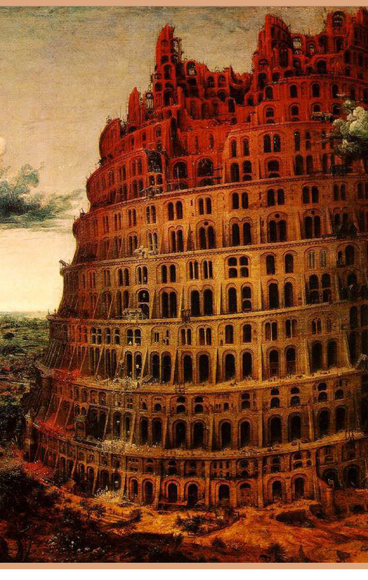
Babylon II
EPHESIANS 5:1-2
Be ye therefore followers of God, as dear children; 2 And walk in love, as Christ also hath loved us, and hath given himself for us an offering and a sacrifice to God for a sweetsmelling savour.

Slide 2
WHY.ARE.WE.NOT.A.DENOMINATION
57 Now, notice the woman, the church; she was Mystery Babylon. We see her appear by Nimrod. What was Nimrod's purpose? Nimrod founded a city and caused all of the other cities to pay tribute to this city. Could we see such a thing today? Is there such a place today?
Is there a church that has domination over every nation in the world? Certainly. Is there a place today that makes every nation pay tribute to it?
58-0927

Slide 3
Literal Babylon vs. Mystery Babylon
The physical city of Babylon was originally built by Nimrod after the flood. It was located on the Euphrates River, about 55 miles south of where Baghdad, Iraq stands today. The name Babylon came from the Tower of Babel that was constructed there.
Babylon became a large city of global prominence around 1728 BC during the reign of Hammurabi. The glory years of Babylon were achieved under Nebuchadnezzar II (604-562 BC).
The city declined during the reign of Belshazzar, and came to ruin when Xerxes, the Persian king, destroyed it in 478 BC.

Slide 4
WHY.I'M.AGAINST.ORGANIZED.RELIGION
218 Notice, this is the angel of Light, the last angel, it's the angel in the church age to the Laodicea. It's the Laodicea messenger, because the next chapter is the 19th, which is the coming Bride. And this is the last angel that came to bring Light before the coming of the Bride to go meet Christ. It was the Laodicean Church Age, then. What was the Laodicean Church Age messen-ger? Calling them out of Babylon! Churches caught in her cage with her, with her dogmas, denying the Word and accepting dogmas.
62-1111

Slide 5
TOTAL.SEPARATION
32 It is a total separation. We're not to go back into the world no more, or have anything to do with the world, but cleave only unto God. Jesus is coming after a Bride, a Woman, a Church that's separated from the things of the world, or the cares of the world. She is separated from the fashions of this modern age that we live in.
She is separated from the cares and the traditions of churches. She is separated only to God, and God is the Word. 64-0121

Slide 6
EPHESIANS 5:1-7
Be ye therefore followers of God, as dear children; 2 And walk in love, as Christ also hath loved us, and hath given himself for us an offering and a sacrifice to God for a sweetsmelling savour.

Slide 7
EZEKIEL 18:30-32
Therefore I will judge you, O house of Israel, every one according to his ways, saith the Lord GOD. Repent, and turn yourselves from all your transgressions; so iniquity shall not be your ruin. 31 Cast away from you all your transgressions, whereby ye have transgressed; and make you a new heart and a new spirit: for why will ye die, O house of Israel? 32 For I have no pleasure in the death of him that dieth, saith the Lord GOD: wherefore turn yourselves, and live ye.

Slide 8
EZEKIEL 36:24-27
For I will take you from among the heathen, and gather you out of all countries, and will bring you into your own land. 25 Then will I sprinkle clean water upon you, and ye shall be clean: from all your filthiness, and from all your idols, will I cleanse you. 26 A new heart also will I give you, and a new spirit will I put within you: and I will take away the stony heart out of your flesh, and I will give you an heart of flesh. 27 And I will put my spirit within you, and cause you to walk in my statutes, and ye shall keep my judgments, and do them.

Slide 9
ACTS 1:6-8
When they therefore were come together, they asked of him, saying, Lord, wilt thou at this time restore again the kingdom to Israel? 7 And he said unto them, It is not for you to know the times or the seasons, which the Father hath put in his own power. 8 But ye shall receive power, after that the Holy Ghost is come upon you: and ye shall be witnesses unto me both in Jerusalem, and in all Judaea, and in Samaria, and unto the uttermost part of the earth.

Slide 10
EPHESIANS 3:14-17
For this cause I bow my knees unto the Father of our Lord Jesus Christ, 15 Of whom the whole family in heaven and earth is named, 16 That he would grant you, according to the riches of his glory, to be strengthened with might by his Spirit in the inner man; 17 That Christ may dwell in your hearts by faith; that ye, being rooted and grounded in love…

Slide 11
JOHN 14:16-26
Yet a little while, and the world seeth me no more; but ye see me: because I live, ye shall live also. 20 At that day ye shall know that I am in my Father, and ye in me, and I in you. 21 He that hath my commandments, and keepeth them, he it is that loveth me: and he that loveth me shall be loved of my Father, and I will love him, and will manifest myself to him.

