Slide 1
Knowledge Shall Increase
HOSEA 4:6-7

Slide 2
WORLD.IS.FALLING.APART
61 Every so often the world gets in such a chaotic condition until there is nothing can help it. We've had this several times, these preludes. And we find that each time when it meets this condition, it causes people to start praying.
And they feel that everything has played itself out, as all of our systems and everything that we have, play itself to the end. It did that in the antediluvian world...

Slide 3
Politics and other things just comes to its end, there is no more to it. I think all that's done by God, for a purpose, to kind of rejuvenate, to kind of bring back. It has a way of renewing itself. And I think it's just a law of God, that these things comes to that place.
62 …Christ's first advent, we could say the world was falling apart. It was a corruptible time in politics, in religion. The whole systems had become corrupted. They had mingled, injecting man-made theories, religions... And the world was falling apart… God gave them a Messiah, they didn't want it the way He sent it.

Slide 4
Welcome to the New Age of Nuclear Instability
A report issued by the director of Nat’l. Intelligence (Feb.) recognized that “the risk of interstate conflict, including among great powers, is higher than at any time since the end of the Cold War. The threat of state and nonstate use of weapons of mass destruction will continue to grow.”
https://www.nytimes.com/2019/02/01/opinion/inf-nuclear-weapons.html

Slide 5
WE.WOULD.SEE.JESUS
49 We're at the end time, my brother. Hearts failing, fear, sputniks in the skies. One extra drink of vodka, could pull a little lever, we'd would be powder in two minutes. And the world would fly plumb into the sun yonder. Just what the Scripture predicts it'll do. But remember the Church will go home before that happens. 58-0523

Slide 6
ESCAPE.HITHER.COME.QUICKLY
13 But the oncoming judgments, the world is feeling it. I've heard that in the Pentagon, I don't know, but they say that they don't know what to do. Well, there's only one Book can direct you on what to do, that's God's Bible, lift up your head; look up. There's no way of escape.
It's already come into the hands of men that they can destroy this world in an hour if they want to. What would hinder Russia this afternoon, some of those leaders to drink one can of vodka too much, punch a button that would send the entire world out of its orbit, and wouldn't contrary the Scriptures a bit, we're at the end time.
58-0202

Slide 7
THE.HANDWRITING.ON.THE.WALL
69 Do you realize this is a searching out time?. This may be the last Gospel message that's preached. Before the message begins tonight, you know, that bomb may strike the earth.
There isn't a thing to keep it from being so. They're set. They're ready. All it takes is a few drinks of vodka, and here it would come. And the only thing that holds it off right now, is the grace of God, trying to get His church together…
58-0309

Slide 8
https://thebulletin.org/current-issue/?utm_source=Bulletin%20Blast&utm_medium=iContact%20email&utm_campaign=Statement_February6

Slide 9
Magnetic North Just Changed.
Here's what that means.
Magnetic north has never sat still. In the last 100 yrs. or so, the direction in which our compasses steadfastly point has lumbered ever northward, driven by Earth's churning liquid outer core some 1,800 miles beneath the surface. Yet in recent years, scientists noticed something unusual: Magnetic north's routine plod has shifted into high gear, sending it galloping across the Northern Hemisphere—and no one can entirely explain why.
https://www.nationalgeographic.com/science/2019/02/magnetic-north-update-navigation-maps/

Slide 10
The changes have been so large that scientists began working on an emergency update for the World Magnetic Model, the mathematical system that lays the foundations for navigation, from cell phones and ships to commercial airlines… Now, the wait for a new north is over. The World Magnetic Model update was officially released on Monday, and magnetic north can again be precisely located for people around the world.

Slide 11
“We know that the pole now is moving faster than it has for decades, but how often does that happen in the long historical record? We don't have any idea. What we know is what it's doing now is different, and that's always exciting scientifically.”
Geoff Reeves, Scientist, Los Alamos National Lab
ROMANS 8:22
For we know that the whole creation groaneth and travaileth in pain together until now.

Slide 12
A.PROPHET.LIKE.UNTO.MOSES
5 And notice that even nature itself is calling for that day. Nature is groaning. Everything seems to be out of cater… The stars are not in their orbits as they should be, and everything seems to be out of cater.
It's all waiting, groaning for that day of perfection, when our Lord Jesus shall come and perfect everything that's imperfected. 59-1120

Slide 13
WATCHMAN.WHAT.OF.THE.NIGHT
30 And men go right on living… look up in the face of God, and deny there is such a thing as hell, and setting on a pot of it. Falling volcanics... And the earth all out of cater... Science says the earth, out in the sea, it's becoming more shallow; at the North Pole, it's becoming deeper, because the earth is a spreading out. Oh, it's just about ready to be delivered. And people see these things...
60-0722

Slide 14
Knowledge: (Heb.) da'ath
Perception, skill, discernment,
understanding, and wisdom.
HOSEA 4:6-7
My people are destroyed for lack of knowledge: (discernment, understanding) because thou hast rejected knowledge, I will also reject thee, that thou shalt be no priest to me: seeing thou hast forgotten the law of thy God, I will also forget thy children. 7 As they were increased, so they sinned against me: therefore will I change their glory into shame.

Slide 15
FAITH.IS.THE.SUBSTANCE
15 This day that we're living in, it's such a day of unsettled peace and unsettled rest everywhere. People are running to-and-fro seeking whatever they may seek. Most anybody can get a following. No matter what they teach or think, somebody will listen to them. And it's a day that the prophets spoke of.
…I think real true ministers of the Gospel ought to be up and going, ought to be giving the people the right things: meat in due season.
47-0412

Slide 17
1. Immorality THE.FLASHING.RED.LIGHT
191 The infallible Voice of Jesus Christ warned us to watch the days of Noah and compare it with the day that we live. And then when we seen those things happen, women becoming fair, and sons of God taking them, and how these things would be, then we know that that generation would see the Coming of the Lord. Then, we know the flashing light, His coming is near.
63-0623

Slide 18
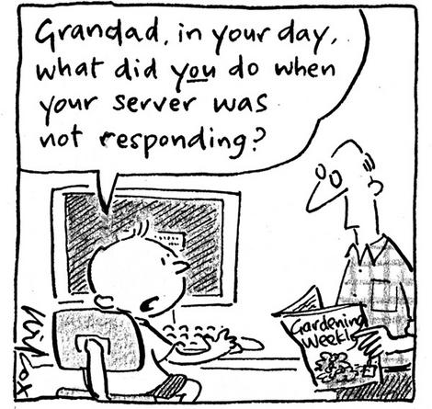

Slide 19
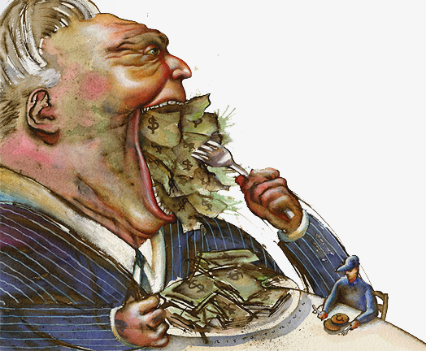
2. Greed
Financial Realities
In a Declining America

Slide 20
THE.TRUE.EASTER.SEAL
84 We find that greed in church, and in politics, and national affairs… look what's happened down there now in Africa; not only there, but all over the world everywhere... this is all they have, is right here on earth, or, they live that way.
If this was all I had, I'd be a miserable person. I'm looking for a City whose Builder and Maker is God. There's where we lay our treasures up, for that purpose.
61-0402

Slide 21
3. Knowledge
DANIEL 12:4
But thou, O Daniel, shut up the words, and seal the book, even to the time of the end: many shall run to and fro, and knowledge shall be increased.
A.SUPER.SIGN
67 Right here in the last fifty years, he's come from a horse and buggy, to a jet or a rocket. Why? Bible said they would "run to and fro" in these last days, "and knowledge shall increase." It's a sign of the end time. 62-0708

Slide 22
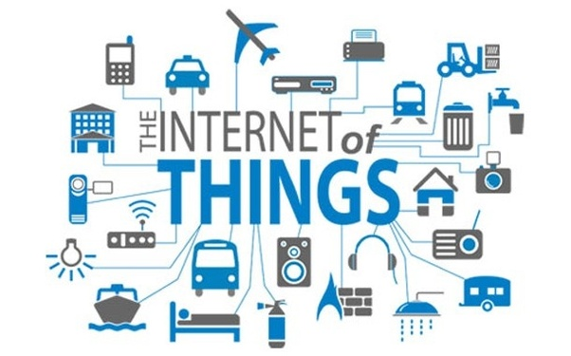

Slide 23
THE.JUNCTION.TIME
31 Now, the prophets prophesied of things. They didn't know what they were talking about. They just said them, didn't understand. Daniel said he couldn't understand, but he just wrote it out, because it wasn't for his day. The Angel told him to close up the book until the end time. Many would run to and fro, and knowledge increase, and at that time he'd stand in his lot at the end of the time, and all these things would take place.
56-0122

Slide 24
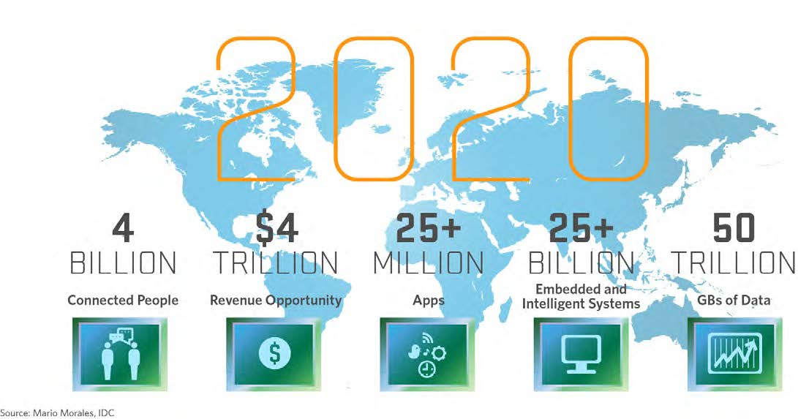

Slide 25
I.WAS.NOT.DISOBEDIENT
We realize that in the garden of Eden when they tasted the tree of knowledge, they broke off relationship with the Tree of Life. And since then man has went after knowledge and destroys himself every time he bites from the tree: gun powder, automobiles, and now an atomic bomb. Knowledge, knowledge...
Truly the prophet Daniel said, "They'll run to and fro, and knowledge shall increase.“
49-0718

Slide 26
DANIEL 12:1-13
1And at that time shall Michael stand up, the great prince which standeth for the children of thy people: and there shall be a time of trouble, such as never was since there was a nation even to that same time: and at that time thy people shall be delivered, every one that shall be found written in the book.
4 But thou, O Daniel, shut up the words, and seal the book, even to the time of the end: many shall run to and fro, and knowledge shall be increased.

Slide 27
IS.THIS.THE.SIGN.OF.THE.END.SIR?
236 This may be the answer here. I don't know. You all been here last Sunday. Many Sundays, you people here that gets the tapes, you understand these things. Because, now I'll just strike these places, and you watch it… I don't know. That's why I'm saying, sirs, is this it?
237 I believe that "the seventh angel" of Rev. 10 is the seventh church-age messenger of Rev. 3:14.
62-1230E

Slide 28
THE.REVELATION.OF.JESUS.CHRIST
311 (Zech. 12:9) When is the Gospel returning to the Jews? When the day of the Gentile is finished, the Gospel is ready... And this great thing is fixing to happen, will carry over to Rev. 11 and pick up those two prophets, Elijah and the Moses returning back again for the Jews.
We're ready for it. Everything is setting in order, just ready. This Gentile Message, as the Jews brought it to the Gentiles, the Gentiles will take it right back to the Jews again. And the Rapture will come.
60-1204

Slide 29
IS.THIS.THE.SIGN.OF.THE.END.SIR
241 The seventh angel of Rev. 10:7 is the 7th church-age messenger. Notice his type of Message. Now, it wasn't to the first angel, wasn't given That; second angel, third, fourth, fifth, sixth. But it is the seventh angel that had this type of Message. Notice his type of Message, "Finishing all the mysteries of God, that are written in the Book." The seventh angel is winding up all the mysteries that's laying loose-ended, all out through these organizations and denominations. The seventh angel gathers them up, and finishes the entire mystery.
62-1230E

Slide 30
IS.THIS.THE.SIGN.OF.THE.END.SIR
270 Notice, each church age had its messenger. Paul was the first messenger. And what did he do? Declared war on the Orthodox church, for not believing the Messianic sign that Jesus had produced to them. Why, they should’ve knowed it.
271 Remember, Paul come at the end of the age. All the messengers come at the end of the age… What was it? Sounding of a trumpet; an angel, messenger, standing there with the Word! How we could go down to Irenaeus, the messenger of the next church age!

Slide 31
And Martin, the next church age, when they begin to get the doctrine of the Nicolaitanes, begin to come in… And then Luther, the fifth messenger, he blasted that Catholic church, with the Word of God. "The just shall live by faith," he said. John Wesley raised up, in the days of the Anglican church. "Why," they said, "there's no more reason to have revivals," and it went to seed.

Slide 32
John Wesley stood up, with the message of the second work of grace, sanctification…
Now we're in the Laodicean age, when they've again denominated; And we're looking for a prophet to come, to blast this age, and turn them back from their iniquity.
279 And remember, this messenger was the seventh angel, and he was to take all the mysteries and gather them up… O God, send us a fearless prophet with THUS SAITH THE LORD, that the vindicated Word of God will move through it and prove that he's sent from God.

Slide 33
GIFTS &CALLINGS.ARE.WITHOUT.REPENTANCE
Now, the Spirit of Christ is in the Church. It has never left the Church; It's been in the Church. And the days are growing evil, because that knowledge, man's knowledge, that he received in the garden of Eden... When he left the Tree of Life to eat from the tree of knowledge, that knowledge is increasing constantly. And as knowledge increases, they get away from the Bible and get into a theory.
50-0300

Slide 34
ONENESS.OF.UNITY
21-4 How many believes He's Jehovah-jireh, the Lord that healeth thee? Listen friends, too many times my ministry in America hasn't been very forceful, because it looks like the people is so confused. One teaches one thing, and one another; instead of setting down and taking the Bible and reading it for yourself, and being convinced by the Holy Spirit...
58-0128

Slide 35
I CORINTHIANS 2:1-4
And I, brethren, when I came to you, came not with excellency of speech or of wisdom, declaring unto you the testimony of God. 2 For I determined not to know any thing among you, save Jesus Christ, and him crucified. 3 And I was with you in weakness, and in fear, and in much trembling. 4 And my speech and my preaching was not with enticing words of man's wisdom, but in demonstration of the Spirit and of power: 5 That your faith should not stand in the wisdom of men, but in the power of God.

Slide 36
LEAN.NOT.UNTO.THY.OWN.UNDERSTANDING
54 John 10, "My sheep know My Voice." A Voice, of course, is His Word, when He is speaking. “My Voice has been proven to them, to be true. It's been vindicated that it is My Voice." Notice, they are not subject to following any other voice. They won't.
In other words, they will not understand a theological voice that's teaching contrary to the Word. The sheep don't understand that no more than the eagle, last night, could understand the clucking of the hen. They don't understand it, because he was an eagle. And that's the same thing with a genuine born-again child of God, they understand only the things that are of God. 65-0120

Slide 37
EPHESIANS 1:17-19
That the God of our Lord Jesus Christ, the Father of glory, may give unto you the spirit of wisdom and revelation in the knowledge of him: 18 The eyes of your understanding being enlightened; that ye may know what is the hope of his calling, and what the riches of the glory of his inheritance in the saints, 19 And what is the exceeding greatness of his power to us-ward who believe, according to the working of his mighty power,

Slide 38
TRYING.TO.DO.GOD.A.SERVICE
178 The evening time, He promised He would reveal, though, open these Seven Seals and show what them churches had missed back there. Revelations 10, and Malachi 4, Luke 17:30, He said He would do it. Now let's not mix it up. Let's keep it right like that.
65-0718

Slide 39
220 But now is the Bride-calling, now is when the Seven Seals has been opened, now when the complete things that the reformers left has to be opened; and only Malachi 4 can do that, because it takes the revelation straight from God to an individual to do so. That's right! It can't come to a group, never did. One man! That's what God promised in the shadows of the coming for His Bride, an Eliezer.

Slide 40
Knowledge (Gr.) epignosis
Acknowledgement of precise and correct knowledge; used of the knowledge of things ethical and divine.
EPHESIANS 1:17
That the God of our Lord Jesus Christ, the Father of glory, may give unto you the spirit of wisdom and revelation in the knowledge of him:
4:13 Till we all come in the unity of the faith, and of the knowledge of the Son of God, unto a perfect man, unto the measure of the stature of the fulness of Christ:

