Slide 1

The Ministry of the
Mystery of God
Part 4 The Breach
REVELATION 4:1
After this I looked, and, behold, a door was opened in heaven: and the first voice which I heard was as it were of a trumpet talking with me; which said, Come up hither, and I will shew thee things which must be hereafter.

Slide 2
BIrthdays & Anniversaries
Feb. 28th Bill & Cindy Walters
Mar. 3rd Peter & Rachel Coffey
Mar. 4th Luther & Mary Ann Roy
Mar. 8th Sharon McCafferty
Mar. 9th Matt Cross

Slide 3
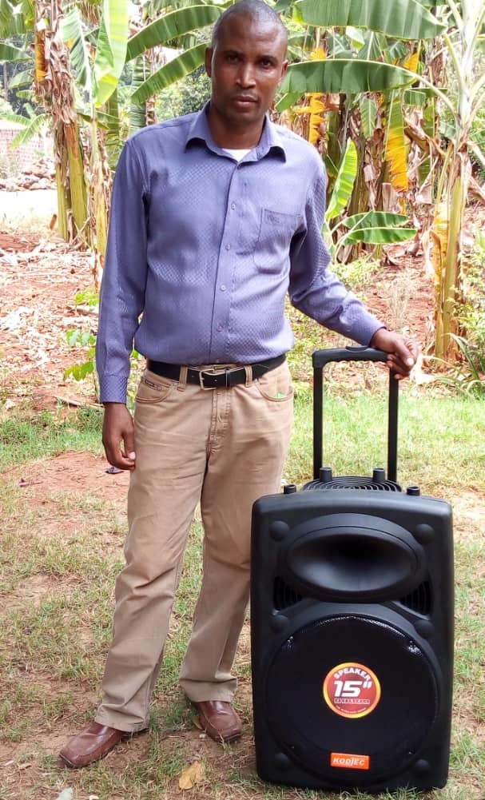
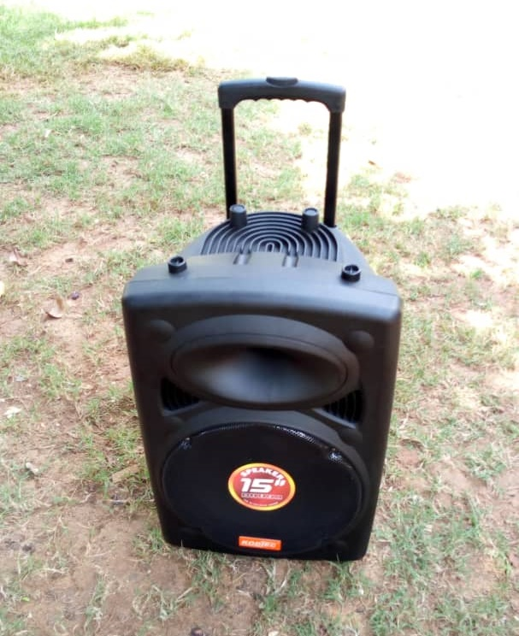
US $160

Slide 4
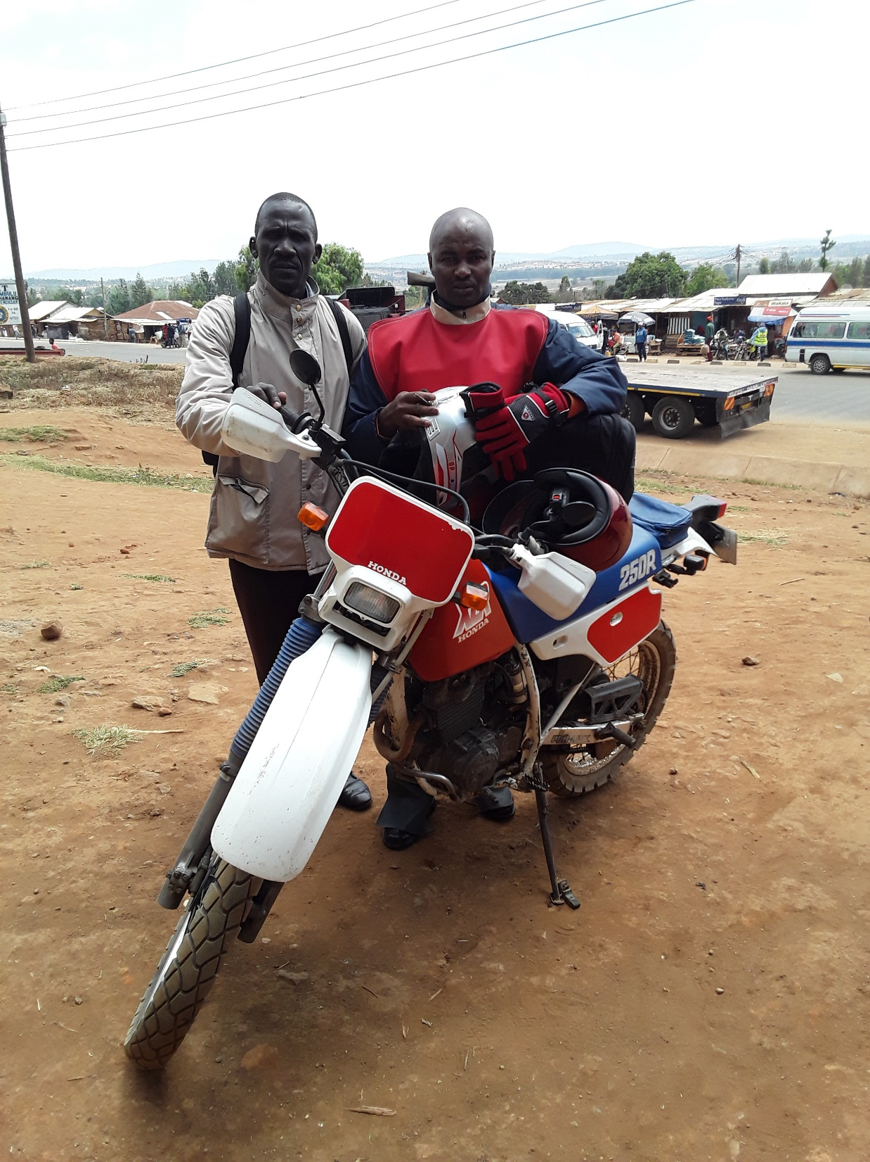
Trip 1
Dareda & Kigoma
Tanzania
Bro. Elibariki
Bro. Malachi

Slide 5
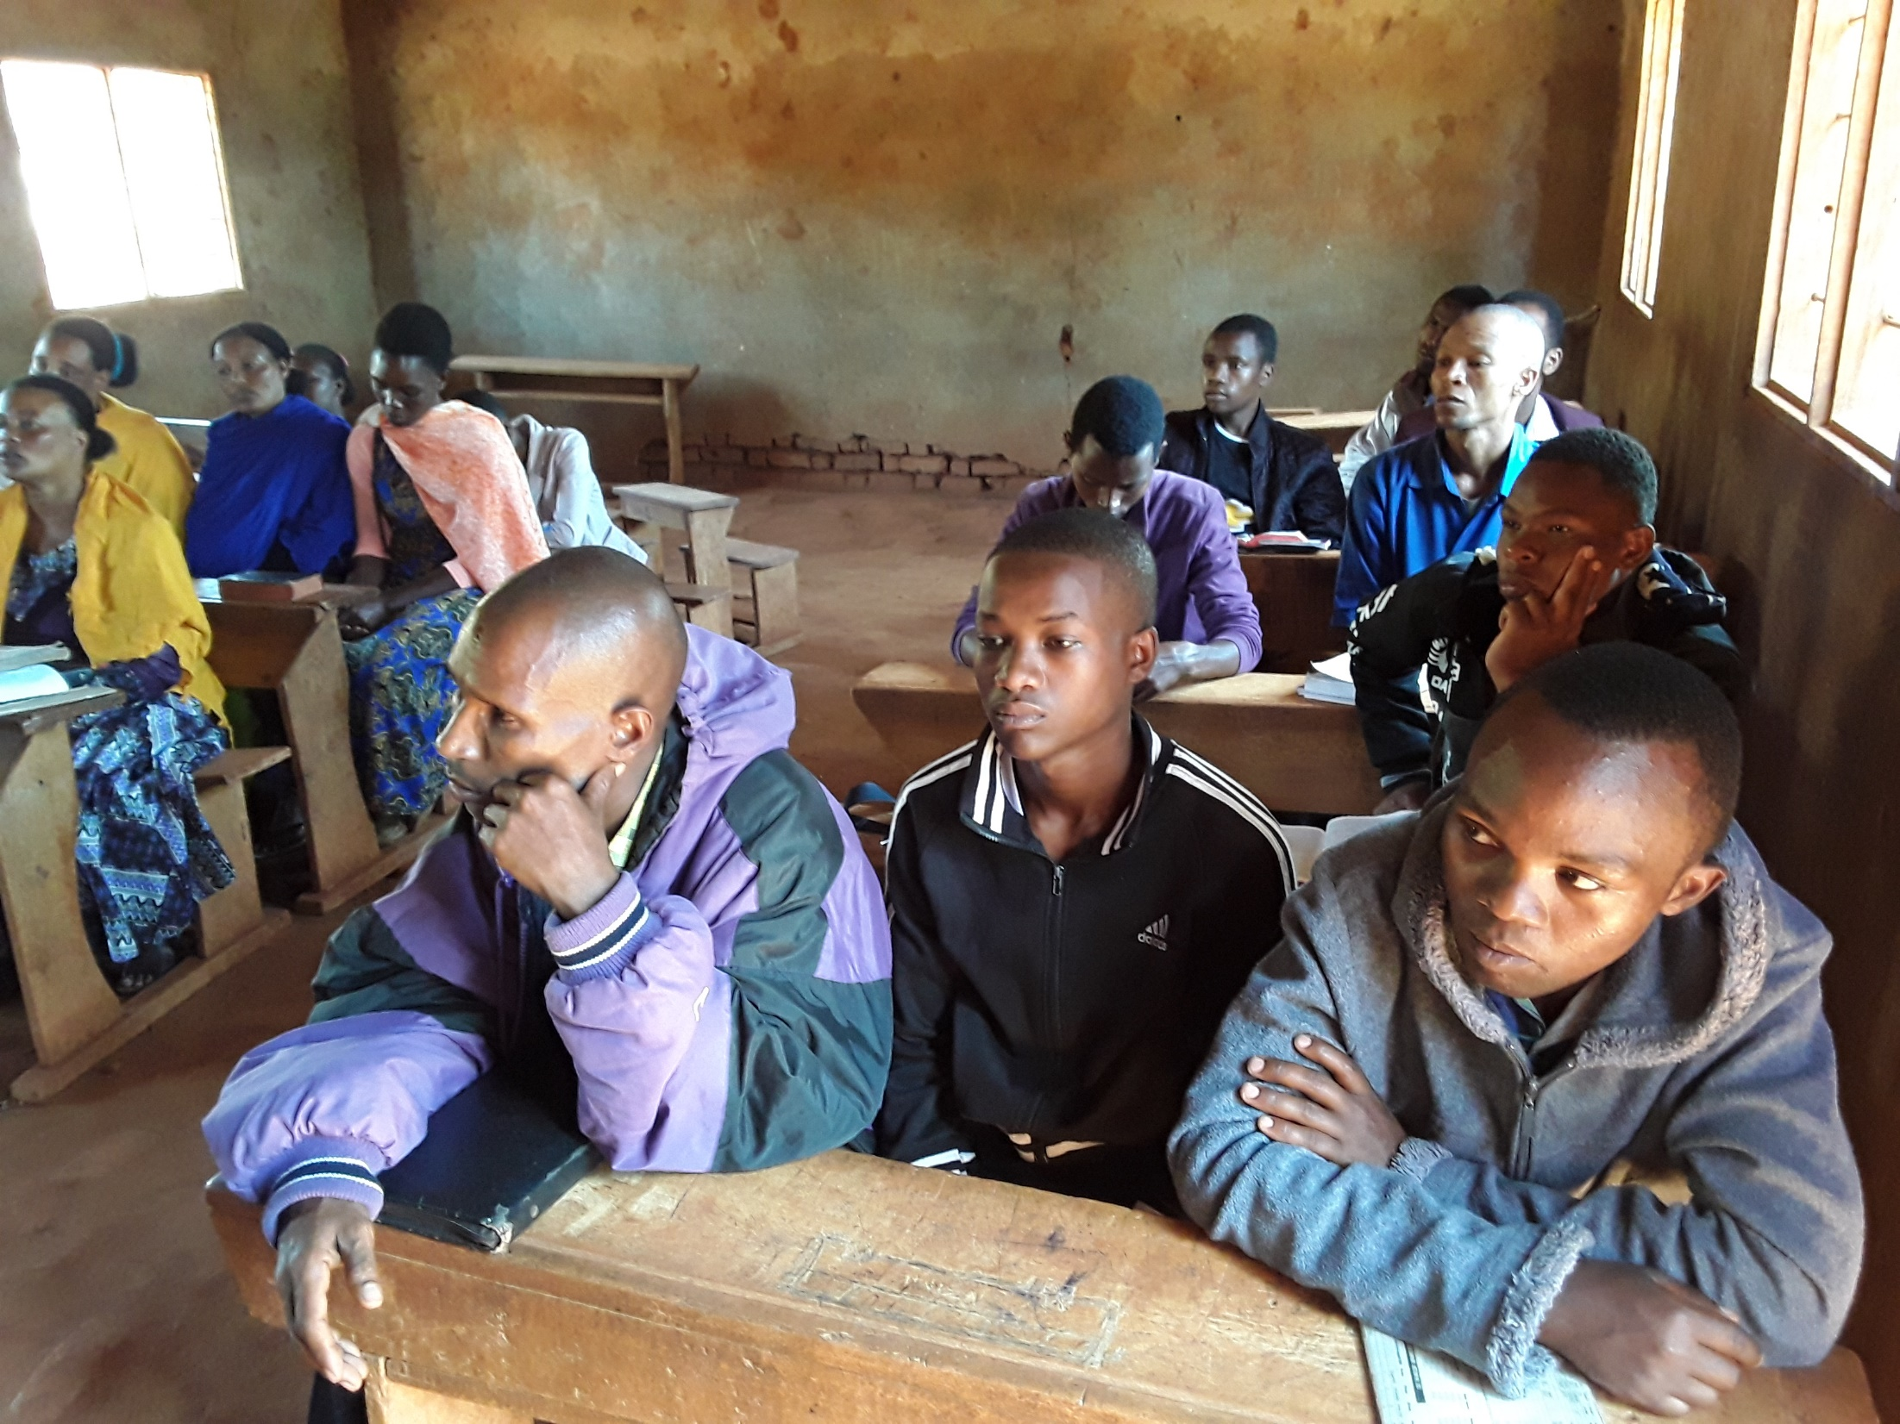

Slide 6
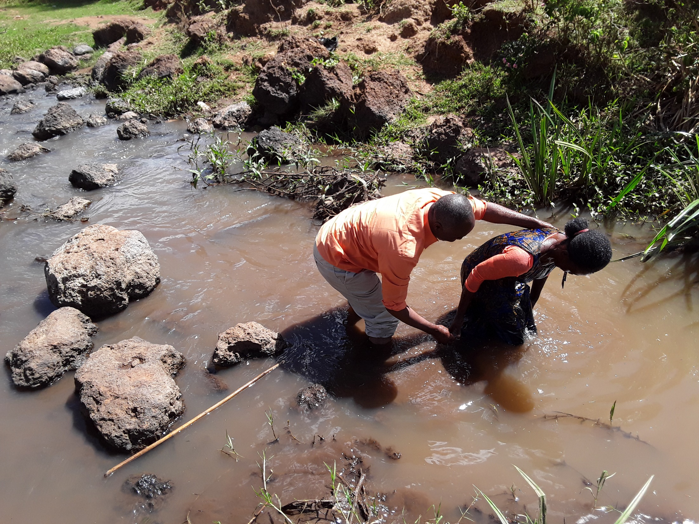

Slide 7
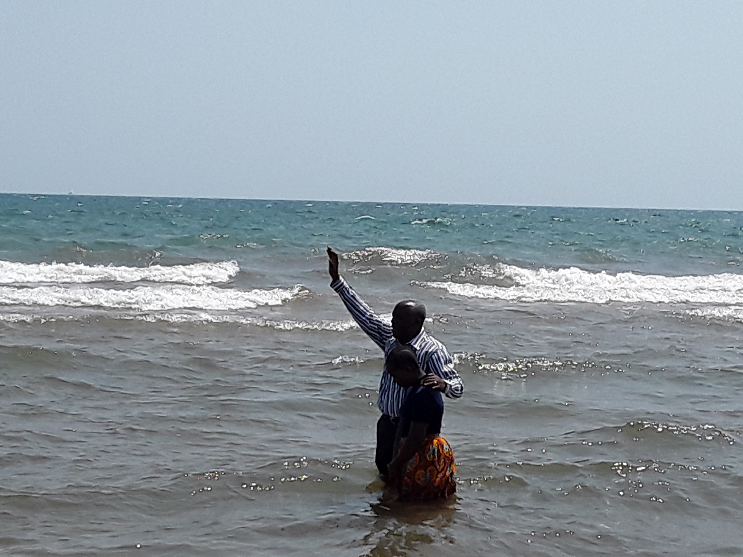

Slide 8
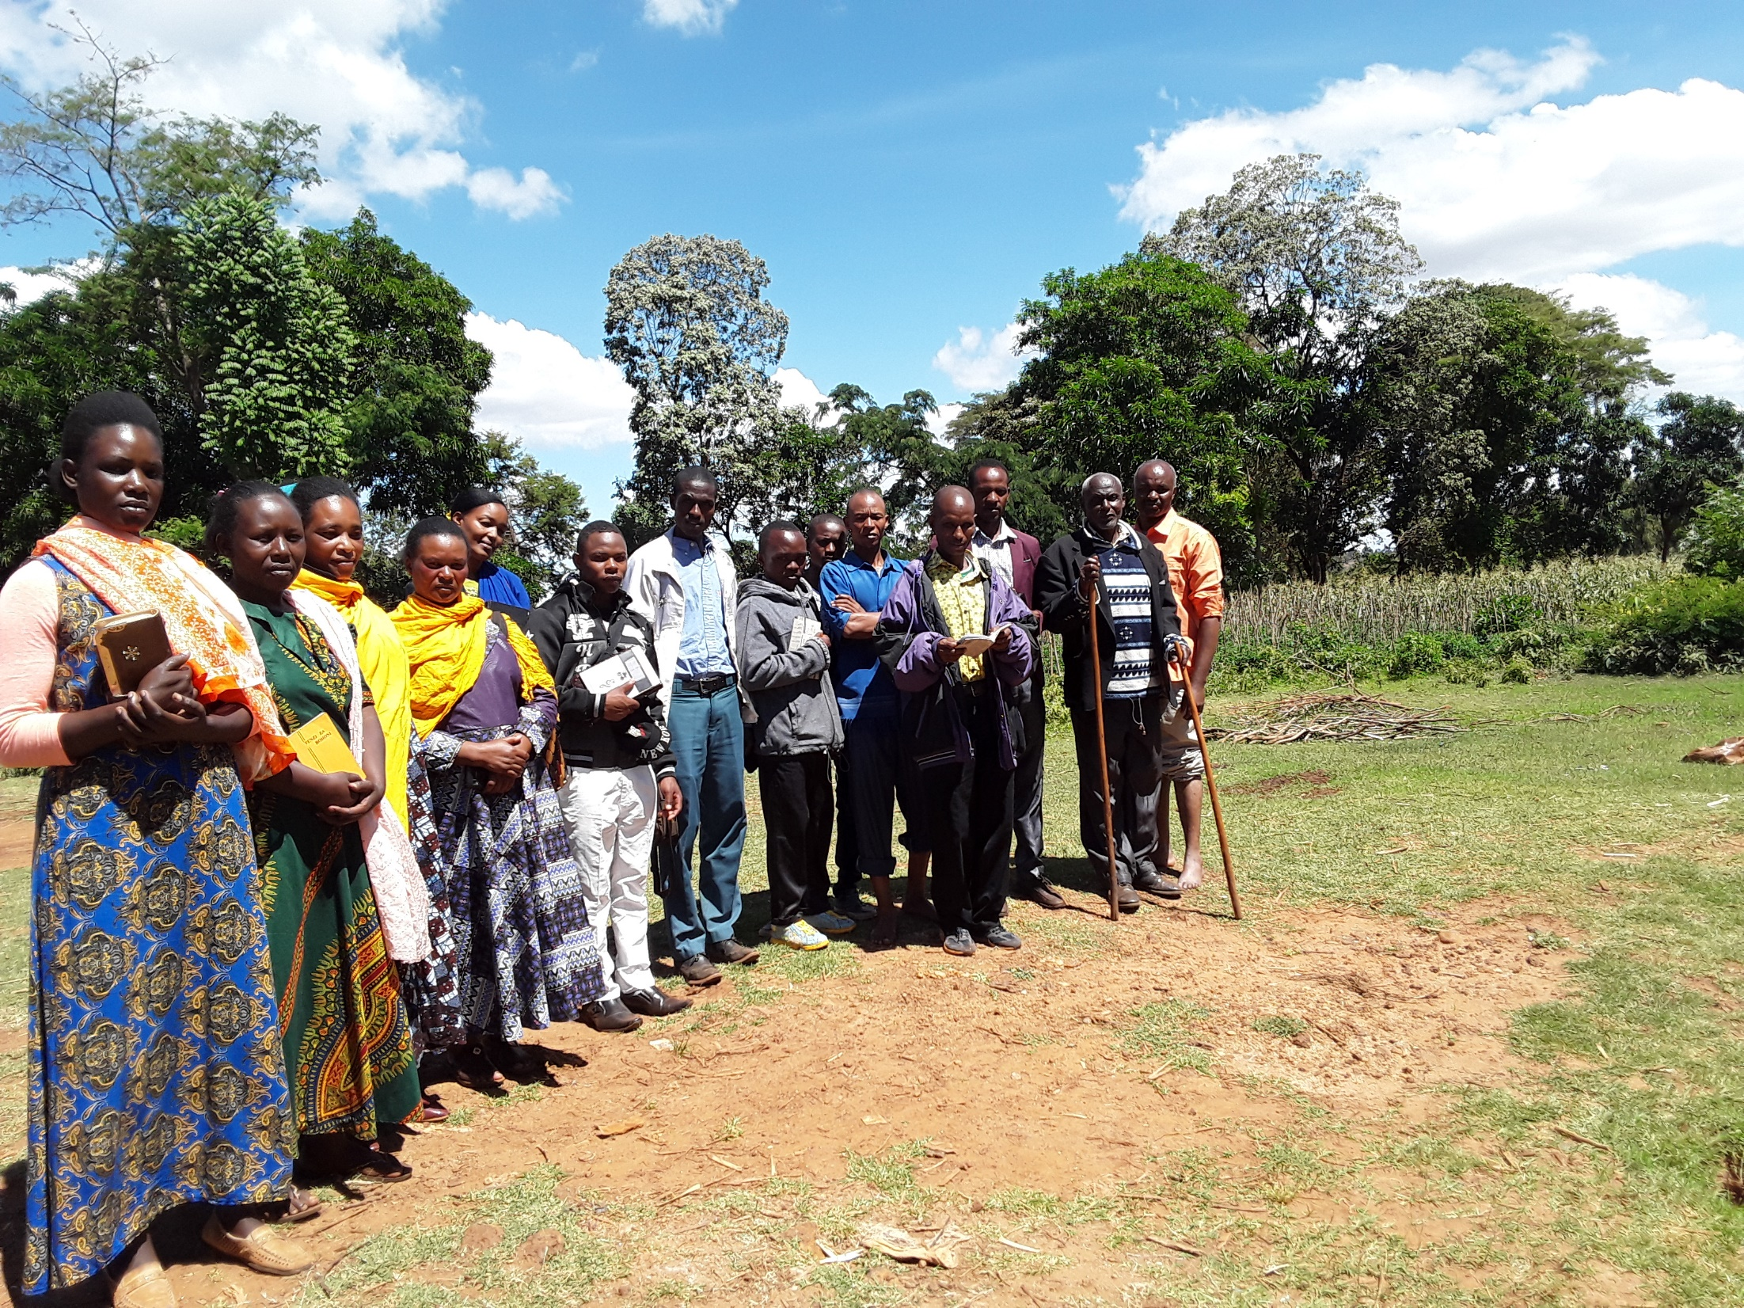

Slide 9
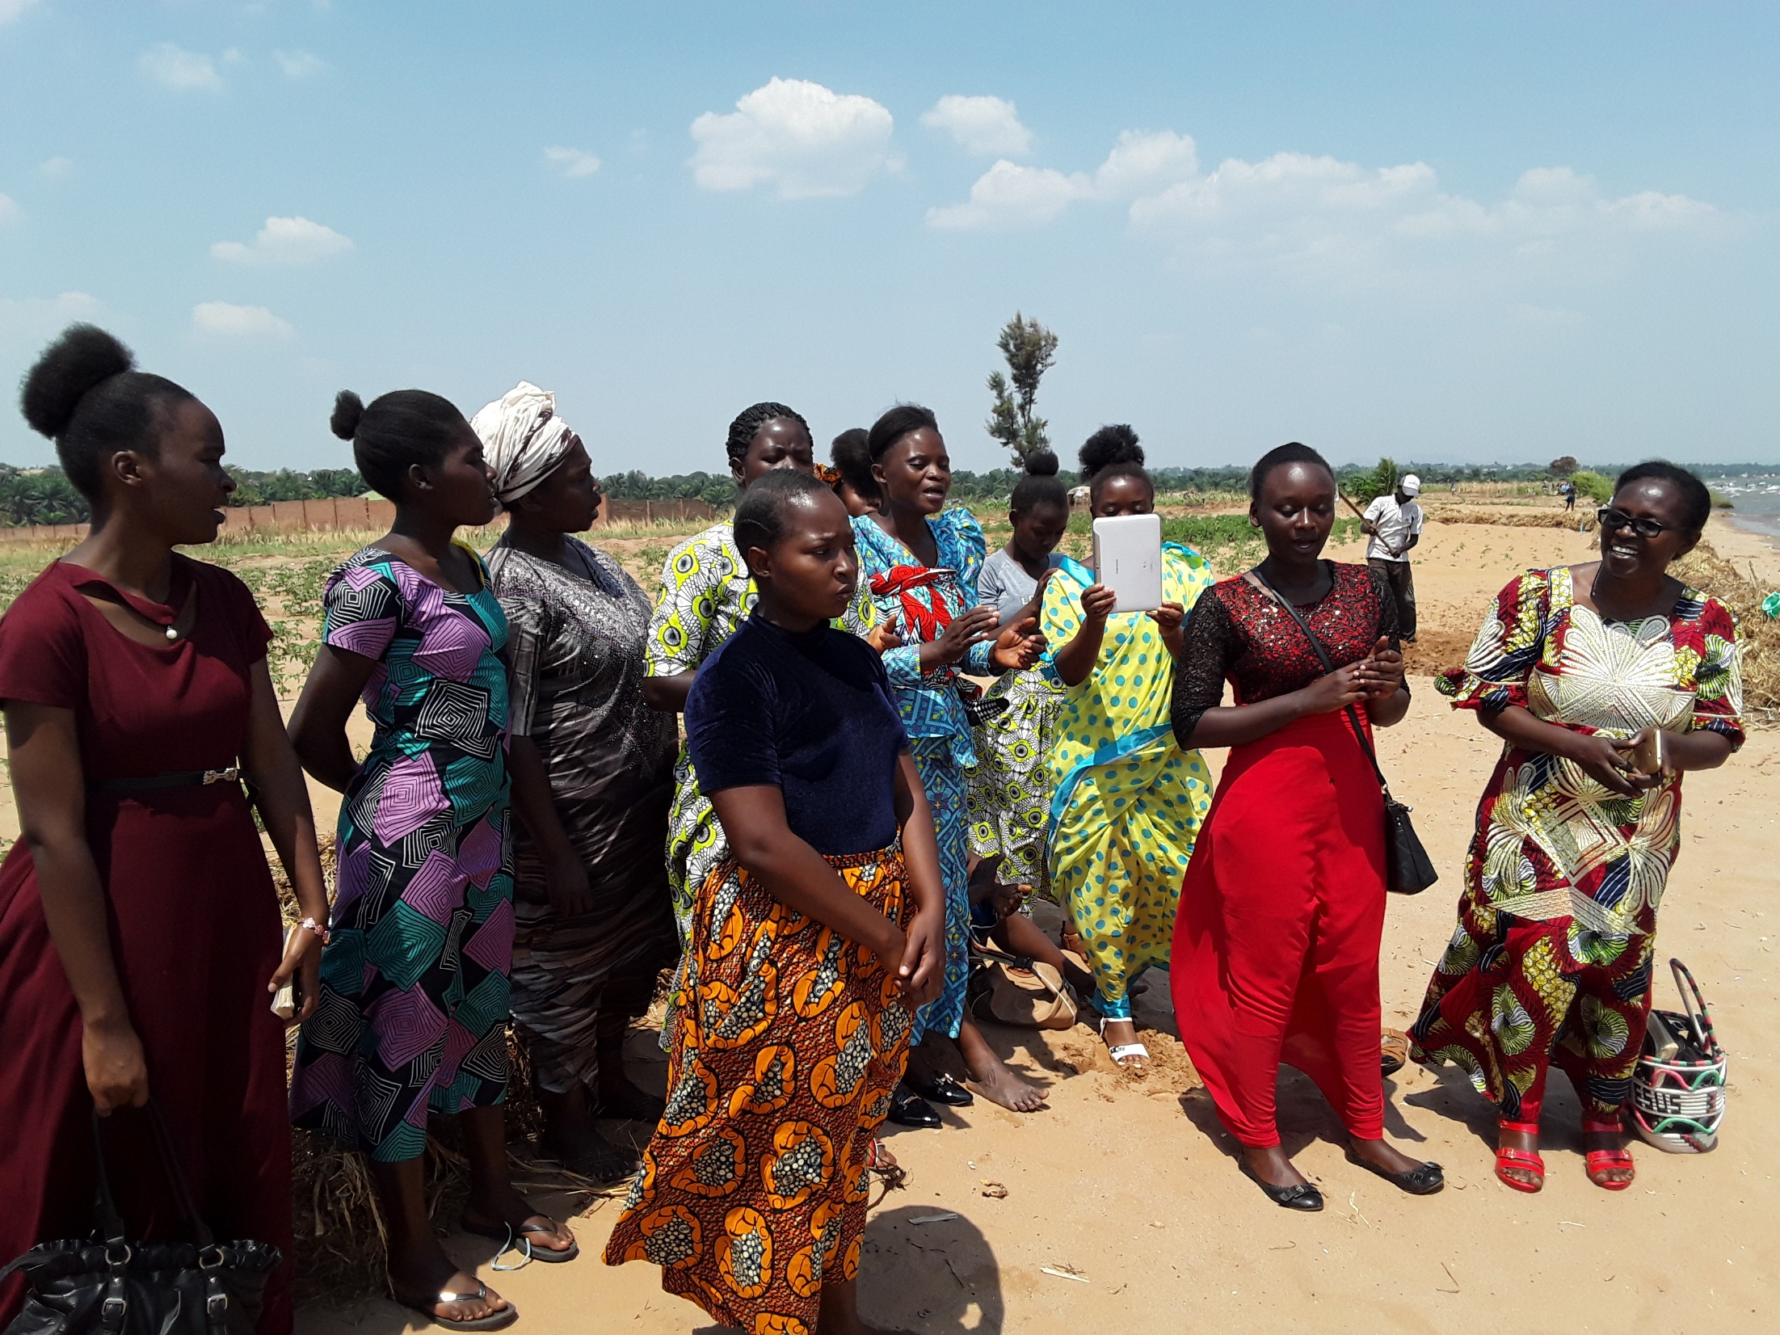

Slide 10
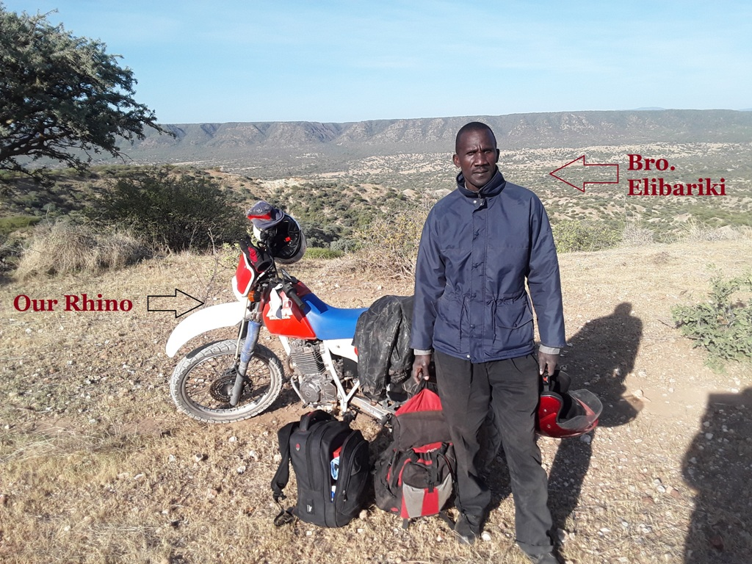

Slide 11
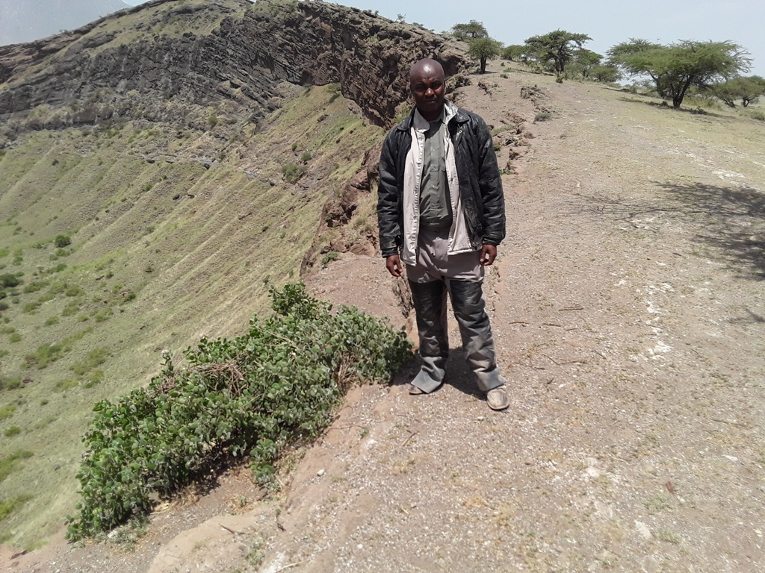

Slide 12
Bro. Malachi & Bro. Elibariki went to Loliondo for mission work. Bro. Elibariki comes from this tribe. So it was very important to accompany Brother Malachi because of language barrier. Maasais are people who do not want to bend the fact. So you can see the pictures and presume that all these are believers. But all of them came just to hear the Word and they wanted to know the Truth about the Word of God.
Bro. Malachi will go soon because they are calling and some wants to be baptized. We thank God for them and this is encouraging. Thank you for the missionary funds.
Bro. Elias

Slide 13
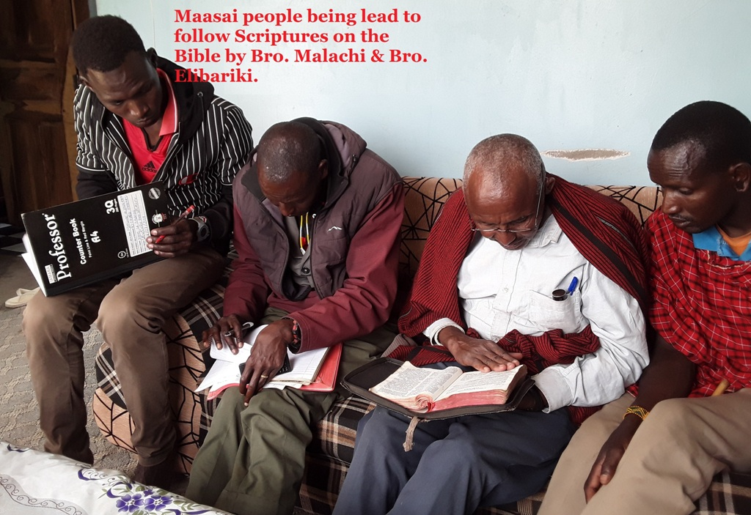
Loliondo,
Tanzania

Slide 14
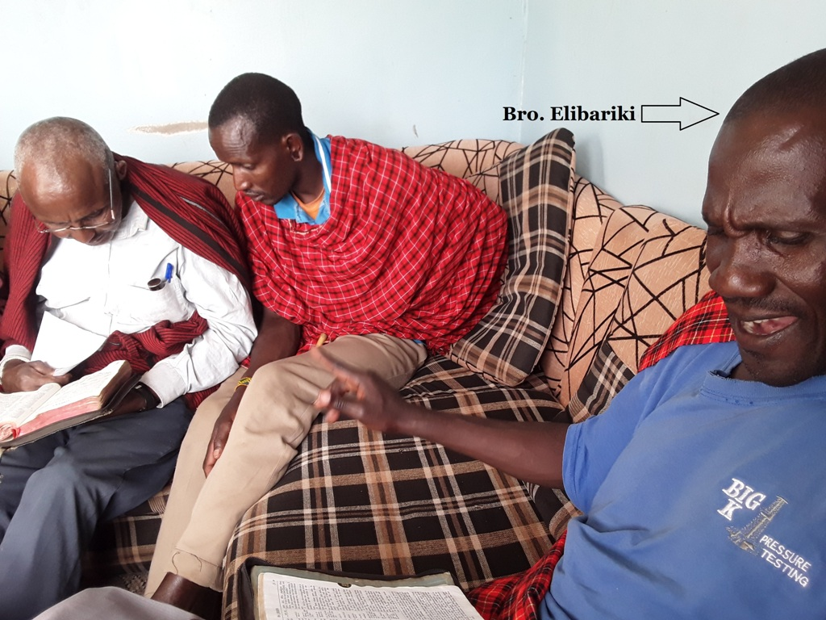

Slide 15
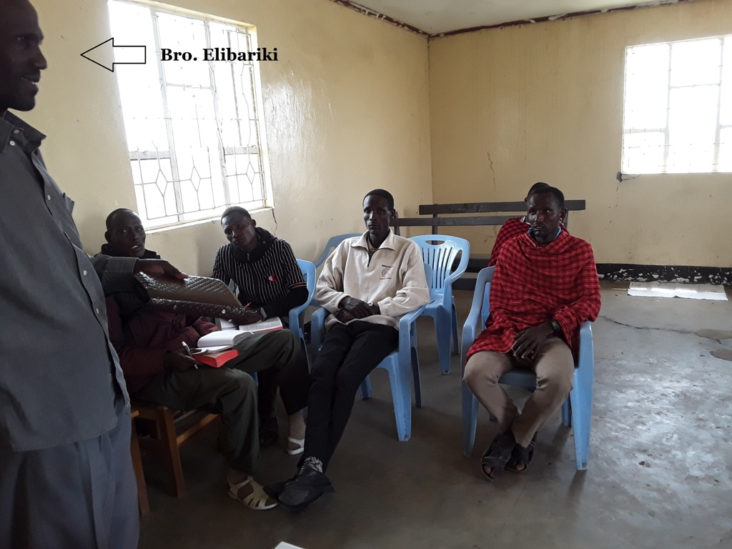

Slide 16
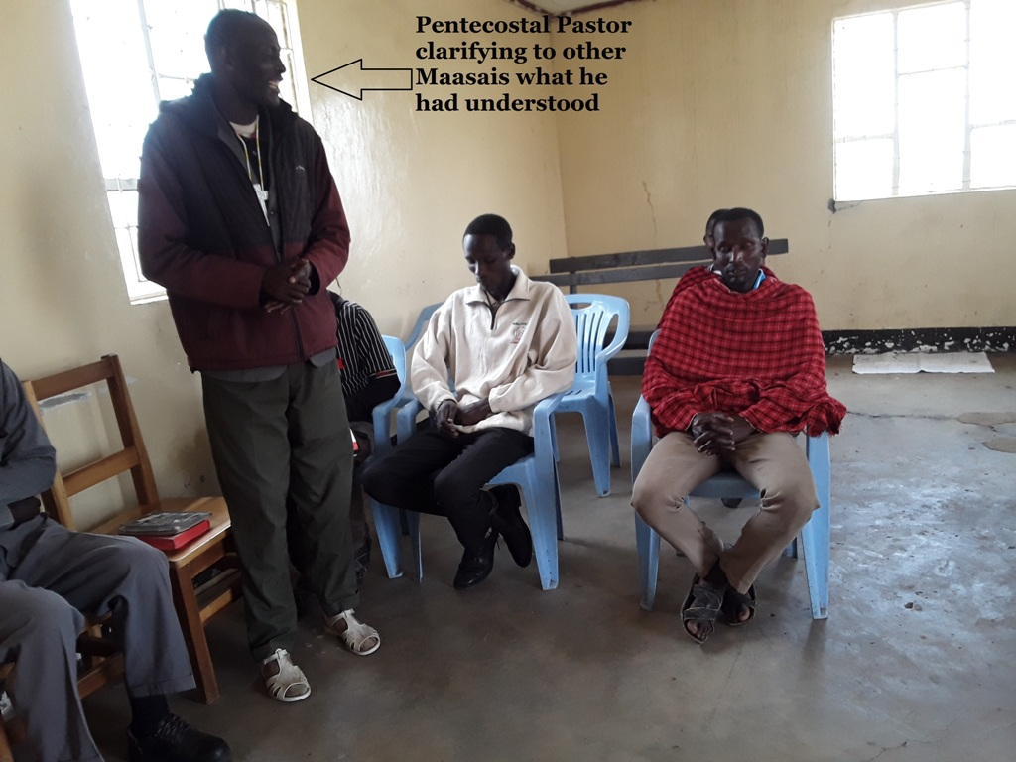

Slide 17
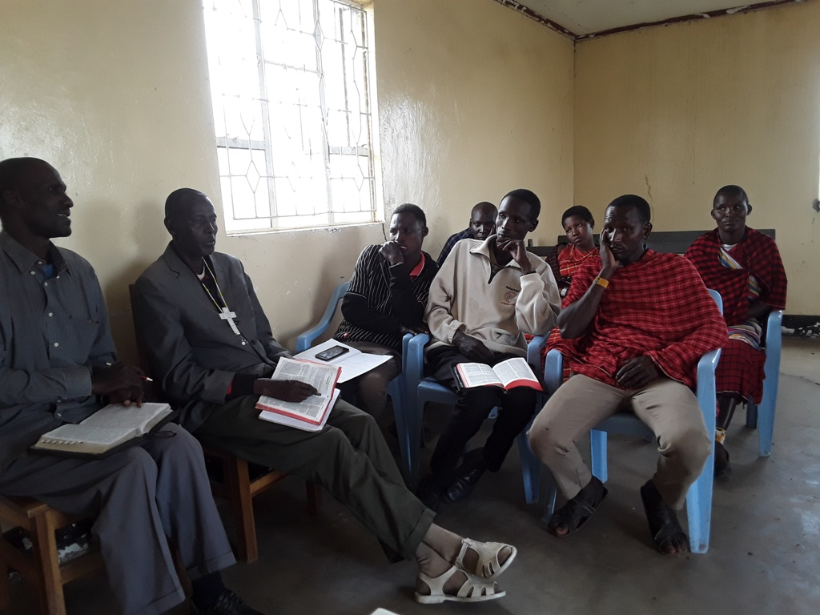

Slide 18
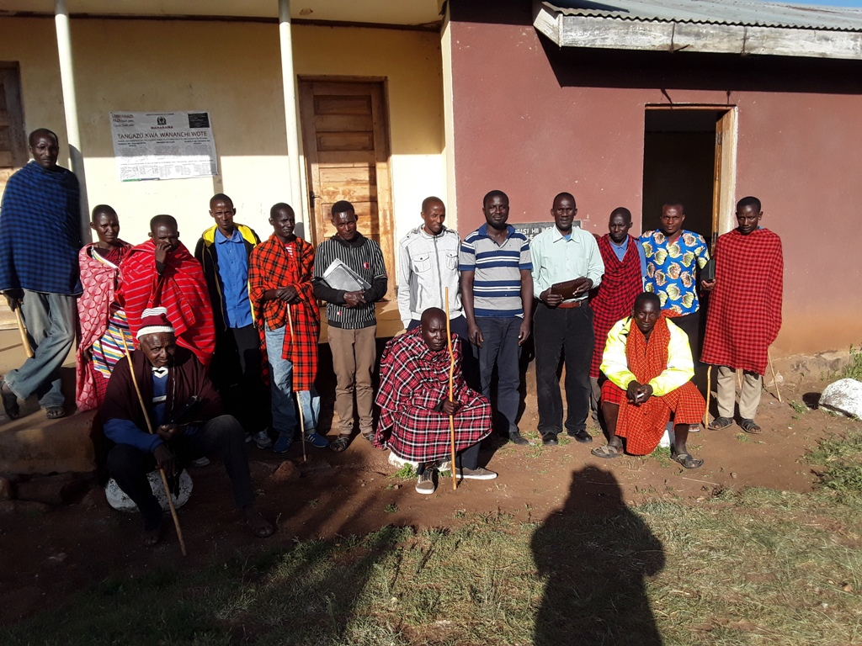

Slide 19
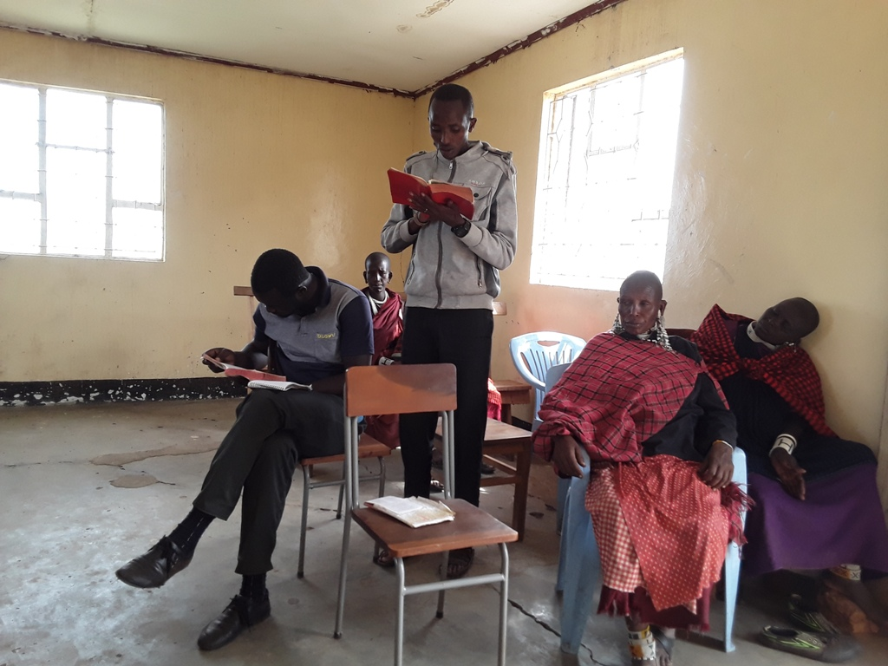

Slide 20
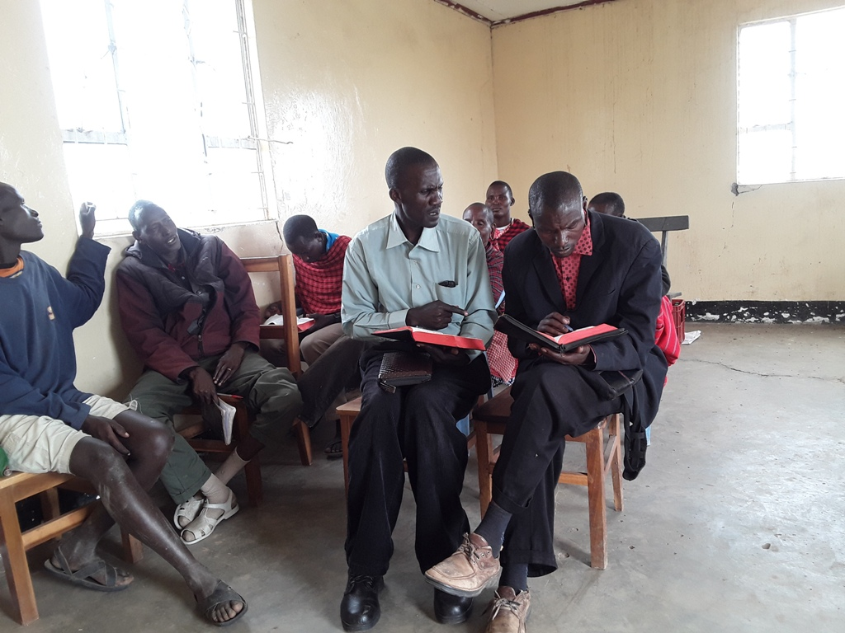

Slide 21
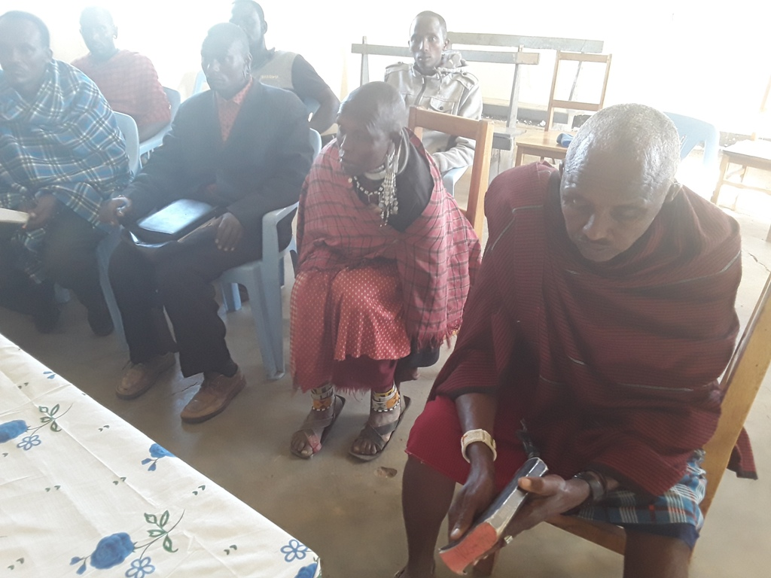

Slide 22
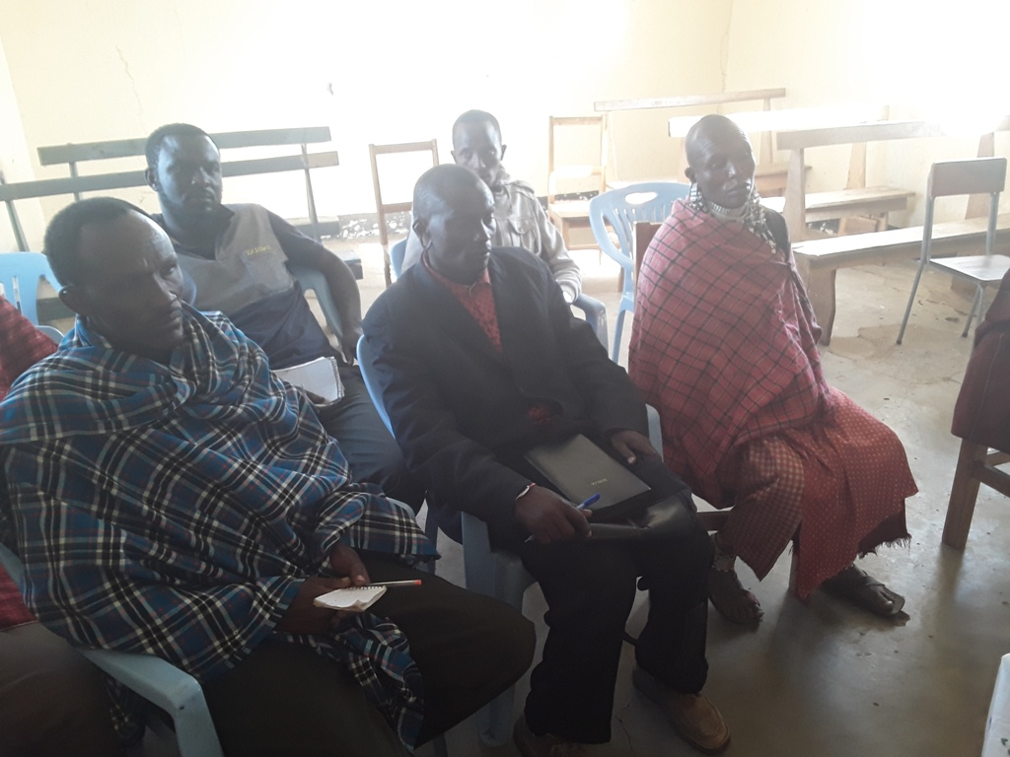

Slide 23
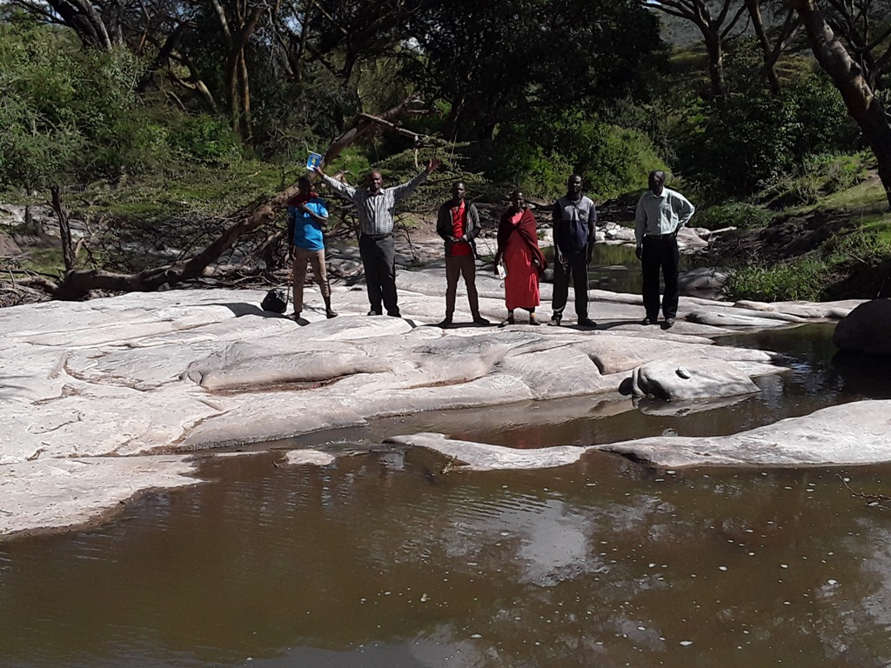

Slide 24
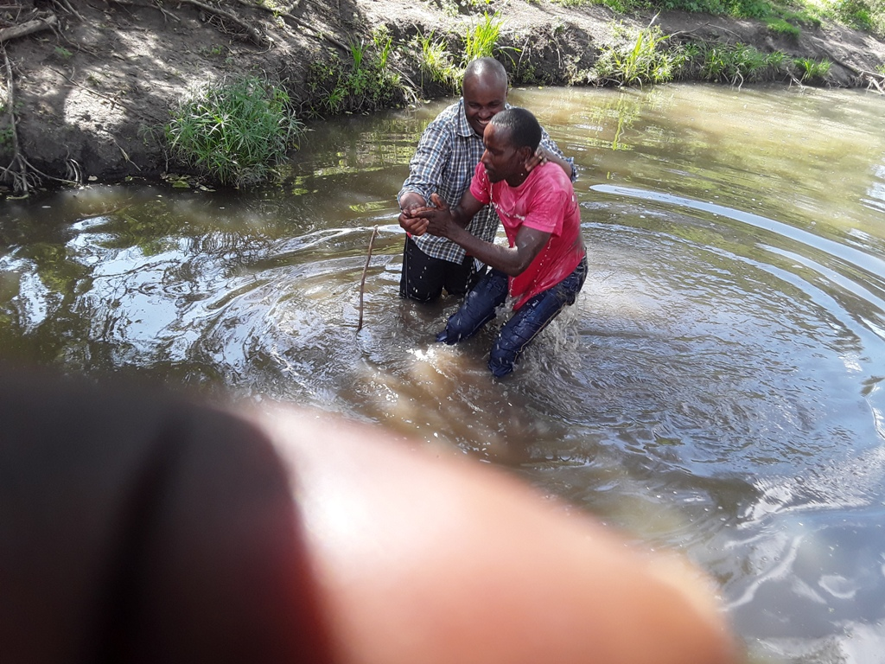

Slide 25
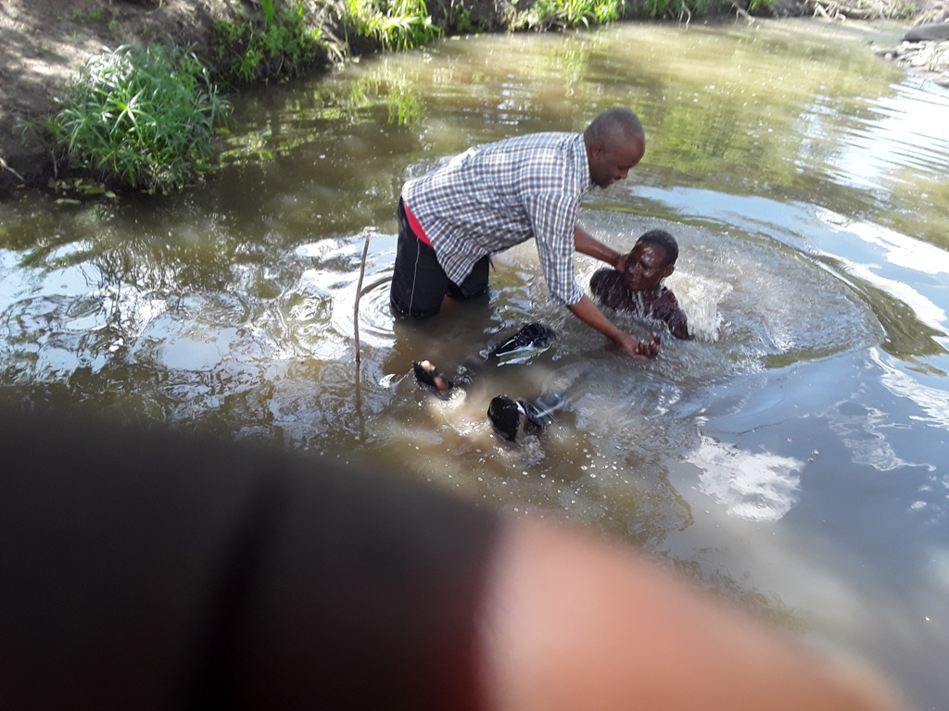

Slide 26
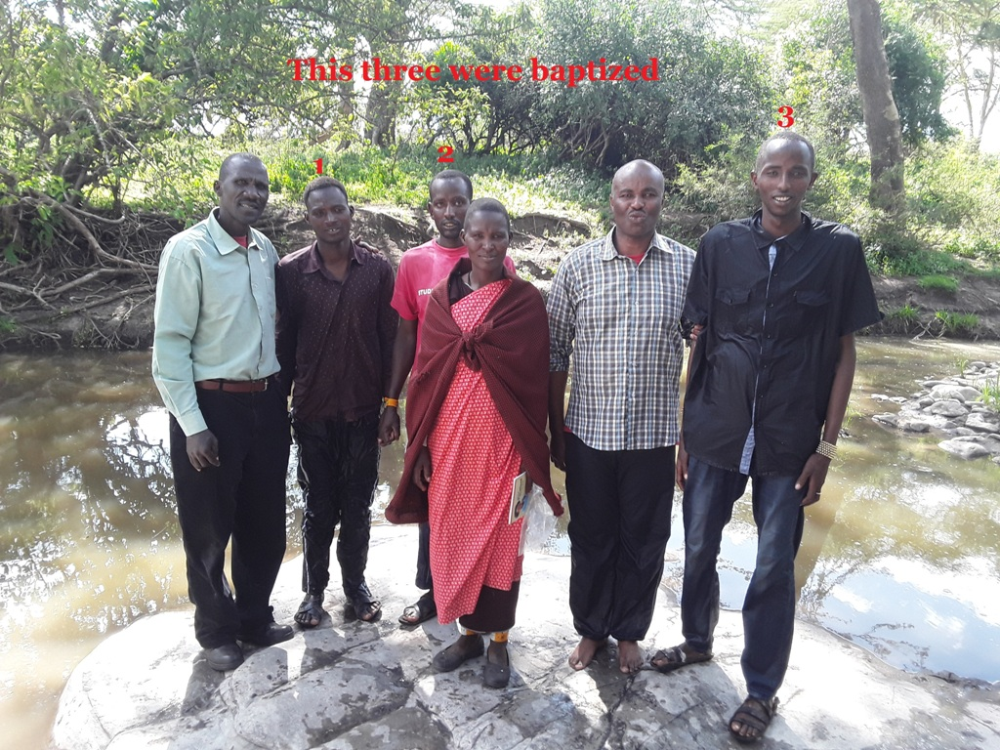

Slide 27
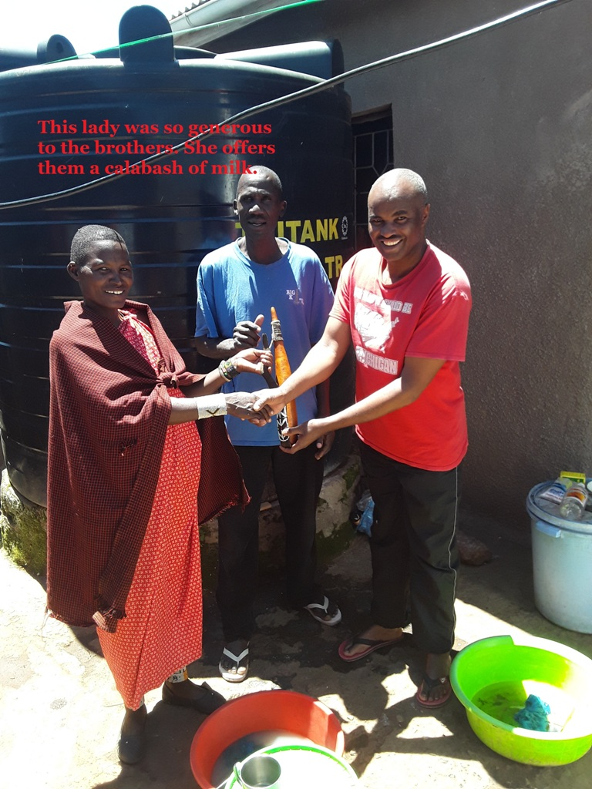

Slide 28
The Ministry of the
Mystery of God
Part 4 The Breach
REVELATION 4:1
After this I looked, and, behold, a door was opened in heaven: and the first voice which I heard was as it were of a trumpet talking with me; which said, Come up hither, and I will shew thee things which must be hereafter.

Slide 29
Gen 6:8
Noah’s Ark
4000 years ago
1 Thes 4:16
Rapture
This age now
2000 yrs
2000 yrs
2000 yrs
1000
yrs
Gen 2:7
Adam & Eve
6000
years ago
Matt 1:1
Jesus Christ
Life/death &
Resurrection
2000
years ago
Rev 20:4
Millennium
Next 1000
years
to come

Slide 30
Gen 6:8
Noah’s Ark
4000 years ago
Rev 21:1
Eternity
1 Thes 4:16
Rapture
This age now
2000 yrs
2000 yrs
2000 yrs
1000
yrs
Gen 2:7
Adam & Eve
6000
years ago
Matt 1:1
Jesus Christ
Life/death &
Resurrection
2000
years ago
Rev 20:4
Millennium
Next 1000
years
to come

Slide 31
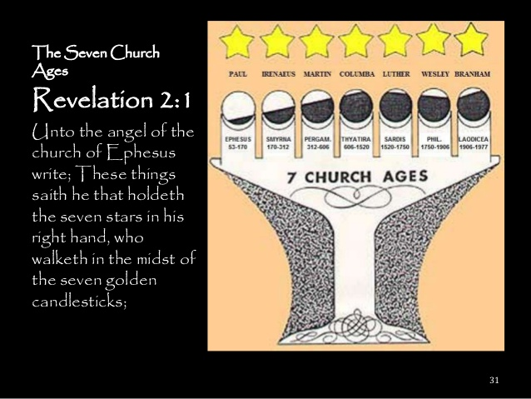

Slide 32
HIS.UNFAILING.WORDS.OF.PROMISE
38 …as God gave out His Word, what would be, predestinated His church before the found-ation of the world, it would appear before Him without spot or wrinkle, and the timepiece is moving right on down.
And It'll be there, a church, glorious church, without spot or wrinkle. I'm trusting that we're all here tonight members of that church.... There's only one way to enter that church, not by any denomination; you enter it by new birth.
64-0120

Slide 33
II CORINTHIANS 10:4-5
(For the weapons of our warfare are not carnal, but mighty through God to the pulling down of strong holds;) 5 Casting down imaginations, and every high thing that exalteth itself against the knowledge of God, and bringing into captivity every thought to the obedience of Christ;

Slide 34
TRYING.TO.DO.GOD.A.SERVICE
208 See, God has His way of doing things. These man thought they were doing God a service. Be careful! Not emotion, not enthusiasm, not imaginations, but it must be "THUS SAITH THE LORD," must be right.
65-1127

Slide 35
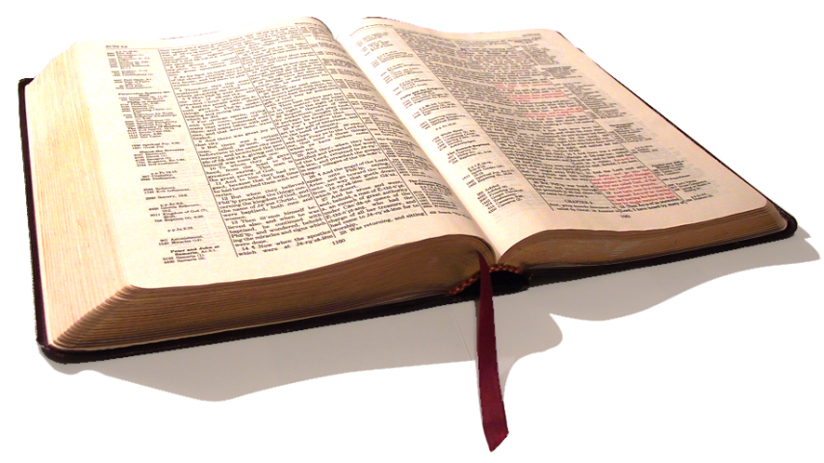
COD
Raised up with Him in resurrection. Look where I once was. Now, I'm above that. By His grace He lifted me up, and here I am now seated in heavenly places in Christ. Oh, my. Then the Bible becomes a new Book. You're reading It thru spiritual eyes and spiritual understanding.
62-0527

Slide 36
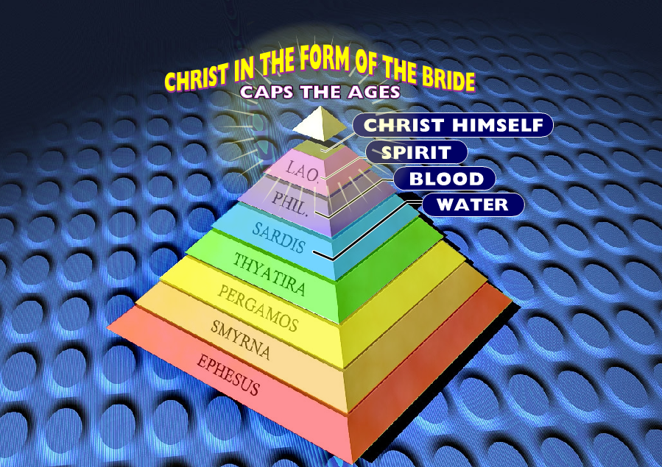

Slide 37
THE INVISIBLE UNION
The Word that fell on the Day of Pentecost will not work this day. That was for Pentecost. This is for the Bride, going Home of the Bride. We got something different.
We're in the Bride age. No more than the Word of Noah would work in the days of Moses; no more than Moses' law would have worked in the time of Paul here.
65-1125

Slide 38
SEED.IS.NOT.HEIR.WITH.THE.SHUCK
89 Notice, see how close it looks. Matt. 24:24, "The two spirits in the last days," the church spirit of the church people, and the Bride Spirit of the Bride people, "would be so close together till it would deceive the very Elected if it was possible." That's how close.
65-0218

Slide 39
Revelation 10:7
“But in the days of the voice of the seventh angel … the mystery of God should be finished, as he hath declared to his servants the prophets.

Slide 40
Junction
1. An act of joining, state of being joined;
2. A place or point of meeting; an intersection of roads especially where one terminates;
3. Something that joins.

Slide 41
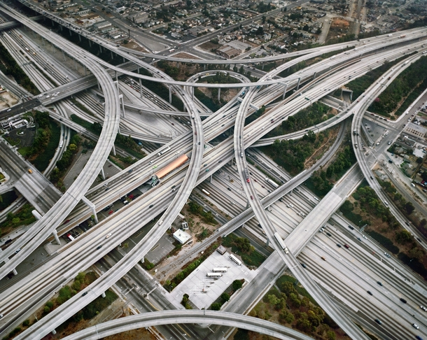

Slide 42
EVENING.MESSENGER
116 Now we come to the church dispensation's end time. The same Son that came and changed the dispensation then, comes again.
That's going to be from earth to glory.
63-0116

Slide 43
Christ
Rev. 10:1-6
EndTime
Rev. 10:1-11
Jews
Gentiles
Satan’s Eden
THE.BREACH
44. Now, here's the angel on earth, another Angel, mighty Messenger come down. This angel was a earthly angel, messenger. But here comes One down from heaven: a rainbow, covenant. Only Christ, it could be…

Slide 44
THE.BREACH
47 He returns back in the 10th chapter after the coming time, that all the mysteries is to be finished, and the Seals are to be broke, and proclaiming that its time is no more.
And he said, "When the seventh angel has begin to sound, then the mysteries should be finished…” and time for the Angel to appear. We're close, somewhere. Notice, the Seven Seals holds the mystery of the Book. Until we can see what those Seven Seals has sealed in, we're only presuming them things.

Slide 45
DANIEL 12:4
But thou, O Daniel, shut up the words, and seal the book, even to the time of the end: many shall run to and fro, and knowledge shall be increased.

Slide 46
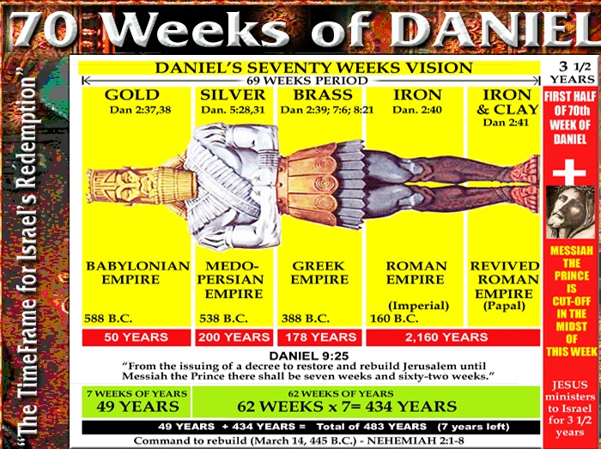

Slide 47
THE.JUNCTION.OF.TIME
4 Always in the days gone by, dispensations has always come to their end, we hit a junction. There's junctions on the highways, the roads we travel in this world. They junction on this grand old highway that we travel to glory.
5 …There has been in my searching of the Scripture for quite awhile, I have found seven great junctions in God's Word. And seven is God's complete number.

Slide 48
He completes in seven. He worked six days and the seventh rested. The world exists in its reign over the earth for six thousand years, the seventh is the Millennium. And all the mathe-matics of the Bible are perfect… God is always on time with His message.
6 And so today, I believe that we're facing a great something that the church should know and understand, that we ought to know what all this is about, and find it in God's Word.
56-0115

Slide 49
THE.FIRST.SEAL
341 In the end time, not in the early days when Christ was preaching, but in the end time, the last part of the week, where we just took the 70 Weeks of Daniel; and Christ has prophesied for the three and a half years, and three and a half years are yet determined.
And this prince in that time is to make a covenant with Daniel's people, which is the Jews. That's when the Bride's taken out now.
63-0318

Slide 50
The Week of Daniel’s Prophecy
Total of 7 Days
3 ½ Days
Earthly Ministry
3½ Days
Endtime (Rev. 11)

Slide 51
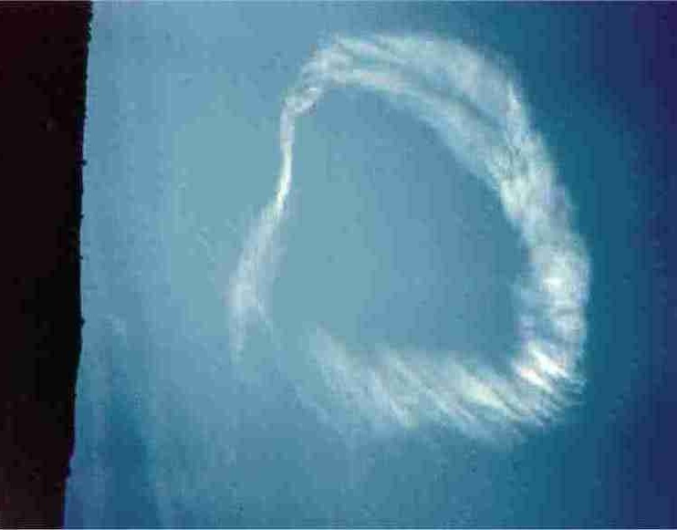
The
Book of Revelation
And when he had opened the seventh seal, there was silence in heaven about the space of half an hour. Rev. 8:1

Slide 52
Chap. 1: The Introduction
Chap. 2 & 3: Messages to the Church Ages
Chap. 4 & 5: Come Up Hither
Chap. 6: 6 Seals Described
Chap. 7: 144,000 & Judgement Cycle
Chap. 8: 7th Seal, Trumpeting Angels.

Slide 53
THE.BREACH
…No denomination has a right for the interpretation of the Book. No man has a right to interpret It. It is the Lamb Who interprets It, the Lamb is the One Who speaks It, makes the Word to be known by vindicating and bringing the Word to Life.
55 Notice, and this Book is not revealed until the church ages and denominational ages has run out, and there's time no more. It's only revealed after church ages and denominational ages has run out. That's the reason the thing is in such a scruple tonight. 63-0317

Slide 54
I THES. 4:15-17
For this we say unto you by the word of the Lord, that we which are alive and remain unto the coming of the Lord shall not prevent them which are asleep. 16 For the Lord himself shall descend from heaven with a shout, with the voice of the archangel, and with the trump of God: and the dead in Christ shall rise first: 17 Then we which are alive and remain shall be caught up together with them in the clouds, to meet the Lord in the air: and so shall we ever be with the Lord.

Slide 55
THE.RAPTURE
152 Now, the first thing is... A shout; and then a voice; and then a trumpet.
Shout: a messenger getting the people ready.
The second is a voice of the resurrection: the same voice, that, a loud voice in Saint John 11:38-44, that called Lazarus from the grave. Getting the Bride together; and then the resurrection of the dead, see; to be caught up with It. Now watch the three things takes place. The next is what? Was a trumpet... A shout; a voice; a trumpet.
65-1204

Slide 56
The.Feast.Of.The.Trumpets
45 Now, the hidden mysteries of Christ was fully revealed in the SEVEN SEALS.
64-0719

Slide 57
The.Unveiling.Of.God
184 It's been veiled through these ages, according to what God said, and it will be opened in the last days, those Seven Seals would be broke, and the full thing would come into view of the people, what's took place all along. The hour of the seventh angel's message, all the mysteries of God should be made known in that Elijah, this last hour.
64-0614

Slide 58
THE.BREACH
This is Seven Seals on the Book, and the Book will not be released until the message of the 7th angel. So we are presuming, but the genuine revelation of God will be made perfect in that sounding and vindicated Truth… And this seven-sealed Book, remember, it was closed here in Rev. 5th chapter, and Rev. 10 it is opened.
51 And now, we're going to see what the Book says about how it become open. And is not made known until the Lamb takes the Book, and breaks the Seals, and opens the Book. The Lamb's got to take the Book; it's His…

Slide 59
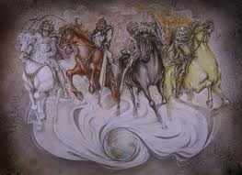
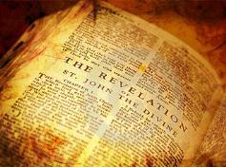
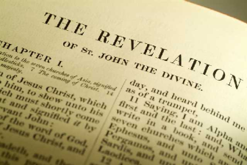

Slide 60
The.Feast.Of.The.Trumpets
134 This is the complete revelation of Jesus Christ. The Seven Seals had the mysteries hid, of what it all was; and is supposed to open it in the last day, at the Laodicean age, at the end of time.
Thanks be to God! That finishes the message to the church. When they look back and see what has been, and see where it's all brought up to, that finishes it, the age of the church.
64-0719

Slide 61
The Ages & The Seals
Church Ages
Specific Events within a Specific Time Frame.
7 Messengers, each with a Unique Message.
Seven Seals
“Packets” of Information which happened through the Ages, but remained hidden by Seals on the Book;
Revelation 5

Slide 62
REVELATION 5:1-9
And I saw in the right hand of him that sat on the throne a book written within and on the backside, sealed with seven seals. 2 And I saw a strong angel proclaiming with a loud voice, Who is worthy to open the book, and to loose the seals thereof?
3 And no man in heaven, nor in earth, neither under the earth, was able to open the book, neither to look thereon. 4 And I wept much, because no man was found worthy to open and to read the book, neither to look thereon.

Slide 63
QUESTIONS.AND.ANSWERS.3
64-0830M
1092-142 And now, the opening of the Seven Seals that was given by the Holy Spirit, the Seven Seals only was to make known what had been left off in the dispensations behind us.

Slide 64
The.Seventh.Seal 63-0324
578-1 …You will notice that One angel was very notable to me. The rest of them just seemed ordinarily; but this angel was a noted angel. He was to my left in the constellation in a form of a pyramid. And you remember, it was in the pyramid where the mysterious white rock was not written on. And the angels took me into that pyramid of themselves, the mysteries of god known only to them. And now, they with the messengers that come to interpret that pyramid or that message of the secret of these Seven Seals which lays with inside the pyramid.

Slide 65
The.World.Is.Falling.Apart 63-0412m
171 Just a few days ago, when them seven angels came down in that vision. Many of you knowing it. Said, "go to Tucson and wait there for a while, and you'll hear a blast go off. When it goes, return back. And the seven seals were opened at the tabernacle, the other day.

Slide 66
Look 63-0428
202 … Rocks rolled down, and things like that. And the holy spirit turned, said, "return to your home immediately, for the Seven Seals is going to be opened." Get the tapes and find out. That's THUS SAITH THE LORD, told before it happened, and everything. Find out if it's truth, or not. When I'm gone on, that still lives on.

Slide 67
The.Uniting.Time.And.Sign 63-0818
97 Never before, since the early church age, was the pillar of fire ever among the people. Never before, since the early church age, did they ever see the things that we are seeing today. And this was only made possible when God sent the Seven Seals and give us a sign by it, and sent seven angels down out of heaven; and come to bring back that scattered word in them denominations, and tie it back into the word of god again, to bring down his Holy Spirit.

Slide 68
The.Feast.Of.The.Trumpets 64-0719
134 This is the complete revelation of Jesus Christ. And the Seven Seals had the mysteries hid, of what it all was; and is supposed to open it in the last day, at the Laodicean age, at the end of time. Thanks be to God! That finishes the message to the church. When they look back and see what has been, and see where it's all brought up to, that finishes it, the age of the church.

Slide 69
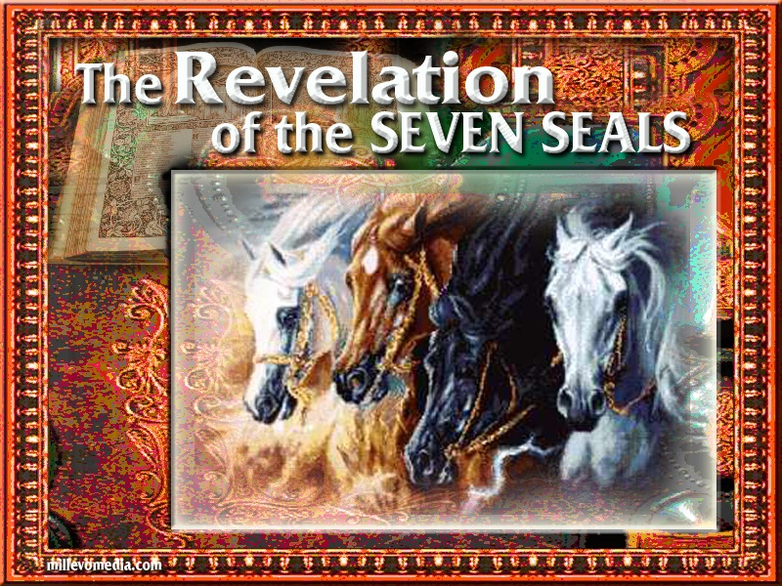
“The Seven-sealed Book is revealed at the time of the Seven Thunders of Revelations 10.” – William Branham, The Breach
REVELATION 6:1
“And I saw when the Lamb opened one of the seals, and I heard, as it were the noise of thunder, one of the four beasts saying, Come and see.”

Slide 70
“Now, we see that this seven-sealed Book now, is the mystery of redemption. It's a Book of Redemption from God. Now, all the mysteries at this time should be finished at the sounding of this messenger. Now, here's the angel on earth, and another Angel, mighty Messenger come down. See, this angel was a earthly angel, messenger. But here comes One down from heaven: a rainbow, covenant. Only Christ, it could be; just exactly like it was in Revelations 1st chapter, standing in the midst of the seven golden candlesticks with a rainbow..
THE BREACH

Slide 71

First Seal:
REVELATION 6:1-2
“And I saw when the Lamb opened one of the seals, and I heard, as it were the noise of thunder, one of the four beasts saying, Come and see.
And I saw, and behold a white horse: and he that sat on him had a bow; and a crown was given unto him: and he went forth conquering, and to conquer.”
MATTHEW 24:4-5
And Jesus answered and said unto them, Take heed that no man deceive you. For many shall come in my name, saying, I am Christ; and shall deceive many.
DECEPTION

Slide 72
THE.FIRST.SEAL 63-0318
156-1 And they said, "Now, here's a white horse, and a white horse is a power, a charger." And said, "The man that set on the white horse was the Holy Spirit that went forth in the early age and conquered that age for the Kingdom of God. He had a bow in his hand which meant like Cupid. He shot the arrows of love into the hearts of the people, the love of God, and He conquered."
Now, that sounds very good, but it isn't the Truth.

Slide 73
THE.FIRST.SEAL 63-0318
122-2 And now, the Lamb is standing now tonight as we enter into this 6th chapter; He's got the Book in His hand and starting to reveal it. And, I hope that people are spiritual. I would've had a horrible mistake on that if it hadn't been about twelve o'clock today when the Holy Spirit came in the room and corrected me on something that I was writing down to say. I was taking it from an old context.

Slide 74



VS. LION AGE
BOLDNESS OF PREACHING
(Galatians 1:8)

Slide 75

Second Seal:
REVELATION 6:3-4
“ And when he had opened the
second seal, I heard the second beast say, Come and see.
And there went out another horse [that was] red: and [power] was given to him that sat thereon to take peace from the earth, and that they should kill one another: and there was given
unto him a great sword.”
MATTHEW 24:6, 9
“ And ye shall hear of wars and rumours of wars: see that ye be not troubled… Then shall they deliver you up to be afflicted, and shall kill you: and ye shall be hated of all nations for my name's sake.”
WAR

Slide 76
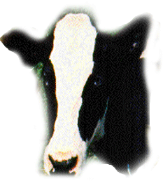


VS. CALF AGE
SPIRIT OF SACRIFICE,
A BEAST OF BURDEN

Slide 77

Third Seal:
REVELATION 6:5-6
“ And when he had opened the third seal, I heard the third beast say, Come and see. And I beheld, and lo a black horse; and he that sat on him had a pair of balances in his hand.
And I heard a voice in the midst of the four beasts say, A measure of wheat for a penny, and three measures of barley for a
penny; and [see] thou hurt not the oil
and the wine..”
FAMINE
MATTHEW 24:6
“….. and there shall be famines.”

Slide 78

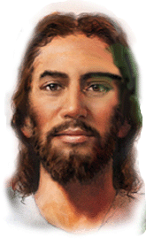

VS. FACE OF A MAN AGE
MAN’S CUNNINGNESS & WISDOM

Slide 79

Fourth Seal:
REVELATION 6:7-8
“ And when he had opened the fourth seal, I heard the voice of the fourth beast say, Come and see.
And I looked, and behold a pale horse: and his name that sat on him was Death, and Hell followed with him. And power was given unto them over the fourth part of the earth, to kill with sword, and with hunger, and with death, and with the beasts of the earth. “
PESTILENCES & DEATH
MATTHEW 24:7
“For nation shall rise against nation, and kingdom against kingdom: and there shall be famines, and pestilences, and earthquakes, in divers places.”

Slide 80



VS. EAGLE AGE
PROPHETIC REVELATION

Slide 81
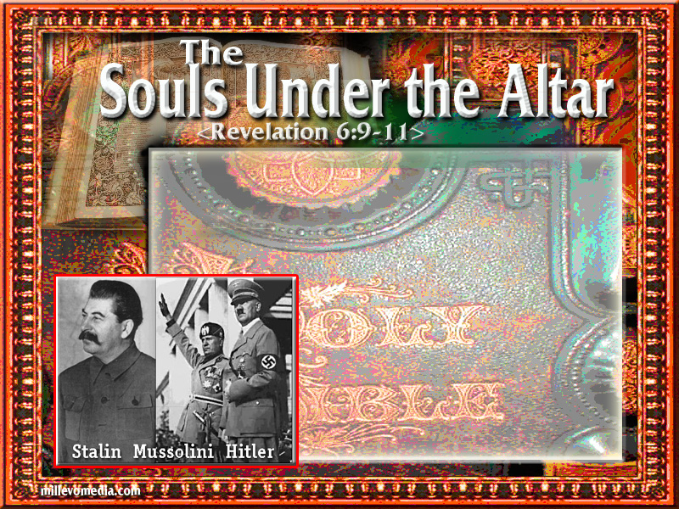
Fifth Seal:MARTYRDOM
“And when he had opened the fifth seal, I saw under the altar the souls of them that were slain for the word of God, and for the testimony which they held:
And they cried with a loud voice, saying, How long, O Lord, holy and true, dost thou not judge and avenge our blood on them that dwell on the earth?
And white robes were given unto every one of them; and it was said unto them, that they should rest yet for a little season, until their fellow servants also and their brethren, that should be killed as they [were], should be fulfilled.”

Slide 82
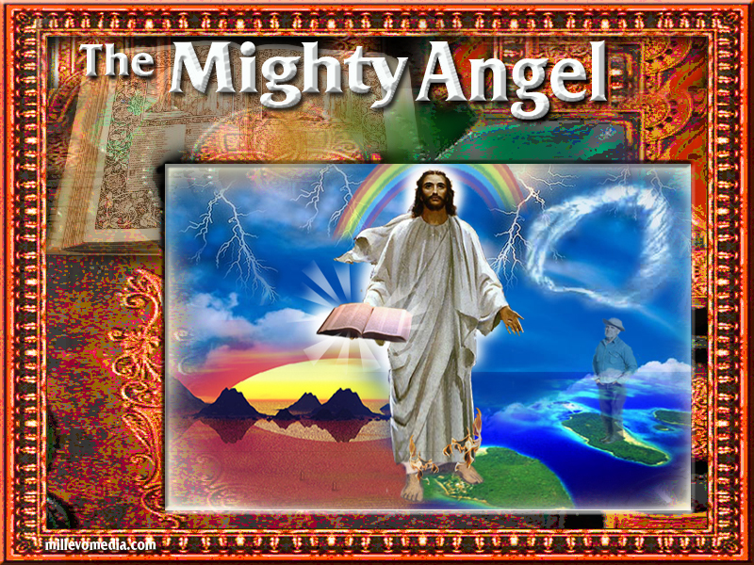
The Seventh Seal:
REVELATION 8:1
“And when he had opened the seventh seal, there was silence in heaven about the space of half an hour.”
THE WORD COMING OF CHRIST – NOT THE PHYSICAL RETURN

Slide 83
SHOUT, VOICE, TRUMPET:
“For the Lord himself shall descend from heaven with a shout, with the voice of the archangel, and with the trump of God: and the dead in Christ shall rise first: Then we which are alive and remain shall be caught up together with them in the clouds, to meet the Lord in the air: and so shall we ever be with the Lord.” I Thes. 4:16-17

Slide 84
1963
THE EFFECT OF THE CHURCH’S REJECTION OF THE WORD

Slide 85
1962
Sept - Timothy Leary founds International Foundation for Internal Freedom (IFIF) to promote LSD research & publish The Psychedelic Review.
Oct 22 - Cuban Missile Crisis - Soviet missile bases in Cuba, Kennedy orders naval blockade.
1963
July - Newport Folk Festival July 26-28, includes Bob Dylan, Joan Baez, Phil Ochs and Pete Seeger
Aug 28 - Martin Luther King's I Have a Dream speech, Wash DC Civil Rights: 200,000 attend
Oct 13 - Beatles on TV at London Palladium. 15 million get to see them perform "She Loves You" and "Twist and Shout".
Nov 22 - JFK Assassinated in Dallas, Texas, LBJ sworn in
Nov 22 - Aldous Huxley dies while tripping on LSD (intentionally!)
Nov 24 - LBJ escalates the Vietnam War
Nov 29 - Beatles "I Want to Hold Your Hand" Released

Slide 86
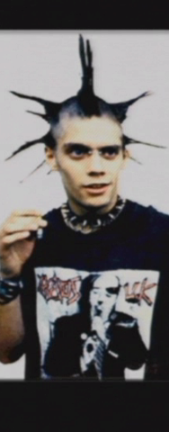
JEZEBEL.RELIGION 61-0319
…You just watch the wave of sin happen now. You watch go plumb to the core. You watch modernistic; watch ungodly things happen in the churches. "And, finally, there'll come a persecution," the Bible says so, THUS SAITH THE LORD. Certainly there will be.

Slide 87
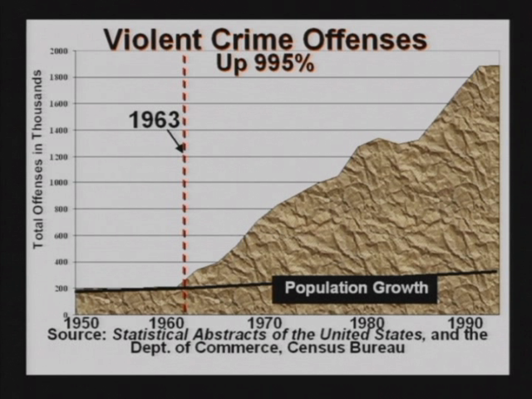

Slide 88
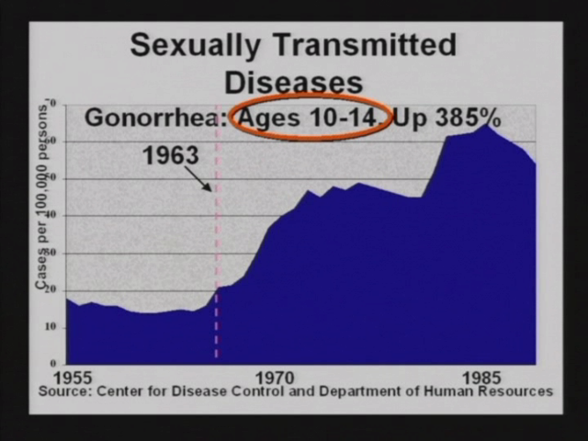

Slide 89
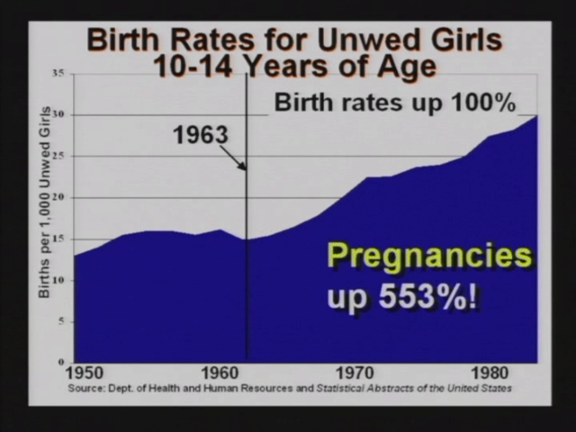

Slide 90
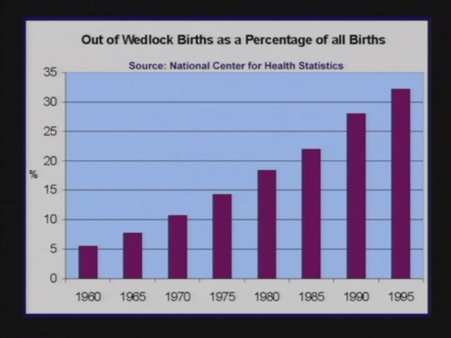

Slide 91
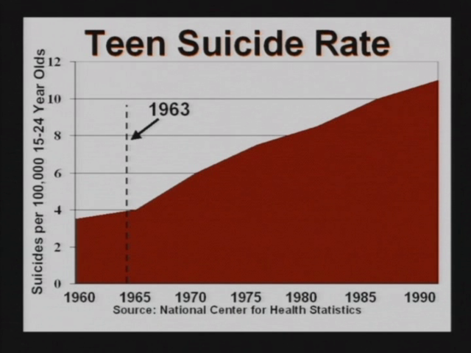

Slide 92
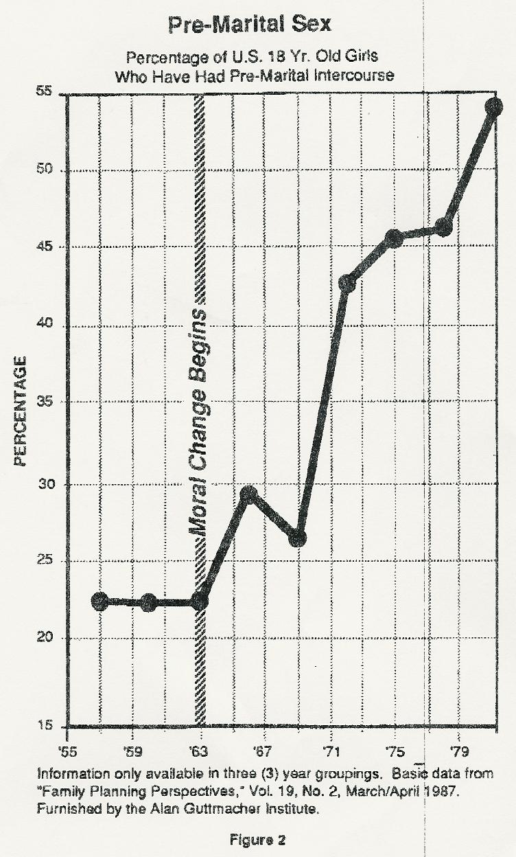

Slide 93
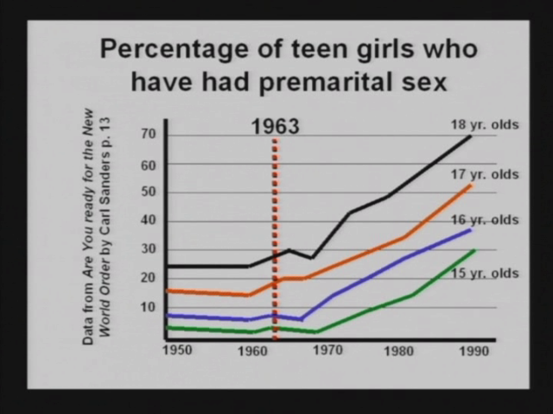

Slide 94
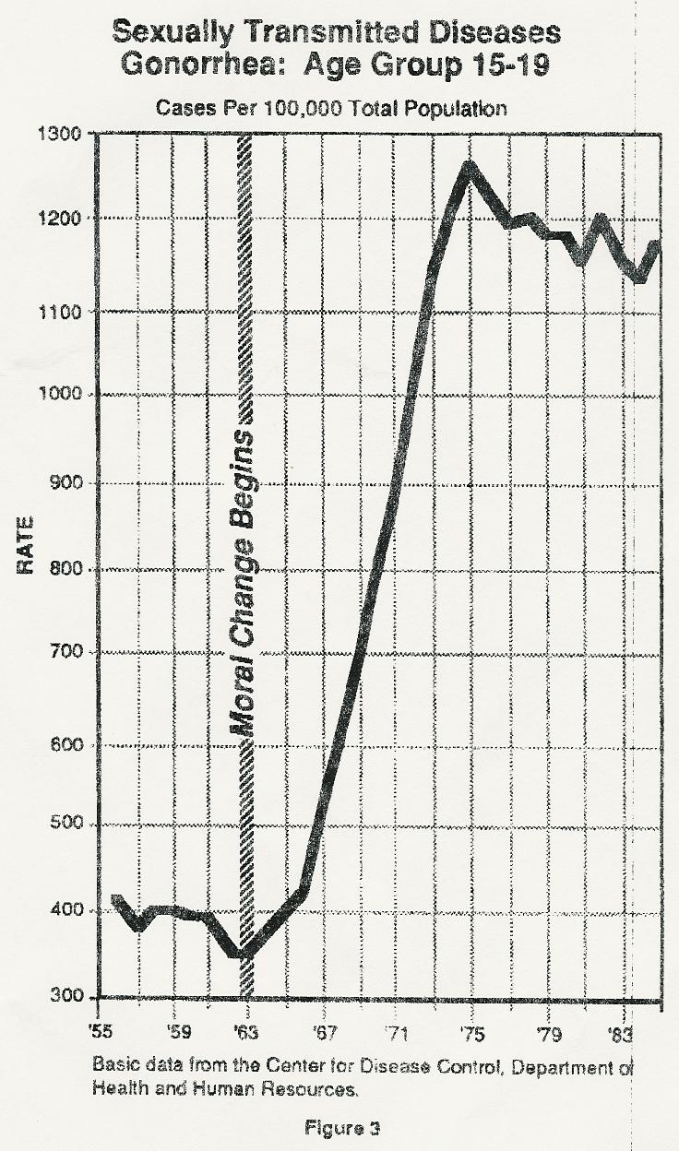

Slide 95
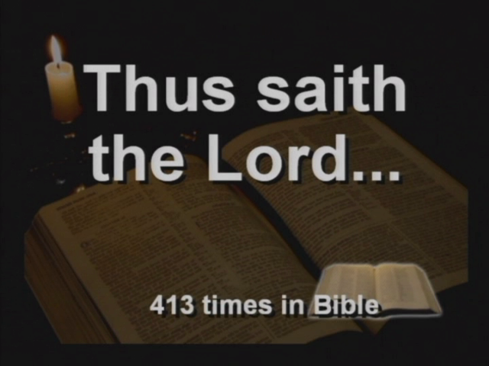

Slide 96
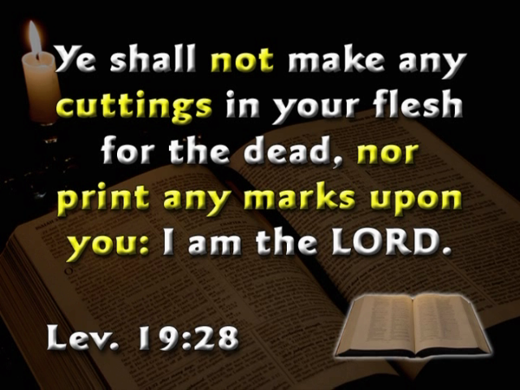

Slide 97
DESPERATIONS 63-0901E
22 And all the things that He hasn't done down through the ages, in the church ages, He is now doing. Back to the Word,… And in the last days, the Seven Seals being opened, was to pick up every straggle that's been left off in it, and make the whole thing in one great big body of the Bride, that them who lived back there was not perfect until this Church be perfected, this Bride group in the last days, to bring them in, and all together be taken up.

Slide 98
Souls.That.Are.In.Prison.Now 63-1110
140 …but one day he rose from there, come forth. Where was the book at? It was still in the abstract owner, God Almighty. And John looked around, and he wept, because there was no man even worthy to look on the book and, especially, open the seals, to reveal what the hidden mystery was.
141 the mysteries was in the seven seals. When these Seven Seals was opened, that opened up the entire Bible… And it was the book of redemption, New Testament.

Slide 99
The.Feast.Of.The.Trumpets 64-0719
57 …He has lotted the word for each age that would be on the earth. He lotted it in the church age, and the Seven Seals revealed every bit of it.
58 Revelations 10, we find, at the end of the seventh angel's message, that, these mysteries that had been hid would be revealed… Notice, the reason is because there had been no prophets during this age. The Bible said, that, “God does nothing till he reveals it to his servants, the prophets." And the Word of the Lord in all ages has always come to the prophets, never to a system, never to a group.

Slide 100
QUESTIONS.&.ANSWERS.3
64-0830M
1092-142 And now, the opening of the Seven Seals that was given by the Holy Spirit, the Seven Seals only was to make known what had been left off in the dispensations behind us.
The.Feast.Of.The.Trumpets 64-0719
45 Now, the hidden mysteries of Christ was fully revealed in the SEVEN SEALS.

Slide 101
WHO.DO.YOU.SAY.THIS.IS
64-1227
155 Look what the Lord God has done. Started off in great signs, and wonders, and miracles, which we all enjoyed. Then watch... Then come the Message behind it.
156 Watch what's taken place. Walking along, not just by yourself, man along with you. See a cluster of Angels come from the Heavens, shake the whole earth, just stand there.
…

Slide 102
SEED.IS.NOT.HEIR.WITH.THE.SHUCK 65-0218
101 But at the opening of the Seven Seals, Revelations 10, the full Word is to be born into manifestation again, and vindicated by the Spirit of God, in the full strength as It was when He was here on earth; manifested in the same way, doing the same things that It did when It was here on earth. Hebrews 13:8.
In Saint Luke 17:30, Jesus said, "In the last days, as it was in the days of Sodom, when the Son of man will be revealing Himself again, it'll be the same thing."

Slide 103
THE.SEED.IS.NOT.HEIR.WITH.THE.SHUCK 65-0218
128 They (Christians) want the Word of God, fresh, the promise of the hour. God promised rabbits in the days of Luther. He promised other things in the days of others. But now He promised us a full square Meal, the full seven course Menu, for all the Seven Seals are opened, and everything is ready for the Word of God, to those who can receive...

Slide 104
THE.SEED.IS.NOT.HEIR.WITH.THE.SHUCK JEFF.IN V-6 N-4 THURSDAY_ 65-0218
149 Then what is it now? "We must be about the Father's business," the Wheat would cry back, the Grain. Yes, sir. What must it do? Vindicate Malachi 4, vindicate Luke 17:30, vindicate Hebrews 13:8, vindicate Saint John 14:12, vindicate all of His Word. Vindicate Revelations, the 10th chapter, of the opening of the SEVEN SEALS, and the mysteries of God; even to serpent's seed, and all, would be manifested; marriage and divorce and all these other mysteries that's been hid under the pillars for all these years, from the theologians and so forth, but it's now the hour. That's the Father's business.

Slide 105
THE.SEED.IS.NOT.HEIR.WITH.THE.SHUCK
JEFF.IN V-6 N-4 THURSDAY_ 65-0218
149 Then what is it now? "We must be about the Father's business," the Wheat would cry back, the Grain. Yes, sir. What must it do? Vindicate Malachi 4, vindicate Luke 17:30, vindicate Hebrews 13:8, vindicate Saint John 14:12, vindicate all of His Word. Vindicate Revelations, the 10th chapter, of the opening of the SEVEN SEALS, and the mysteries of God; even to serpent's seed, and all, would be manifested; marriage and divorce and all these other mysteries that's been hid under the pillars for all these years, from the theologians and so forth, but it's now the hour. That's the Father's business.

Slide 106
THIS.DAY.THIS.SCRIPTURE.IS.FULFILLED
65-0219
163 And that next morning, at ten o'clock, sitting in my room there, about ten o'clock, the Angel of the Lord came down. He said, "Go to Tucson. You'll be northeast of Tucson, and there will come seven Angels in a cluster that will shake the whole earth around you. It'll be told you from there."
165 And said, "The Seven Seals of the hidden mysteries of the entire Bible will be opened, and fulfill Revelation 10, that in the seventh Angel’s Message these things should come to pass.” This day this Scripture is fulfilled before our eyes. This day this Scripture is fulfilled.

Slide 107
THIS.DAY.THIS.SCRIPTURE.IS.FULFILLED JEFF.IN V-3 N-8 FRIDAY_ 65-0219180
There It is, hanging in the sky; so far, there is no humidity, no moisture or nothing to make a--a fog. How could they come there? It was the Angels of God returning back, after their Message. This day that prophecy has been fulfilled in our midst. This day this Scripture has been fulfilled.
181 Watch, SEVEN SEALS HAS BEEN OPENED. The whirlwind is to the West Coast. Now, don't miss it, like they did back yonder.

Slide 108
WHO.IS.THIS.MELCHISEDEC
65-0221E
Think of this great Person, of how great this Man must be! And now, the question is, "Who is this Man?" Theologians has had different ideas. But since the opening of the Seven Seals, the mysterious Book that's been mysterious to us... According to Rev. 10:1-7, all the mysteries that's wrote in this Book, that's been hid down through the age of the reformers, is supposed to be brought out into view by the angel of the last church age… All the mysteries of the mysterious Book is to be revealed to the Laodicea messenger of that age.

Slide 109
IT.IS.THE.RISING.OF.THE.SUN
65-0418M
308 He is the One who opened those Seals. He is those Seals. For the whole Word of God is Christ and Christ is the Seals that was opened. What is the opening of those Seals then, revealing Christ.
309 And the very seven Angels, which represented the Seven Churches all completed, and we couldn’t even see it. They did, they took the picture, not us. And there He is, standing there, Supreme Judge; Showing that He is Alpha and Omega, the beginning and the end. Quickening Power did that to us.
310 Quickening Power let’s us see His coming. Quickening Power snatched us from death to life.

Slide 110
DOES.GOD.CHANGE.HIS.MIND
65-0427
177 But now He is, through the Church age now, He has been Son of God. In the Millennium He'll be Son of David, sitting on David's throne. But between this time, we find out by the Scriptures, He is to reveal Himself again as Son of man, a prophet.
178 Cause, THE WORD OF THE LORD COMES TO PROPHETS ONLY, NEVER TO THEOLOGIANS. IT IS TO PROPHETS. And the Lord said He did nothing, in His unchanging Word we just talked about, until first He shows His prophets. And the end time, them SEVEN SEALS THAT THIS BIBLE HAS SEALED UP, THE SEVENFOLD MYSTERIES OF ALL OF CHRIST, HAS TO BE REVEALED FIRST, AND IT CAN ONLY BE BROUGHT TO A PROPHET. We've been looking for that, for years, and we believe that His Spirit is among us now, so we find.

Slide 111
ASHAMED
JEFF.IN V-3 N-9 SUNDAY_ 65-0711
45 I left here, by a vision, to go yonder to Tucson, to see what the Lord wanted me to do. There He met me up there, as He told you here that He would do it, and the form of seven Angels, and said to return back and the SEVEN SEALS was to be opened. That's just exactly what happened.

Slide 112
ASHAMED
JEFF.IN V-3 N-9 SUNDAY_ 65-0711
67 THERE HE IS WITH THEM ANGELS, THE MESSAGE, WHICH WAS THE SEVEN BREAKING OF THEM SEVEN SEALS that revealed serpent seed and all these things here. And it shows that it is His very covering, it's His Supreme Authority. He is Supreme, and He is wigged, or covered.

Slide 113
TRYING.TO.DO.GOD.A.SERVICE.WITHOUT.BEING.THE.WILL.OF.GOD
JEFF.IN V-4 N-8 SUNDAY_ 65-0718M
160 So He promised He would do it a certain way, and anything contrary to that He won't do it. See? But by His original way, according what He said in Amos 3:7, that's the way He'll do it. And that must be a vindicated and proved to be right.
Now, you know what He promised today, then He's doing it today. That's just what He said He would do. He would open those SEVEN SEALS, and what all He'd do; reveal the mysteries back there, how these baptisms and all things had been all messed up. And here it is, in His very Presence. Science proves it. The heavens has declared it.

Slide 114
THE.SEVENTH.SEAL 63-0324E
577-3 The seven Angels... I was in the west. You remember the little bitty messengers; they went east. The second messengers, the doves, they went east... They was with me all the time. That was that first and second pull. Now, the third came from the west sweeping forward with great terrific speed, and they picked me up. That was coming back east with the mystery of these seven seals, just like it said in Junior Jackson's dream that the Lord let me interpret for him there.

Slide 115
TRYING.TO.DO.GOD.A.SERVICE.WITHOUT.BEING.THE.WILL.OF.GOD
65-0718M
178 The evening time, He promised He would reveal, though, open these SEVEN SEALS and show what them churches had missed back there. Revelations 10, and Malachi 4, Luke 17:30, He said He would do it. Now let's not mix it up. Let's keep it right like that.

Slide 116
SPIRITUAL.FOOD.IN.DUE.SEASON
JEFF.IN V-8 N-7 SUNDAY_ 65-0718E
83 THEN BACK OUT THERE AT THE BEGINNING OF THE SEVEN SEALS, WHEN THOSE SEVEN ANGELS COME DOWN IN THAT PYRAMID FORM, STOOD THERE AND TOLD ME TO RETURN BACK HERE AND SPEAK ON THOSE SEVEN SEALS, AND HE'D BE WITH ME, HE'D SHOW ME WHAT THEY WERE, THE LOST THINGS. I always thought it was sealed on the back of the Book and it'd be something wasn't wrote in the Book, but it turned out that it was made known that He cannot do that. It isn't something that's written in the Book... It's something that's been hid in the Book. "For whosoever shall take one Word from It or add one word to It..." So it is a mystery that's been in the Book in these seven church ages. Each one of them produced a--a mystery, all about water baptism and these other things that they've fumbled about so long.

Slide 117
SPIRITUAL.FOOD.IN.DUE.SEASON
JEFF.IN V-8 N-7 SUNDAY_ 65-0718E
161 Now mark that with what the last prophet said, "Behold I send to you Elijah the prophet, and he will restore the hearts of the children back to the fathers." See? A Message to bring them back to the Bible, and the Son of man will be revealing Himself in that day. And at that day of the sounding of the last church age, the seventh angel, the mysteries of God should be made known in that day. The SEVEN SEALS would be broken. The mysteries of all these churches and things, how they happened, and what tak-... how, what taken place.

Slide 118
THE.ANOINTED.ONES.AT.THE.END.TIME
JEFF.IN V-5 N-3 SUNDAY_ 65-0725M
244 Started where? This is "false prophet," singular. "False prophet," the first pope; and from there come out "the--the whore, and the mother of harlots," the whole thing.
A false trinity was rising; not in the early days, wouldn't be made manifest in the early days, it went right on through with it. BUT WHEN THE SEVEN SEALS BE COME, AND OPENED THOSE MYSTERIES AND REVEALED THEM; THAT'S WHEN "THE FROGS, THREE UNCLEAN SPIRITS LIKE FROGS, COME OUT TO MANIFEST THEMSELVES," A TRINITY DOCTRINE AGAINST THE TRUTH.

Slide 119
THE.ANOINTED.ONES.AT.THE.END.TIME
JEFF.IN V-5 N-3 SUNDAY_ 65-0725M
247 Now listen closely. We see plainly, after the SEVEN SEALS has been opened, that's to reveal that mystery. What is that trinity? See? Where was it ever called trinity? See? Where in the Bible did It even speak the word trinity? Where could there be three Gods, that we worship three Gods and not be heathens?

Slide 120
THE.ANOINTED.ONES.AT.THE.END.TIME
JEFF.IN V-5 N-3 SUNDAY_ 65-0725M
262 Notice, the very day when this messenger... Not when he starts on, but when he begins to declare his Message. See? The First Pull, healing; Second Pull, prophesying; Third Pull, the opening of the Word, the mysteries revealed. No more, there is no more higher order to reveal the Word, than prophets. But the only way the prophet can be vindicated is by the Word. And, remember, the Third Pull was the opening of them SEVEN SEALS, to reveal the hidden Truth that's been sealed in the Word. Do you see it?

Slide 121
WHAT.IS.THE.ATTRACTION.ON.THE.
MOUNTAIN
JEFF.IN V-8 N-8 SUNDAY_ 65-0725E
139 I met Brother Fred and them, a little after. Said, "What was it?"
I said, "That was it."
"What are you going to do?
140 "Return home. For, THUS SAITH THE LORD, the seven mysteries that's been hid in the Bible all these years, these denominations and everything, God is going to open those seven mysteries to us in the SEVEN SEALS."

Slide 122
CHRIST.IS.REVEALED.IN.HIS.OWN.WORD
JEFF.IN V-4 N-10 SUNDAY_ 65-0822M
158 So we see the evening Light's here. And what does it do to have Light, if you don't have any eyes to see how to get around in It? What is the evening Light? The Light comes on, to reveal something. Is that right? If there's something here, you feel and you can't understand what it is, in the darkness, then turn a light on. It's to reveal! What's Malachi 4 to do? See? Do the same thing. What was the opening of the SEVEN SEALS to do, where all these denominations staggering around in this...?... Is to reveal, bring out. If you haven't got any eyes, then what's the use to reveal? There has to be eyes, first, to see. Is that right? …

Slide 123
To reveal Malachi 4, reveal Saint Luke 17:30, Saint John 14:12, also John 15:24, 16:13. And to also reveal Revelations 10:1 to 7, the opening of the SEVEN SEALS, and the seventh angel's Message; to open up, to reveal, when the evening Light's come.

Slide 124
CHRIST.IS.REVEALED.IN.HIS.OWN.WORD_ JEFF.IN V-4 N-10 SUNDAY_ 65-0822M
162 Now it's in the eyes. What good will you need eyes, or need light, if that eyes wasn't there to see? There has to be eyes, first, to see. And then when that come, He opened the SEVEN SEALS and revealed the evening Light, taking all the mysteries that's been hid down through these church ages, and now revealed them as He promised to do in Revelations 10:1 to 7. Here we are today setting in the midst of the Word, and the Word being revealed to us by Jesus Christ. Then, This is God's Word.

Slide 125
GOD'S.POWER.TO.TRANSFORM
PHOENIX.AZ V-16 N-5 SATURDAY_ 65-0911
77 Now, it's hard to say this. It's--it's very hard, because speaking to people who feel the same way I do, and the way I have been for many years. But since the opening of those SEVEN SEALS, of them Angels just behind the mountain yonder, This has become a new Book. It's the things that's been hid, is being revealed as God promised in Revelation 10, He would do it.

Slide 126
POWER.OF.TRANSFORMATION
PRESCOTT.AZ V-17 N-1 SUNDAY_ 65-1031M
124 Now if children has come up under that kind, see, under that kind of teaching, that's what their parents was, they have the nature of their parents, their denominations, and so forth, they have to believe that. See, they believe that because they're born under that parent. But today we're not born under that parent; our Parent is the Word. And the Word... "Well," say, "I was born under God, too." For that age. But this is the climax age, this is the age beyond those denominations.
125 There had to come forth, must come forth; God ordained it so, that there must come forth, them SEVEN SEALS must be opened. It was supposed to be done in this Laodicean age. And I think, beyond any shadow of doubt...

Slide 127
WHAT.HOUSE.WILL.YOU.BUILD.ME
TUCSON.AZ V-19 N-6 SUNDAY_ 65-1121
5 Brother Jack Moore, a very good friend of both Brother Pearry and I, and we love Brother Jack. The Message, I think, kind of baffled him a little, especially on some of the things that we hold dear and believe, that It came to us through the opening of the SEVEN SEALS, as we believe It, such as, "serpent's seed," and "Eternal security of the believers," and--and so forth, some of those Messages. That, maybe to others... We don't think This is hard, but, It, you've got to open your heart to Truth. We believe that we're living in the end time. That's just so real to us, that we're just at the end of the road.

Slide 128
WHAT.HOUSE.WILL.YOU.BUILD.ME
TUCSON.AZ V-19 N-6 SUNDAY_ 65-1121
13 And now if the Old Testament had to be drove from the... the writer had to be drove from his people, into the wilderness, to get inspiration to write the Old Testament. And in the New Testament, the writer was drove by the Author, into a desert place, to get the inspiration to write the New Testament. And the Books are sealed with SEVEN SEALS; it would also require the same, I believe, in these days, to open those SEVEN SEALS.

Slide 129
THE.INVISIBLE.UNION.OF.THE.BRIDE.OF.
CHRIST
SHP.LA V-2 N-15 THURSDAY_ 65-1125
196 What did He do? He opened up the SEVEN SEALS of the last Message. You notice that? The SEVEN SEALS, which, all the mysteries of the seven church ages was sealed with SEVEN SEALS. The reformers didn't have time to do it in their days. They didn't live long enough. But this blessed revelation of the SEVEN SEALS, it's open to us in this last days, from a prophecy that went forth to Arizona.

Slide 130
THE.INVISIBLE.UNION.OF.THE.BRIDE.OF.
CHRIST
SHP.LA V-2 N-15 THURSDAY_ 65-1125
259 The apostles, them who set forth the Bible. Here come Luther out, in reformation, his words, his church, won't work today. Wesley's won't. Pentecostal's won't. It worked in their day.
260 But it's another day. This is the opening of the SEVEN SEALS. I know It sounds strange to you, but God has vindicate it so perfectly. There's no question in It. Just perfectly!

Slide 131
THE.INVISIBLE.UNION.OF.THE.BRIDE.OF.
CHRIST
SHP.LA V-2 N-15 THURSDAY_ 65-1125
287 Oh, no wonder, no wonder the damnation of God heaps up! God put It right before your eyes. You shut your eyes and fail to look at It. Yeah. Shutting up your bowels of compassion, when you see the true Word of God and these SEVEN SEALS being vindicated and proved to be so.

Slide 132
THE.INVISIBLE.UNION.OF.THE.BRIDE.OF.
CHRIST
SHP.LA V-2 N-15 THURSDAY_ 65-1125
300 Now we're closing, in saying this. Finish up the great commission, how could they do it? We know they're dead. God let it die in this scientific age, all of it, so--so He could (do what?) open up the Seven-Seal mystery to the undenominational Bride. How can a denomination accept those SEVEN SEALS, when It's absolutely contrary, serpent's seed and all those other things? The whole, full seven mysteries is contrary to what they been taught, because they took the old school from their Bible school

Slide 133
THE.INVISIBLE.UNION.OF.THE.BRIDE.OF.
CHRIST
SHP.LA V-2 N-15 THURSDAY_ 65-1125
301 And the SEVEN SEALS of God, when It was opened there on the mountain, God will let me die right now at this pulpit if That ain't the Truth. And I foretold you, a year and six months before it happened, what He told me, "Go to Arizona," and what would happen out there in the desert. And there's men setting right here, tonight, was standing right there and present when the seven Angels come down. And even mag-... The magazine, Life magazine, packed the article of It. It's right there in the observatory, everything. Now they don't even know what It's all about.

Slide 134
THE.INVISIBLE.UNION.OF.THE.BRIDE.OF.
CHRIST
SHP.LA V-2 N-15 THURSDAY_ 65-1125
303 God had to open up those SEVEN SEALS, not in a denomination. I've always been against it. But, out of denomination, He might take a Bride, not a denominational bride. He couldn't do it. It's against His Own Word. HE OPENED THOSE SEVEN MYSTERIES IN THERE. That shows forth, brings forth those things that's been hid since the foundation of the world, might be revealed in the last days, to sons of God. They brought That forth now before the people, that they see It there, you now, to this undenominational Bride. Oh, my!

Slide 135
THE.INVISIBLE.UNION.OF.THE.BRIDE.OF.
CHRIST
SHP.LA V-2 N-15 THURSDAY_ 65-1125
360 Lord, I'm thankful. I'm very thankful. Thanksgiving to You, Lord; not for natural food, yet that. But, Lord, the end time is here. I'm thankful for this spiritual Food, Lord, the spiritual Food of the SEVEN SEALS was promised to be opened.

Slide 136
TRYING.TO.DO.GOD.A.SERVICE.WITHOUT.IT.BEING.GOD'S.WILL
SHP.LA V-7 N-2 SATURDAY_ 65-1127B
70 The whole earth shook, everywhere. Rocks that size rolled down, dust flying like that. And I looked, and standing before me stood seven Angels; just exactly the way it was. I felt like I was standing way up off the ground. First, I thought somebody had shot me, you know, with that black hat on; looked like a javelina hog, anyhow, you know they're dark. I thought somebody had shot me, such a... right close. And I--I seen then what it was. Well, as soon as... I got my commission, and the Scripture, "The SEVEN SEALS which is the seven mysteries." See?

Slide 137
TRYING.TO.DO.GOD.A.SERVICE.WITHOUT.IT.BEING.GOD'S.WILL
SHP.LA V-7 N-2 SATURDAY_ 65-1127B
220 But now is the Bride-calling, now is when the SEVEN SEALS has been opened, now when the complete things that the reformers left has to be opened; and only Malachi 4 can do that, because it takes the revelation straight from God to an individual to do so. That's right! It can't come to a group, never did. One man! That's what God promised in the shadows of the coming for His Bride, an Eliezer. See?

Slide 138
TRYING.TO.DO.GOD.A.SERVICE.WITHOUT.IT.BEING.GOD'S.WILL
SHP.LA V-7 N-2 SATURDAY_ 65-1127B
304 Now, quickly now, as we are fixing to close in a few moments.
305 Now, He said, "In the days of the Message of the seventh angel, the earthly angel, seventh church age, then all these mysteries that's been lost back through these other six church ages should be revealed right then." Well, that's exactly what those Angels said. Here is the SEVEN SEALS, or the opening of these mysteries. And you try to get It before those denominations. Contrary to what they... Brother, they close up like a clam, but they've always done it. But it's season!

Slide 139
I.HAVE.HEARD.BUT.NOW.I.SEE
SHREVEPORT.LA V-7 N-3 SATURDAY_ 65-1127E
201 And then He promised, in the hour of the seventh angel's Message, the SEVEN SEALS would be revealed; and the mysteries of God would be declared (Revelation 10) when the seventh angel begins to sound his Message, not the healing service, the Message that follows the healing service.

Slide 140
THE.RAPTURE
YUMA.AZ V-5 N-14 SATURDAY_ 65-1204
75 Now, the Book was written, but then, remember, It was sealed with SEVEN SEALS. And these SEVEN SEALS was not to be opened (Revelations 10) until the sounding of the last earthly angel on earth, Revelations 10:7. See? "And in the days of the sounding of the last angel's Message, seventh angel, the mystery of God should be finished in that age." That, and that's the age that we're living in.

Slide 141
THE.RAPTURE
YUMA.AZ V-5 N-14 SATURDAY_ 65-1204
76 We all know we're living in the Laodicea Age. There will never be another age to it. It can't be. So, we're living in the Laodicea Age. And THESE SEVEN SEALS THAT'S HELD THAT BOOK, IS A MYSTERY TO PEOPLE, SHOULD BE OPENED AT THAT DAY. That's what He promised. Now, it won't be nothing outside the Word, because you can't add to the Word or take from the Word. It's got to remain always the Word. But the revelation is to reveal the Truth of It, what It is, to make It fit with the rest the Scripture. And then God vindicates that to be the Truth. See?

Slide 142
THE.RAPTURE
YUMA.AZ V-5 N-14 SATURDAY_ 65-1204
156 You're not blind people. You're sensible people.
And if I stood here and said those things for prejudice? I say It because It's Life, because I'm responsible to God for saying It. And I must say It, and my Message. All the time, knowing, back there under healing and so forth like that, was just to catch the people's attention, knowing the Message would come. And here It is. And them SEVEN SEALS opened, those mysteries, and showing those things is what's happened. I didn't know it.

Slide 143
THINGS.THAT.ARE.TO.BE
RIALTO.CA V-4 N-6 SUNDAY_ 65-1205
42 And I do not think that Heaven is a place that my mother used to tell me about. I believe that the Church has grown from that. To think, it used to be, a hundred years ago, or two, I think the old-timers used to think that everyone that died went up to Heaven and had a harp, and--and set up there on the clouds and played a harp. Now, they knew that there was a place called Heaven. But, they, if that be so, all the musicians would have it on us, you see. But it isn't that kind of a place. It isn't playing harps, at all. I believe, don't believe the Bible teaches that. But that was a conception that they had before the fullness of the Word come into existence, or the opening of the SEVEN SEALS, that's promised to us in this age, that we then understand.

Slide 144
MODERN.EVENTS.ARE.MADE.CLEAR.BY.
PROPHECY
SBD.CA V-7 N-6 MONDAY_ 65-1206
320 Dear God, as this audience bows their head and heart, in this solemn moments here of closing of this Bible lecture; when we see the vindication of the Holy Spirit that shook this nation back and forth, and back and forth, great revivals and indication, knowing that something has to follow that. And then see those seven Angels come down there on top of that mountain yonder in Arizona, when even the magazines across the nation's packed It. To see Jesus Himself there in the skies, looking down, and saying that, "In the Revelation 10:7, in the seventh angel's Message, these seals would be opened, the mysteries of God would be made known." That the reformers didn't live long enough to bring it out. And here, these SEVEN SEALS that sealed the whole thing is to be opened in this day.

Slide 145
BREACH.BETWEEN.THE.SEVEN.CHURCH.
AGES.AND.THE.SEVEN.SEALS
JEFF.IN SUNDAY_ 63-0317E
92-1 {152} Notice, now the Book, remember, is sealed. Here's one; here is this seal, then another one's wrapped: a seal. Another one's wrapped: a seal. It's a Book of Redemption. And the whole thing together makes the Book, and it's sealed with SEVEN SEALS. And being it's on the backside is because it's wound up; the seal mystery is on the inside, and it only says the white horse rider, or the black horse rider, and whatmore on the outside, but the mystery of the whole Book is in them Seals. FROM GENESIS TO REVELATIONS, A COMPLETE PLAN OF REDEMPTION IS REVEALED IN THESE SEVEN SEALS. Oh, it's an important time. God help us to get it. See?

Slide 146
QUESTIONS.AND.ANSWERS.4
JEFF.IN COD SUNDAY_ 64-0830E
1161-Q-395 395. HAVE THE SEVEN THUNDERS WHICH EQUALS SEVEN MYSTERIES ALREADY BEEN REVEALED? WERE THEY REVEALED IN THE SEVEN SEALS, BUT ARE YET NOT KNOWN TO US AS THE THUNDERS YET?
NO, THEY WERE REVEALED IN THE SEVEN SEALS; THAT'S WHAT THE THUNDERS WAS ABOUT

