Slide 1
End Time Faith The Mission of the Family
PSALM 68:3-6
God setteth the solitary in families: he bringeth out those which are bound with chains: but the rebellious dwell in a dry land.

Slide 2
Birthdays & Anniversaries
May 14th Nathan Brown
May 16th Caroline Powell
May 18th Mary Ann Roy
May 18th Ladies Tea
June 1st Work Day
June 2nd Bro. Danny Stemen
June 28th Adventures in the Bible
Sept. 27th Men’s Meeting

Slide 3
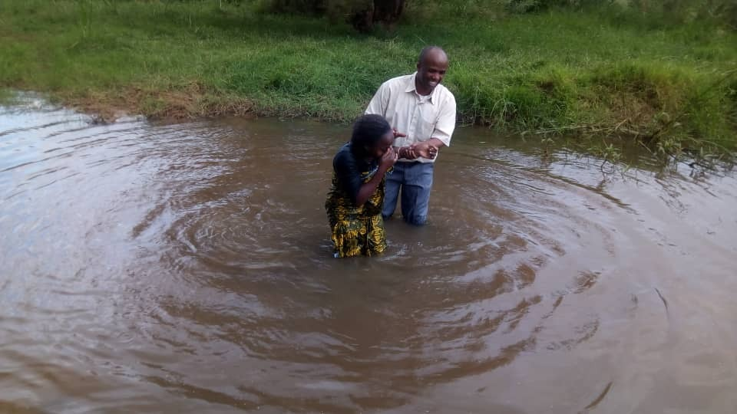
Loliondo, Tanzania

Slide 4
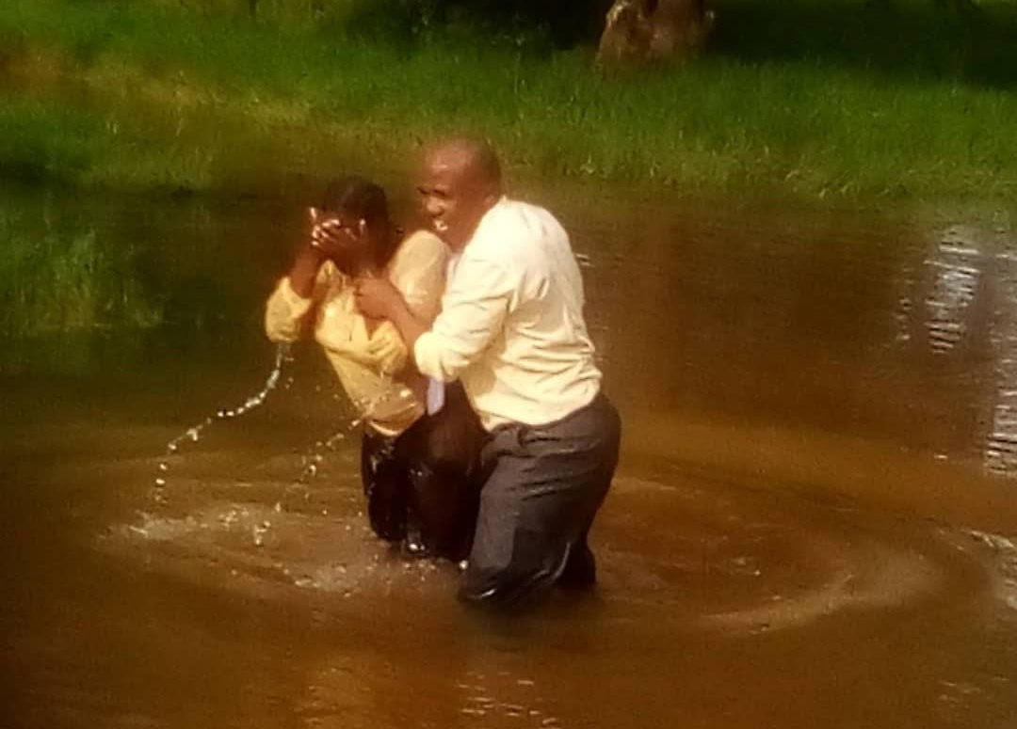

Slide 5
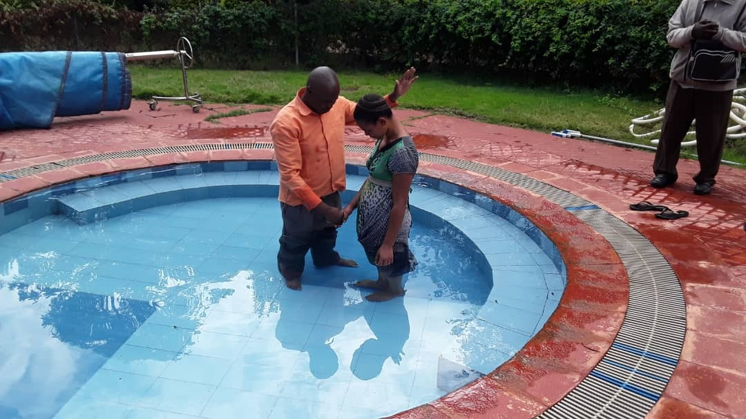

Slide 6
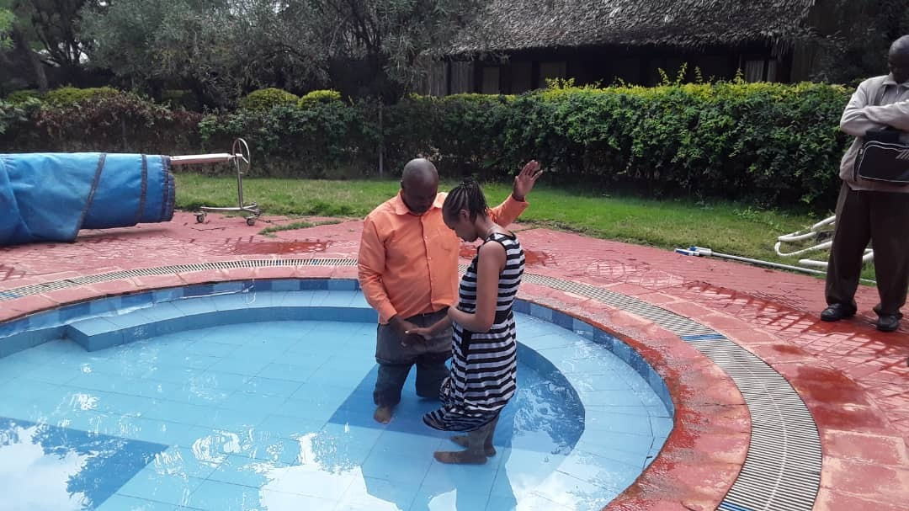

Slide 7
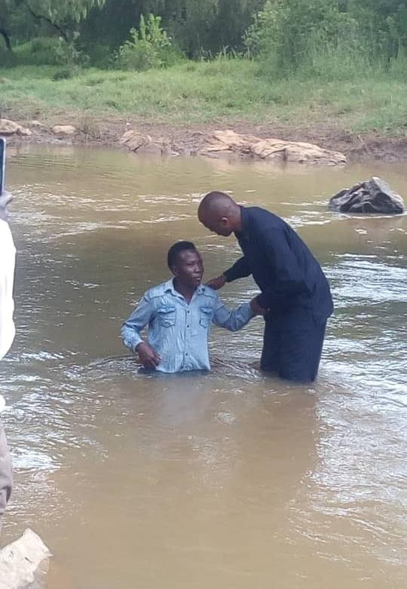
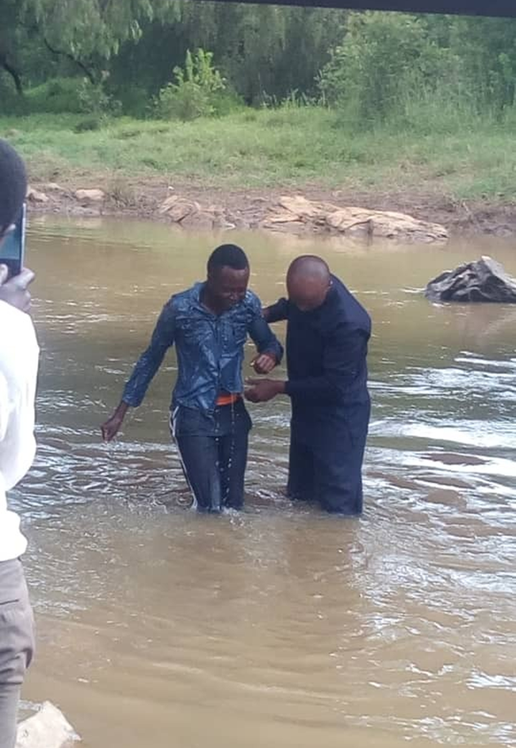

Slide 8
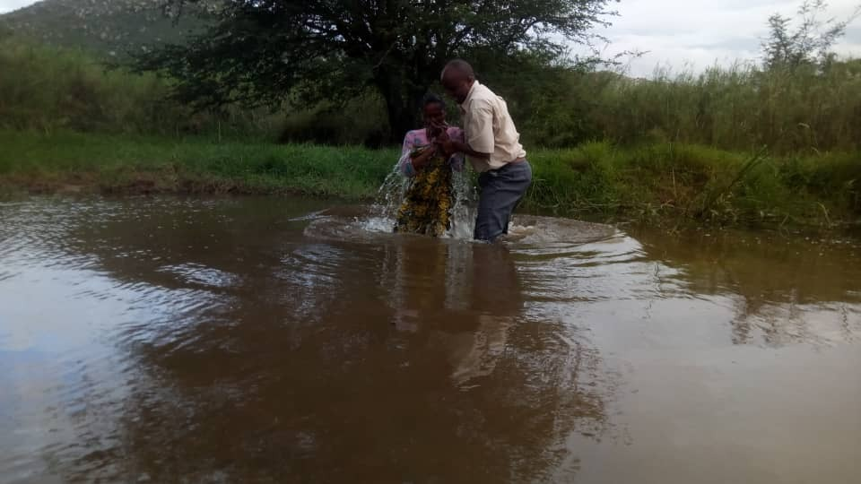

Slide 9
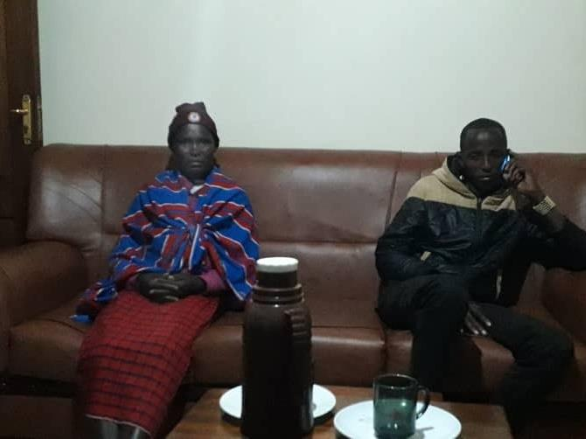
“I have two believers from Loliondo at my house. I asked them to come to see other believers so that they can be encouraged that they are not alone.” Bro. Elias

Slide 10
End Time Faith The Mission of the Family
PSALM 68:3-6
God setteth the solitary in families: he bringeth out those which are bound with chains: but the rebellious dwell in a dry land.

Slide 11
LUKE 11:2-4
And he said unto them, When ye pray, say, Our Father which art in heaven, Hallowed be thy name. Thy kingdom come. Thy will be done, as in heaven, so in earth. 3 Give us day by day our daily bread. 4 And forgive us our sins; for we also forgive every one that is indebted to us. And lead us not into temptation; but deliver us from evil.

Slide 12
GENESIS 18:17-19
And the LORD said, Shall I hide from Abraham that thing which I do; 18 Seeing that Abraham shall surely become a great and mighty nation, and all the nations of the earth shall be blessed in him? 19 For I know him, that he will command his children and his household after him, and they shall keep the way of the LORD, to do justice and judgment; that the LORD may bring upon Abraham that which he hath spoken of him.

Slide 13
MATTHEW 13:22-23
He also that received seed among the thorns is he that heareth the word; and the care of this world, and the deceitfulness of riches, choke the word, and he becometh unfruitful. 23 But he that received seed into the good ground is he that heareth the word, and understandeth it; which also beareth fruit, and bringeth forth, some an hundredfold, some sixty, some thirty.

Slide 14
MARK 10:29-30
And Jesus answered and said, Verily I say unto you, There is no man that hath left house, or brethren, or sisters, or father, or mother, or wife, or children, or lands, for my sake, and the gospel's, 30 But he shall receive an hundredfold now in this time, houses, and brethren, and sisters, and mothers, and children, and lands, with persecutions; and in the world to come eternal life.

Slide 15
HEBREWS 11:6
But without faith it is impossible to please him: for he that cometh to God must believe that he is, and that he is a rewarder of them that diligently seek him.

Slide 16
DOOR.TO.THE.HEART
5 I've never taken an offering in my life. There's been some taken for me, each meeting. And then, if people didn't send me a little something besides the meeting here, I'd have to fold up the first week. And so, but I've just got a little business that the Lord has 'lotted me with for His... There's four in the office. Around the world, and I've been in contact with over ten million people. And you can imagine what it does. We have to make every nickel count, to make ends meet. But we're happy to do that for the Lord.

Slide 17
I'm happy for this offering that you gave me tonight. I pray that God will bless you exceedingly, abundantly. And to the best of my knowledge, I'll spend it to for the glory of God. And God will reward you for it, I pray, in this world a hundredfold and in the world to come, Eternal Life. May it go to make them golden bricks that's in your great home that'll never perish.
58-0302

Slide 18
PSALM 22:23-24
Ye that fear the LORD, praise him; all ye the seed of Jacob, glorify him; and fear him, all ye the seed of Israel. 24 For he hath not despised nor abhorred the affliction of the afflicted; neither hath he hid his face from him; but when he cried unto him, he heard.

Slide 19
II SAMUEL 9:10-13
Thou therefore, and thy sons, and thy servants, shall till the land for him, and thou shalt bring in the fruits, that thy master's son may have food to eat: but Mephibosheth thy master's son shall eat bread alway at my table. Now Ziba had fifteen sons and twenty servants. 11 Then said Ziba unto the king, According to all that my lord the king hath commanded his servant, so shall thy servant do. As for Mephibosheth, said the king, he shall eat at my table, as one of the king's sons. 12 And Mephibosheth had a young son, whose name was Micha. And all that dwelt in the house of Ziba were servants unto Mephibosheth. 13 So Mephibosheth dwelt in Jerusalem: for he did eat continually at the king's table; and was lame on both his feet.

Slide 20
MAKE.THE.VALLEY.FULL.OF.DITCHES
3 A lady in my church... Mrs. Weber, dying with TB, in the sanatorium at the last stages. They sent her home to die: said there's nothing could be done for her. She lived just beyond the Taber-nacle, and she had a got five or six little children. So the Angel of the Lord come to me that night and said, "Go, tell Mr. Webber to get things ready; for he's going to be left with those children on his hands; for his wife's going." Well, I went and told Mr. Webber.

Slide 21
4 And two days after that, some ladies from the government depot there, where she worked, come in. Mrs. Webber said, "If I could only have Bro. Bill to pray for me once more, I seen when my cousin Opal was healed with that cancer, and the doctor just give her 'till morning to live.”
The girls from out at the government said, "There ain't nothing to that guy. He isn't nothing but a hypocrite."

Slide 22
And Miss Webber said, "Look, I'm a dying. And I know that, but I just won't stand still for that. I know better than that. I lived right here around this city, around that man all the time.
I seen him from a child, growed up. You can call it fake if you want to, but I've seen it and seen God heal the people. I know the man's life and I know it's the truth.“
And it happened to be the Angel of the Lord heard that.

Slide 23
5 And that very night, setting on the side of my chair, I seen Him walking through the door. "Tomorrow (Sunday), they're going to pick Miss Webber up, bring her down. She'll be setting on the right hand side in the Tabernacle. I heard her, and tell her I heard her, what she said. And tell her, THUS SAITH THE LORD, she'll live and not die." His Presence was there when she was taking up for what was right. His Presence was there, and He found her.

Slide 24
So He come and told me what she had said to these women, and He had respect to her because she had respect unto what was representing God. So God will do the same thing for you. Not to respect to me, but to respect to Him, to Christ, the One Who died for your healing. If you'll just give respects to Him and His Word, God will do the work for you. Amen.
53-0609E

Slide 25
LEADERSHIP
96 The first step you probably ever taken in your life, speaking of leadership, probably the hands of some kind old mother… Then after mother taught you how to walk, and you thought you were doing great things, then she turned you over to the school teacher. And then she begin to lead you to an education; of how and what you must do, and how you must learn, and--and so forth like that.

Slide 26
98 Then after the school teacher got through with you, your father got a hold of you… he taught you perhaps your business; how to be a successful businessman, how to do things right. Your mother taught you how to be a housewife, how to cook, and so forth like that.
99 Then after they got through with you, then your minister or priest got a hold of you…
65-1207

Slide 27
HoRiM הורה
Parent
Plural Noun
ToRaH תורה
MoRiM
Teacher
מורה
YoReH
יוֺרֶה
Yoreh
Rain is so special in Israel. This word refers to the annual debut of gentle rain on young seedlings, something note-worthy.
It also means an archer.

Slide 28
PSALM 144:11-12
Rid me, and deliver me from the hand of strange children, whose mouth speaketh vanity, and their right hand is a right hand of falsehood: 12 That our sons may be as plants grown up in their youth; that our daughters may be as corner stones, polished after the similitude of a palace:
PSALM 127:3-5
Lo, children are an heritage of the LORD: and the fruit of the womb is his reward. 4 As arrows are in the hand of a mighty man; so are children of the youth. 5 Happy is the man that hath his quiver full of them: they shall not be ashamed, but they shall speak with the enemies in the gate.

Slide 29
EXPECTATION
29 The first preacher that ever gets a child is a mother. There's five Gospels: Matthew, Mark, Luke, John, and mother. And a mother should be a Spirit filled woman, who can teach her children, and teach them to pray and to know about God, and so forth.
55-1001

Slide 30
INVASION.OF.THE.UNITED.STATES
244 To you little mothers here this morning, that's been real mothers, God bless you. You're the fifth Gospel, I think… Remember, when Moses was a little boy, it was a mother who give him his instruction, a godly mother who took little Moses on her knees, taught him all.
She was his teacher, under Pharaoh, said these things, "Moses, someday you're going to deliver the children of Israel. You're the boy that's called.

Slide 31
Keep yourself pure and un-spotted from the world, for you're the one."
No other place do we know where he ever went to any seminary, any teaching he ever got. He stayed right in Pharaoh's palace, which was a heathen; but his mother taught him. That's a real mother. She taught him the precepts of the Lord. She told him how he must be holy. She told him how and what he must live, and how, what God would do for him. And it stuck with Moses all the days of his life.

Slide 32
And any good, true, loyal mother that'll take her little babies, instead of send them to picture shows and dances, and so forth like that, and she'll put them on her lap and teach them about the Lord Jesus Christ...
54-0509

Slide 33
GENESIS 3:16-17
Unto the woman he said, I will greatly multiply thy sorrow and thy conception; in sorrow thou shalt bring forth children; and thy desire shall be to thy husband, and he shall rule over thee. 17 And unto Adam he said, Because thou hast hearkened unto the voice of thy wife, and hast eaten of the tree, of which I commanded thee, saying, Thou shalt not eat of it: cursed is the ground for thy sake; in sorrow shalt thou eat of it all the days of thy life;

Slide 34
The Age That Women Have Babies: How a Gap Divides America
By QUOCTRUNG BUI and CLAIRE CAIN MILLER AUG. 4, 2018
The difference in when women start families cuts along many of the same lines that divide the country in other ways, and the biggest one is education. Women with college degrees have children an average of seven years later than those without — and often use the years in between to finish school and build their careers and incomes.

