Slide 1
Endtime Faith
Part 7 LUKE 1:37
For with God nothing shall be impossible.

Slide 2
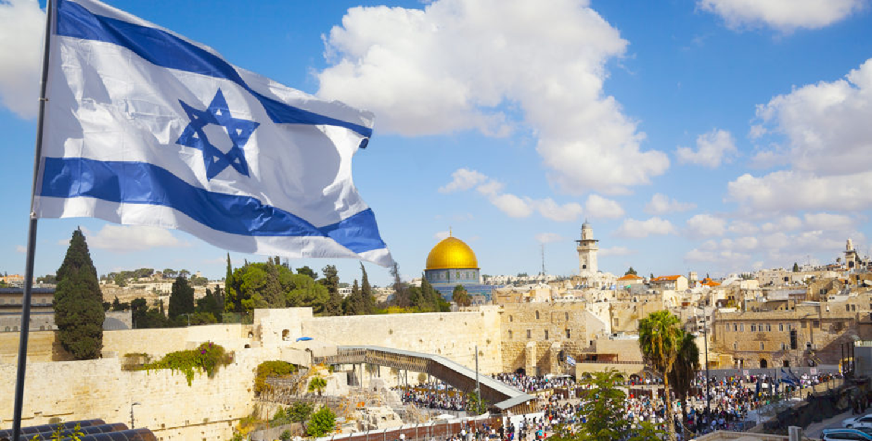
Israel
Oct. 31st 2019

Slide 3
Notices (w) the fact of observing or paying attention to something.
June 1st Work Day
June 2nd Bro. Danny Stemen
June 28th Adventures Through the Bible
Sept 27th Men’s Meeting @HBT

Slide 4
Birthdays & Anniversaries
May 26th Tina Knoblauch
May 28th The Pastor
May 29th Karen Buchanan
May 31st David &Sabrina Stevens
Anastasia Mayl
June 1st Ben & Sharon McCafferty

Slide 5
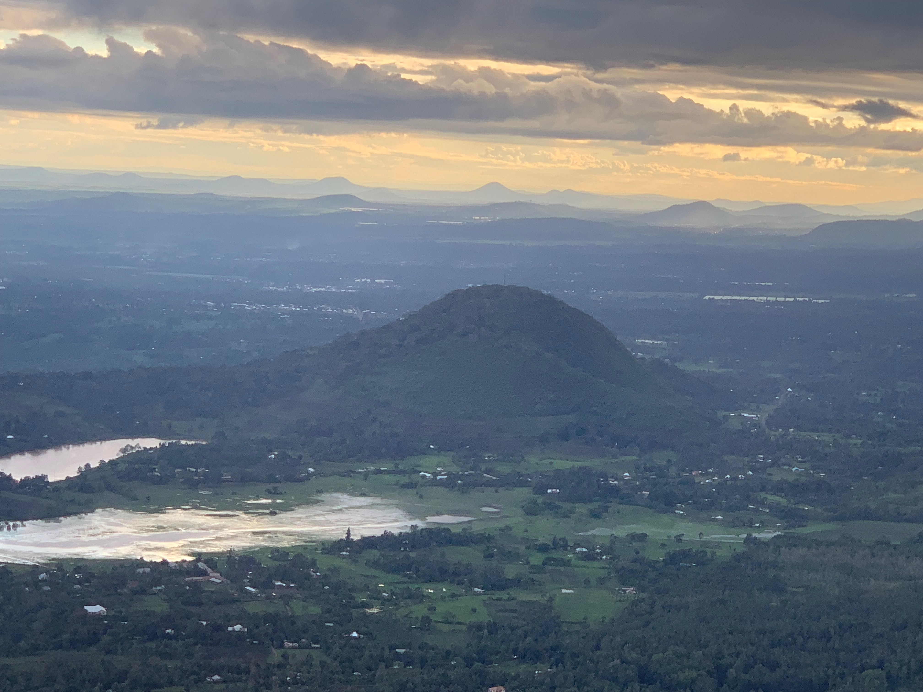
Kenya, Tanzania
May 2019

Slide 6
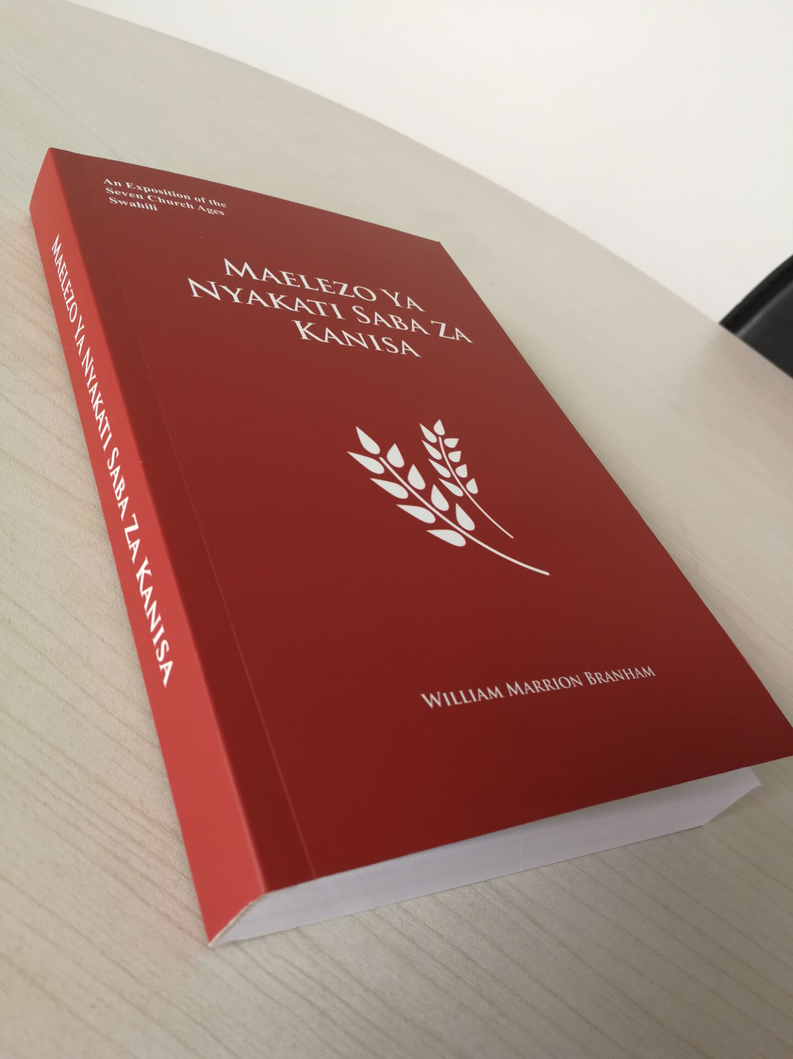
Vision Books
7 Church Ages
Swahili

Slide 7
The Balanced Memorials
That this may be a sign among you, that when your children ask their fathers in time to come, saying, What mean ye by these stones? 7 Then ye shall answer them, That the waters of Jordan were cut off before the ark of the covenant of the LORD; when it passed over Jordan, the waters of Jordan were cut off: and these stones shall be for a memorial unto the children of Israel for ever.
JOSHUA 4:6-7

Slide 8
Definition: Memorial
serving to preserve remembrance :
of or relating to memory.
Definition of memorial
something that keeps remembrance alive:
something (as a speech or ceremony) that commemorates an event.
“Something Happened Here!”

Slide 10
Yad
Vashem
Jerusalem

Slide 13
Children’s Memorial (Yad Vashem)

Slide 15
“Has the like of this happened in your days or in the days of your Fathers? Tell your children about it, and let your children tell theirs, And their children the next generation!”

Slide 16
DEUTERONOMY 4:8-9
And what nation is there so great, that hath statutes and judgments so righteous as all this law, which I set before you this day? 9 Only take heed to thyself, and keep thy soul diligently, lest thou forget the things which thine eyes have seen, and lest they depart from thy heart all the days of thy life: but teach them thy sons, and thy sons' sons;

Slide 17
ABRAHAM'S.SEED
47 Way back a long time ago, the old flapper of long ago. Her daughter today is a chorus girl. What's her daughter going to be? See what you do, bears something upon your generations to follow you. Sin's does to three or four generations, and righteousness does.
59-0423

Slide 18
GENESIS 9:13
I do set my bow in the cloud, and it shall be for a token of a covenant between me and the earth.

Slide 19
Matthew 26:6-13
And when Jesus was in Bethany at the house of Simon the leper, a woman came to Him having an alabaster flask of very costly fragrant oil, and she poured it on His head as He sat at the table… But when Jesus was aware of it, He said to them, “Why do you trouble the woman? For she has done a good work for Me. For you have the poor with you always, but Me you do not have always. For in pouring this fragrant oil on My body, she did it for My burial. Assuredly, I say to you, wherever this gospel is preached in the whole world, what this woman has done will also be told as a memorial to her.”

Slide 20
LUKE 22:19-20
And he took bread, and gave thanks, and brake it, and gave unto them, saying, This is my body which is given for you: this do in remembrance of me. 20 Likewise also the cup after supper, saying, This cup is the new testament in my blood, which is shed for you.

Slide 21
QUESTIONS.AND.ANSWERS.2
257 Now, you say, "Brother Branham, you hunt. Didn't you ever hunt on Sunday?" Let me tell you something. I'm not patting myself to the back of this, I'm not a Sabbatarian now; I believe the Holy Spirit is our Sabbath. I believe that, but I believe we should honor that resurrection as a memorial. That's a memorial... If you honor any day, honor that resurrection.
64-0823

Slide 22
HEBREWS.CHAP.1
95 Jesus left a memorial, an empty tomb. Someday when we go over to the grave, and our loved ones, and hear the little old clods, when they say, "Ashes to ashes, and dust to dust, and earth to earth." But, brother, we can look across the sea, to an empty tomb. Someday, we're going out of here. We're going home.
57-0821

Slide 23
JEREMIAH 31:33-34
But this shall be the covenant that I will make with the house of Israel; After those days, saith the LORD, I will put my law in their inward parts, and write it in their hearts; and will be their God, and they shall be my people. 34 And they shall teach no more every man his neigh-bour, and every man his brother, saying, Know the LORD: for they shall all know me, from the least of them unto the greatest of them, saith the LORD: for I will forgive their iniquity, and I will remember their sin no more.

Slide 24
EXODUS 12:13-14
And the blood shall be to you for a token upon the houses where ye are: and when I see the blood, I will pass over you, and the plague shall not be upon you to destroy you, when I smite the land of Egypt. 14 And this day shall be unto you for a memorial; and ye shall keep it a feast to the LORD throughout your generations; ye shall keep it a feast by an ordinance for ever.

Slide 25
EXODUS 12:24-27
And ye shall observe this thing for an ordinance to thee and to thy sons for ever. 25 And it shall come to pass, when ye be come to the land which the LORD will give you, according as he hath promised, that ye shall keep this service. 26 And it shall come to pass, when your children shall say unto you, What mean ye by this service? 27 That ye shall say, It is the sacrifice of the LORD'S passover, who passed over the houses of the children of Israel in Egypt, when he smote the Egyptians, and delivered our houses. And the people bowed the head and worshipped.

Slide 26
LUKE 22:17-20
And he took the cup, and gave thanks, and said, Take this, and divide it among yourselves: 18 For I say unto you, I will not drink of the fruit of the vine, until the kingdom of God shall come. 19 And he took bread, and gave thanks, and brake it, and gave unto them, saying, This is my body which is given for you: this do in remembrance of me. 20 Likewise also the cup after supper, saying, This cup is the new testament in my blood, which is shed for you.

Slide 27
That this may be a sign among you, that when your children ask their fathers in time to come, saying, What mean ye by these stones? 7 Then ye shall answer them, That the waters of Jordan were cut off before the ark of the covenant of the LORD; when it passed over Jordan, the waters of Jordan were cut off: and these stones shall be for a memorial unto the children of Israel for ever.
JOSHUA 4:6-7

Slide 28
TIME.TESTED.MEMORIALS.OF.GOD
23 And as the priests' feet touched Jordan, she just rolled back from side to side and the water stayed… God stayed the stream (Amen), and she laid there until they passed over.
Then God said to Joshua, "We want to make a memorial unto this. Go out there and send each Israelite, one out of a tribe, and pick up twelve stones and make a memorial. And this memorial shall be, that when your children are passing through this way, they will ask, 'What caused these stones to be here?' And you shall give them the story of how God stayed the Jordan." That's a wonderful memory.
57-0818

Slide 29
TIME.TESTED.MEMORIALS.OF.GOD
God's building a church as a memorial, a memorial of His sacrifice. Christ never come to earth to die in vain. His death will not be in vain. God's able of these stones to rise children to Abraham.
If people won't live in it, they won't take it under consideration and realize what a great gift that God's give them, God's able of the stones to rise children to Abraham. Truly, He will do it.
57-0818

Slide 30
CALLING.JESUS.ON.THE.SCENE
163 I was preaching just like now, the Shekinah Glory present, and all of a sudden, in a heart attack, his eyes went back… His wife there is a registered nurse, she screamed when she caught his heart and seen he was gone. I quietened the audience, went down. Laid my hands upon him, and felt. I looked up at her, she said, "He's gone." And I tried his eyes, I seen his eyes way... turned back like that. He had no more pulse than this has.
164 I said, "Lord Jesus," and He come on the scene. I laid my hand upon him. And he said, tried to speak, "Bro. Branham..." And here he stands, tonight, trophy of the grace of God.
63-0804

Slide 31
Endtime Faith
Part 7 LUKE 1:37
For with God nothing shall be impossible.

Slide 32
JEREMIAH 29:8-13
10 For thus saith the LORD, That after seventy years be accomplished at Babylon I will visit you, and perform my good word toward you, in causing you to return to this place. 11For I know the thoughts that I think toward you, saith the LORD, thoughts of peace, and not of evil, to give you an expected end. 12 Then shall ye call upon me, and ye shall go and pray unto me, and I will hearken unto you.13 And ye shall seek me, and find me, when ye shall search for me with all your heart.

Slide 33
GENESIS 19:15
And when the morning arose, then the angels hastened Lot, saying, Arise, take thy wife, and thy two daughters, which are here; lest thou be consumed in the iniquity of the city.

Slide 34
MATTHEW 17:20
And Jesus said unto them, Because of your unbelief: for verily I say unto you, If ye have faith as a grain of mustard seed, ye shall say unto this mountain, Remove hence to yonder place; and it shall remove; and nothing shall be impossible unto you.

Slide 35
LUKE 1:35
And the angel answered and said unto her, The Holy Ghost shall come upon thee, and the power of the Highest shall overshadow thee: therefore also that holy thing which shall be born of thee shall be called the Son of God. 36 And, behold, thy cousin Elisabeth, she hath also conceived a son in her old age: and this is the sixth month with her, who was called barren. 37 For with God nothing shall be impossible. 38 And Mary said, Behold the handmaid of the Lord; be it unto me according to thy word. And the angel departed from her.

Slide 36
ACTS 20:32
And now, brethren, I commend you to God, and to the word of his grace, which is able to build you up, and to give you an inheritance among all them which are sanctified.

Slide 37
JAMES 1:21-22
Wherefore lay apart all filthiness and superfluity of naughtiness, and receive with meekness the engrafted word, which is able to save your souls. 22 But be ye doers of the word, and not hearers only, deceiving your own selves.

Slide 38
POWER.OF.TRANSFORMATION
52 Now that's what we are here for. That's my Message, has been all along, is the Word of God.
We must hold to That regardless of what other things take place. Always stay with that Word.
65-1031

Slide 39
HEBREWS 4:1-12
Let us therefore fear, lest, a promise being left us of entering into his rest, any of you should seem to come short of it. 2 For unto us was the gospel preached, as well as unto them: but the word preached did not profit them, not being mixed with faith in them that heard it. 3 For we which have believed do enter into rest, as he said, As I have sworn in my wrath, if they shall enter into my rest: although the works were finished from the foundation of the world.

