Slide 1
The Christian Personality The Simple End Time Faith
II COR. 3:12
Seeing then that we have such hope, we use great plainness of speech:

Slide 2
Birthdays, Anniversaries & Things You Just Need to Know
July 24th Jeff & Anna Jackson
July 27th Harrison Jackson
July 28th Kaitlyn Brown
Miles Coffey
Aug. 3rd Amanda Bilton

Slide 3
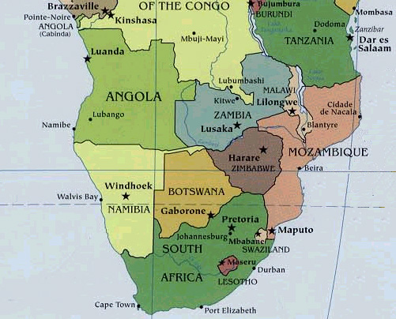

Slide 4
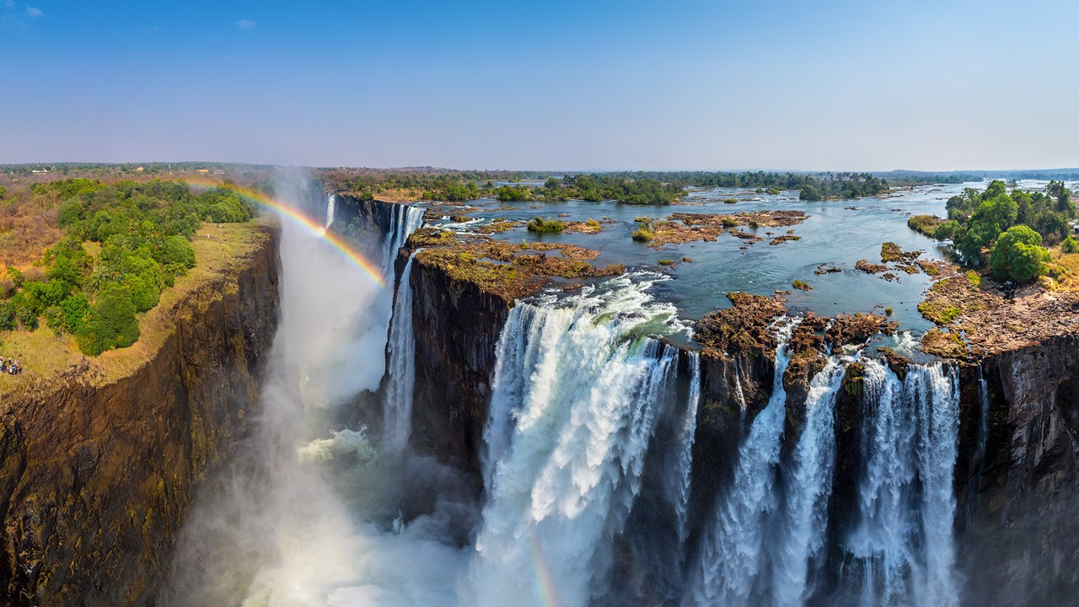

Slide 5
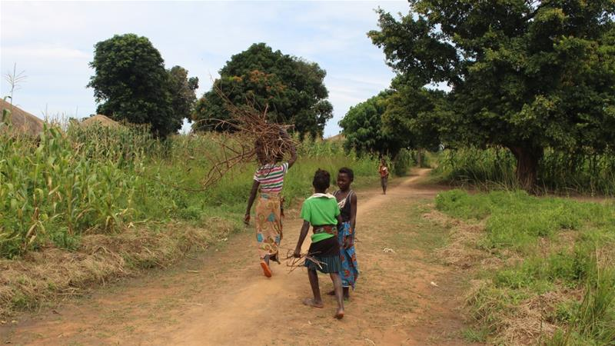

Slide 6
The Simple End Time Faith

Slide 7
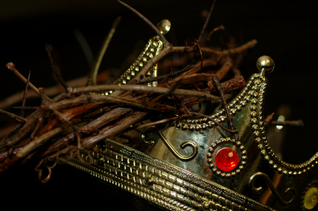
Kings & Priests
REVELATION 5:9
And they sung a new song, saying, Thou art worthy to take the book, and to open the seals thereof: for thou wast slain, and hast redeemed us to God by thy blood out of every kindred, and tongue, and people, and nation;
10 And hast made us unto our God kings and priests: and we shall reign on the earth.

Slide 8
LEADERSHIP
190 We're supposed to represent God and Eternal Life. There's only one form of Eternal Life, and that's God. And we are products of His, because we're genes of His Spirit.
Then we should conduct ourself, women and men, like the Bible said for us to do; Christian gentlemen, sons and daughters of God, borned of the Spirit of God, manifesting the Light in our days and scattering It.
65-1207

Slide 9
IS.YOUR.LIFE.WORTHY.OF.THE.GOSPEL
158 When He came into the world, when there was more, as much unbelief in the world right then as there ever was, it didn't even slow Him up. He went right on preaching just the same, and healing just the same.
Never bothered Him. There was critics. The Man was criticized from the time He was a baby until He died on the cross. Did it stop Him? No, sir. What was His goal? "Always do that which the Father has written. Always do which pleased Him.“ 63-0630

Slide 10
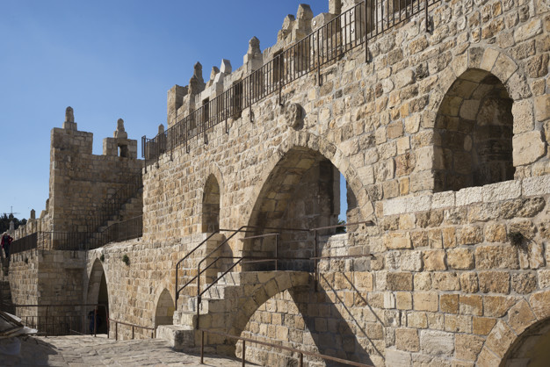

Slide 11
Salvation
Praise

Slide 12
ISAIAH 62:10-12
Go through, go through the gates; prepare ye the way of the people; cast up, cast up the highway; gather out the stones; lift up a standard for the people. 11 Behold, the LORD hath proclaimed unto the end of the world, Say ye to the daughter of Zion, Behold, thy salvation cometh; behold, his reward is with him, and his work before him. 12 And they shall call them, The holy people, The redeemed of the LORD: and thou shalt be called, Sought out, A city not forsaken.

Slide 13
Is. 62:10-12
Go out through the gates! Prepare the highway for my people to return! Smooth out the road; pull out the boulders; raise a flag for all the nations to see. 11 The Lord has sent this message to every land: Tell the people of Israel, ‘Look, your Savior is coming. See, he brings his reward with him as he comes.’”
(NLT)

Slide 14
God: New Birth
Our Witness
Outsiders
The Church
Local Body
Me
Walk in wisdom toward them that are without, redeeming the time.
(Col. 4:5)
So we, being many, are one body in Christ, and every one members one of another. (Rom. 12:5)

Slide 15
Pulpit
Congregation

Slide 16
RESURRECTION.OF.LAZARUS
24 Notice the Angel of God will perform His Word. He'll bring His Word to pass regardless. When the season comes, harvesters are ripe, God is going to send His Word and perform His things. Today I believe that God is going to call a people out of the Gentiles for His Name in this great latter movement here of a revival sweeping the nation. And if the holiness people don't want it, He will raise it up out of something else. It's got to come. He's able of these stones… 50-0813

Slide 17
IMAGES.OF.CHRIST
25 I don't care how intellectual you are, we still got canary brains, because we're only human beings. God's knowed by the Spirit and by the revelation by the Holy Ghost. We'll never be able to understand Him through intellectuals… You can explain, and say the people that cry and turn the other cheek are just the old fashion.
But that's the man that's reflecting Christ in his life, a man who is humble. A man who will walk with God will act like Jesus.
59-0525

