Slide 1
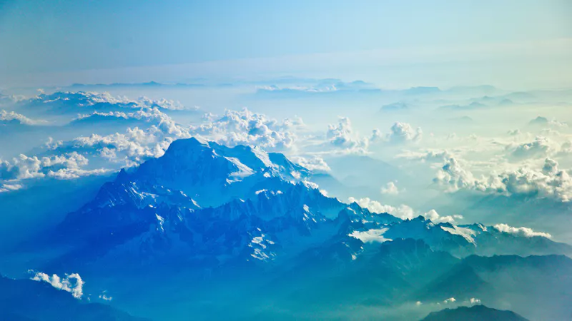
Above All Else
Ex. 19:5
The Christian Personality
He that cometh from above is above all: he that is of the earth is earthly, and speaketh of the earth: he that cometh from heaven is above all. JOHN 3:31

Slide 2
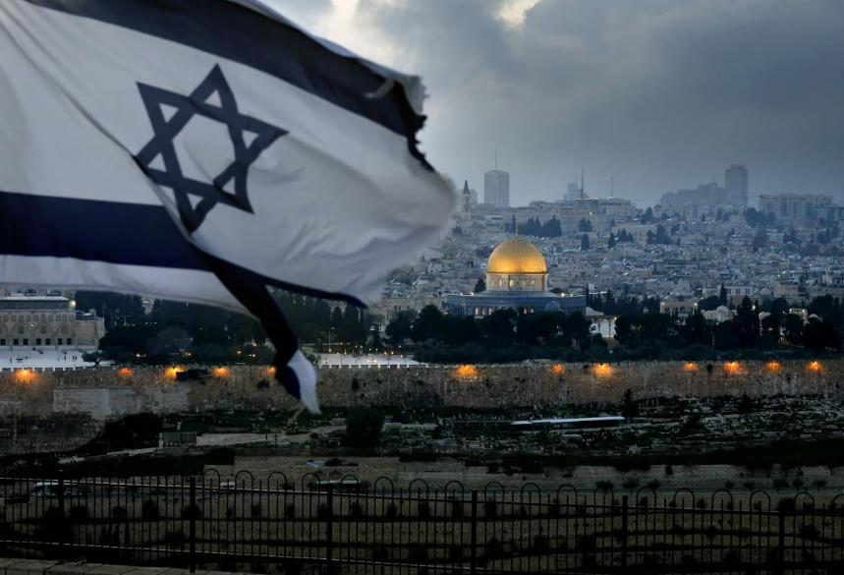

Slide 3
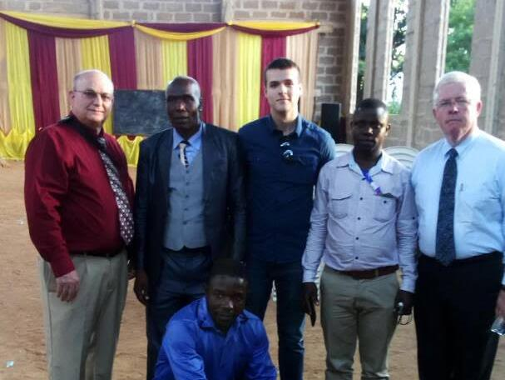
Mwanza, Tanzania

Slide 4
LEADERSHIP
28 Then after mother leads us, a time we have to get a little wisdom, to understand, from daddy, then we get another. We get another leader, a good school teacher… It's a good thing, a good teacher, to teach you right. But after you leave that teacher, one teacher after the other one, from a little first grade, on till you get out of high school or go to college. Then when you leave college, then the teacher is through leading you. The teacher has taught you how to read and write right. But now you are leaving papa, mama, and the teacher, now somebody has to take you from here on. Now who do you want to take you from here on? That's right. Jesus, to take you from there on.
65-1031

Slide 5
Above All Else
Ex. 19:5
The Christian Personality
He that cometh from above is above all: he that is of the earth is earthly, and speaketh of the earth: he that cometh from heaven is above all. JOHN 3:31

Slide 6
VICTORY.DAY
158 He told [Joshua] exactly what to do, and the walls of Jericho fell down. How? The natural man looking through the glass, "Now, here, You brought me over here, and here I am. Look at the opposition…. If we ever get close to that wall, woe unto us. They got rocks, the big slings. They got spears. They got bows. And they just..."
But, see, Joshua put God first.
63-0421

Slide 7
BY.FAITH.MOSES
5 …And duly seeing this (2nd Coming), knowing that our number is just about to be called as a nation, knowing that the church is about to take it's rapture, it moves the heart of a minister or laity to know, that we're in this day and time. It's the greatest time that any person ever lived on the earth, is right now--that is, for the church.
58-0720

Slide 8
NUMBERS 12:3
(Now the man Moses was very meek, above all the men which were upon the face of the earth.)
DEUT. 10:15 Only the LORD had a delight in thy fathers to love them, and he chose their seed after them, even you above all people, as it is this day.
DEUT. 14:2 For thou art an holy people unto the LORD thy God, and the LORD hath chosen thee to be a peculiar people unto himself, above all the nations that are upon the earth.

Slide 9
SEED.IS.NOT.HEIR.WITH.THE.SHUCK
2 Dear God, we deem this a great privilege, tonight, to be here upon this occasion, to bring a living Christ to a dying world and a dying generation.
5 Heal the sick and afflicted. May there not be any feeble among us after the service tonight. And above all things, may there not be one unbeliever left, Lord. May they all believe to Eternal Life, for that's our purpose of gathering here.
65-0218

Slide 10
ESTHER 2:17
And the king loved Esther above all the women, and she obtained grace and favour in his sight more than all the virgins; so that he set the royal crown upon her head, and made her queen instead of Vashti.
JEREMIAH 17:9
The heart is deceitful above all things, and desperately wicked: who can know it?

Slide 11
(Neg.) GENESIS 3:14
And the LORD God said unto the serpent, Because thou hast done this, thou art cursed above all cattle, and above every beast of the field;
I KINGS 16:30
And Ahab the son of Omri did evil in the sight of the LORD above all that were before him.

Slide 12
(Neg.) II THES. 2:3-4
Let no man deceive you by any means: for that day shall not come, except there come a falling away first, and that man of sin be revealed, the son of perdition; 4 Who opposeth and exalteth himself above all that is called God, or that is worshipped; so that he as God sitteth in the temple of God, shewing himself that he is God.

Slide 13
COLOSSIANS 3:12
Put on therefore, as the elect of God, holy and beloved, bowels of mercies, kindness, humbleness of mind, meekness, longsuffering; 13 Forbearing one another, and forgiving one another, if any man have a quarrel against any: even as Christ forgave you, so also do ye. 14 And above all these things put on charity, which is the bond of perfectness. 15 And let the peace of God rule in your hearts, to the which also ye are called in one body; and be ye thankful.

Slide 14
III JOHN 1:2
Beloved, I wish above all things that thou mayest prosper and be in health, even as thy soul prospereth.

Slide 15
HE.SWORE.BY.HIMSELF
God's obligated to His Word. Then God went down there and sent a saviour, here come Moses, leading the children of Israel out.
When they come out in the wilderness, "Oh, give us something to do. We want to form an organization, Give us a law to keep." Exodus 19 was the greatest mistake that Israel ever made. When grace had already provided their salvation, then they wanted something to do to merit it. God already swore to Abraham, what He was going to go. They said, "Let us have the law." And the law never did... No one never kept it. They never did.
54-1212

Slide 16
EXODUS 19:3-7
And Moses went up unto God… 4 Ye have seen what I did unto the Egyptians, and how I bare you on eagles' wings, and brought you unto myself. 5 Now therefore, if ye will obey my voice indeed, and keep my covenant, then ye shall be a peculiar treasure unto me above all people: for all the earth is mine: 6 And ye shall be unto me a kingdom of priests, and an holy nation. These are the words which thou shalt speak unto the children of Israel. 7 And Moses came and called for the elders of the people, and laid before their faces all these words which the LORD commanded him.

Slide 17
EXODUS 15:24
And the people murmured against Moses, saying, What shall we drink? 25 And he cried unto the LORD; and the LORD shewed him a tree, which when he had cast into the waters, the waters were made sweet: there he made for them a statute and an ordinance, and there he proved them, 26 And said, If thou wilt diligently hearken to the voice of the LORD thy God, and wilt do that which is right in his sight, and wilt give ear to his command-ments, and keep all his statutes, I will put none of these diseases upon thee, which I have brought upon the Egyptians: for I am the LORD that healeth thee.

Slide 18
THE.FIRST.SEAL
76 At the end of the ages, of the church ages, all these evil doers will take place and head up in the tribulation. All of these evil doers of the 7 Seals has been working mysterious in the church… Now, it starts back here in a mild form, just keeps getting worse and worse, on down until... And people go right into it, saying, "Oh, yes, this is just fine." But in the last days these things are made known. And they finally go so bad until they go plumb into the tribulation period. 63-0318

Slide 19
MATTHEW 19:28
And Jesus said unto them, Verily I say unto you, That ye which have followed me, in the regeneration when the Son of man shall sit in the throne of his glory, ye also shall sit upon twelve thrones, judging the twelve tribes of Israel. 29 And every one that hath forsaken houses, or brethren, or sisters, or father, or mother, or wife, or children, or lands, for my name's sake, shall receive an hundredfold, and shall inherit everlasting life. 30 But many that are first shall be last; and the last shall be first.

Slide 20
MATTHEW 6:31-34
Therefore take no thought, saying, What shall we eat? or, What shall we drink? or, Where-withal shall we be clothed? 32 (For after all these things do the Gentiles seek:) for your heavenly Father knoweth that ye have need of all these things. 33 But seek ye first the kingdom of God, and his righteousness; and all these things shall be added unto you. 34 Take therefore no thought for the morrow: for the morrow shall take thought for the things of itself. Sufficient unto the day is the evil thereof.

Slide 21
EPHESIANS 3:14-21
For this cause I bow my knees unto the Father of our Lord Jesus Christ, 15 Of whom the whole family in heaven and earth is named, 16 That he would grant you, according to the riches of his glory, to be strengthened with might by his Spirit in the inner man…19 And to know the love of Christ, which passeth knowledge, that ye might be filled with all the fulness of God. 20 Now unto him that is able to do exceeding abundantly above all that we ask or think, according to the power that worketh in us, 21 Unto him be glory in the church by Christ Jesus throughout all ages, world without end. Amen.

