Slide 1
I Want to Go in the Rapture But Life is in the Way
ISAIAH 41:10
Fear thou not; for I am with thee: be not dismayed; for I am thy God: I will strengthen thee; yea, I will help thee; yea, I will uphold thee with the right hand of my righteousness.

Slide 2
Birthdays, Anniversaries, Etc.
August 5th Josh Godwin
August 6th Lydie Ivy
August 7th Tracy Rabon
August 8th Ethan & Anna Pritchard
August 9th Andy Irish
August 10th John & Jennifer Cockman
August 12th Dennis & Sue Sheppard
August 14th Sarah Visocky
Sept. 27th Men’s Meeting

Slide 3
UNITING.TIME.AND.SIGN
97 We see nations uniting, the world uniting, communism uniting, churches uniting; and God uniting Hisself with His Bride, until He and the Church is the same; like the family… Never before, since the early church age, was the Pillar of Fire ever among the people.
Never before, did they ever see the things that we are seeing today. This was only made possible when God sent the Seven Seals and give us a sign by It, sent seven Angels down out of Heaven; and bring back that scattered Word...
63-0818

Slide 4
PSALM 34:17-19
The righteous cry, and the LORD heareth, and delivereth them out of all their troubles. 18 The LORD is nigh unto them that are of a broken heart; and saveth such as be of a contrite spirit. 19 Many are the afflictions of the righteous: but the LORD delivereth him out of them all.
Afflictions: (Heb.) ra’
Bad, disagreeable, malignant; unpleasant, giving pain, unhappiness, misery. Displeasing, sad, unhappy, hurtful, vicious in disposition, injury, calamity.

Slide 5
ISAIAH 41:9-13
Fear thou not; for I am with thee: be not dismayed; for I am thy God: I will strengthen thee; yea, I will help thee; yea, I will uphold thee with the right hand of my righteousness.
Dismayed:
sha’ah
To look at, gaze about; look about.
To look away, gaze afar.
To look in dismay, or anxiety.

Slide 6
JOSHUA 1:7-9
Only be thou strong and very courageous, that thou mayest observe to do according to all the law, which Moses my servant commanded thee: turn not from it to the right hand or to the left, that thou mayest prosper whithersoever thou goest… 9 Have not I commanded thee? Be strong and of a good courage; be not afraid, neither be thou dismayed: for the LORD thy God is with thee whithersoever thou goest.

Slide 7
EXODUS 5:6-9
And Pharaoh commanded the same day the taskmasters of the people, and their officers, saying, 7 Ye shall no more give the people straw to make brick, as heretofore: let them go and gather straw for themselves. 8 And the tale of the bricks, which they did make heretofore, ye shall lay upon them; ye shall not diminish ought thereof: for they be idle; therefore they cry, saying, Let us go and sacrifice to our God. 9 Let there more work be laid upon the men, that they may labour therein; and let them not regard vain words.

Slide 8
EXODUS 3:7
And the LORD said, I have surely seen the affliction of my people which are in Egypt, and have heard their cry by reason of their taskmasters; for I know their sorrows;
EXODUS 5:10,13-14
10 And the taskmasters of the people went out, and their officers, and they spake to the people, saying, Thus saith Pharaoh, I will not give you straw.
13 And the taskmasters hasted them, saying, Fulfil your works, your daily tasks, as when there was straw. 14 And the officers of the children of Israel, which Pharaoh's taskmasters had set over them, were beaten, and demanded, Wherefore have ye not fulfilled your task in making brick both yesterday and to day, as heretofore?

Slide 9
DEUTERONOMY 1:21-22
Behold, the LORD thy God hath set the land before thee: go up and possess it, as the LORD God of thy fathers hath said unto thee; fear not, neither be discouraged. 22 And ye came near unto me every one of you, and said, We will send men before us, and they shall search us out the land, and bring us word again by what way we must go up, and into what cities we shall come.

Slide 10
ISAIAH 31:1-3
Woe to them that go down to Egypt for help; and stay on horses, and trust in chariots, because they are many; and in horsemen, because they are very strong; but they look not unto the Holy One of Israel, neither seek the LORD! 2 Yet he also is wise, and will bring evil, and will not call back his words: but will arise against the house of the evildoers, and against the help of them that work iniquity. 3 Now the Egyptians are men, and not God; and their horses flesh, and not spirit. When the LORD shall stretch out his hand, both he that helpeth shall fall, and he that is holpen shall fall down, and they all shall fail together.

Slide 11
GOD.PROVIDING.HEALING.
FOR.THIS.GENERATION
31 The ground has to receive the wheat in order to reproduce life. And you have to receive the Word of God in your heart to produce what the Word says it will be. Every Word of God is a Seed.
And corn will bring forth a corn, wheat a wheat, barley a barley... And if God's Word is a Seed, and It's placed in the human heart, watered by faith, It'll produce anything that God said in His Word that It would do.

Slide 12
If you need salvation, "Come unto Me all ye that labor and heavy laden, I'll give you rest." If you need healing, "He was wounded for your transgressions, with His stripes you were healed." God has provided the sacrifice for sin and sickness.
And worry, and trouble, and sorrows, and all these things, God has provided the Sacrifice. He's here tonight.
54-0719

Slide 13
THE.SPOKEN.WORD
59-1 God said, "David, you're a man after My Own heart." When God creates a man, he's of His kind. David said, "Thy Word have I hid in my heart that I sin not against You, Lord." Only thing he needed was the rain. David would've been all right if he could just had rain, but the Holy Ghost wasn't yet given. He had the Word, and the Word was in him, and he could know It; he said, "I've hid It in my heart, Lord. It won't bloom out and act like It should, but I've hid It there Lord."

Slide 14
But when Jesus came, which was the Word made manifest took the germ life out of it and brings it back to the Word now. And if David's cup run over, what ought ours to do...? Without the Spirit.
62-0318
I PETER 2:1-2
Wherefore laying aside all malice, and all guile, and hypocrisies, and envies, and all evil speakings, 2 As newborn babes, desire the sincere milk of the word, that ye may grow thereby:

Slide 15
Prayer is an Exchange:
MATTHEW 11:28-30
Come unto me, all ye that labour and are heavy laden, and I will give you rest. 29 Take my yoke upon you, and learn of me; for I am meek and lowly in heart: and ye shall find rest unto your souls. 30 For my yoke is easy, and my burden is light.

Slide 16
1. MARK 8:22-25
And he cometh to Bethsaida; and they bring a blind man unto him, and besought him to touch him. 23 And he took the blind man by the hand, and led him out of the town; and when he had spit on his eyes, and put his hands upon him, he asked him if he saw ought. 24 And he looked up, and said, I see men as trees, walking. 25 After that he put his hands again upon his eyes, and made him look up: and he was restored, and saw every man clearly.

Slide 17
PERSEVERANT
19 Now, all Christians must be persistent. They must be perseverant. And the only way that you're able to do this, is to first to have faith in what you're trying to do.
And if you have no faith, you're just jumping at it, then you cannot be perseverant. But when you really know it's the Truth, then there is nothing going to stop you, you are really perseverant then.
64-0619

Slide 18
2. MARK 9:20-23
And they brought him unto him: and when he saw him, straightway the spirit tare him; and he fell on the ground, and wallowed foaming. 21 And he asked his father, How long is it ago since this came unto him? And he said, Of a child. 22 And ofttimes it hath cast him into the fire, and into the waters, to destroy him: but if thou canst do any thing, have compassion on us, and help us. 23 Jesus said unto him, If thou canst believe, all things are possible to him that believeth.

Slide 19
THE.SPOKEN.WORD
37-2 …You say, "Sure, Bro. Branham, every Word, I believe It." Then don't back up… stay right with that Word and watch what happens; …not by some miracles, the devils do that; but by your constant belief in the Word of God and the life that you live, never denying nothing. 62-0318
PSALM 119:114
Thou art my hiding place and my shield: I hope in thy word.

Slide 20
LETTING.OFF.THE.PRESSURE
11 And this great day that we're living where there is so much pressure, everything seems to be pressurized. Such a hard time, everybody's hurrying just as fast as they can go… Shouldn't do that, Christians shouldn't. But here we go, just as hard as we can, rushing…. And we're so nervous.
62-0609

Slide 21
COUNTDOWN
93 Well, you know, they had one took off in slow motion one time. His name was Enoch. He just walked on up, but he was an astronaut. Sure. He was pressurized, he didn't have to be changed, nothing. No, he was already pressurized when he started walking. Just walked right on out of all the dimensions and everything, walked out in the Presence of God.
62-0909M

Slide 22
The Problem:
THE.SPOKEN.WORD
17-3 Now, remember, every spoken Word of God is the original Seed. God planted everything in the earth by His Word, and as long as you stay with the original seed, it will breed itself right back and reproduce itself again. Hybreed it, it dies…
62-0318

Slide 23
HYBRID:
An organism that is the offspring of two parents that differ in one or more inheritable characteristics, especially the offspring of two different varieties of the same species or the offspring of two parents belonging to different species.
The mule, which is the offspring of a male donkey and a female horse, is an example of a hybrid. It is strong for its size and has better endurance and a longer useful lifespan than its parents. However, mules are sterile, as are many animals that are hybrids between two species.

Slide 24
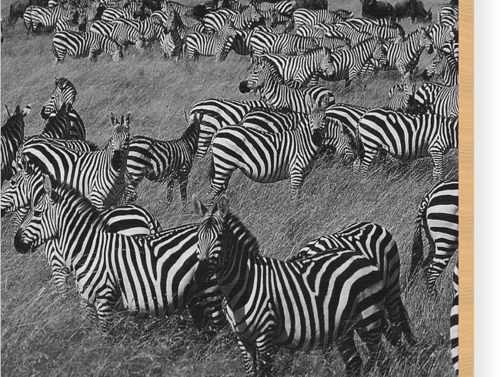

Slide 25
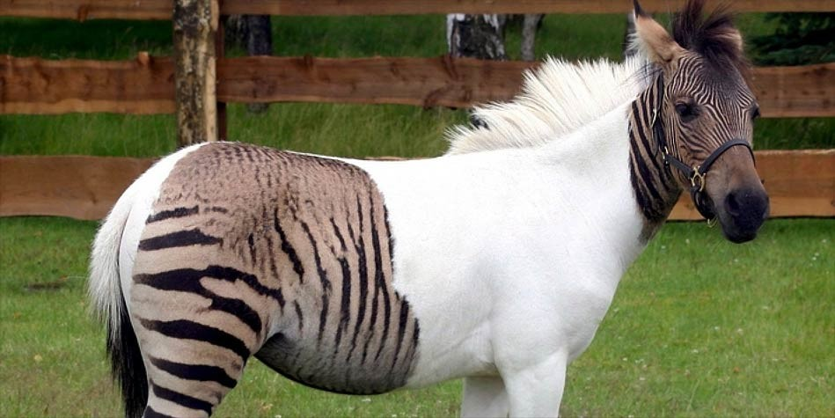
Horse and Zebra

Slide 26
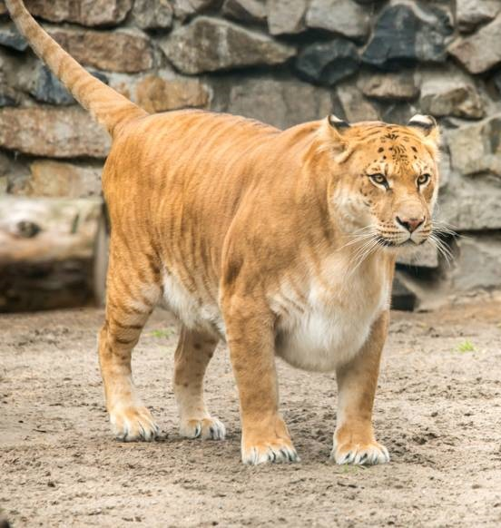
The Liger
The liger is a hybrid offspring of a male lion and a female tiger. The liger has parents in the same genus but of different species. The liger is distinct from the similar hybrid called the tigon, and is the largest of all known extant felines.

Slide 27
HAVING.CONFERENCES
42 I seen so many of them at meetings. You're talking about the baptism of the Holy Ghost; they get up and go home like a mule. They don't know who their father was; just stand there and look, and "Haw, haw. The days of miracles is passed."
Now, a horse ain't like that. He's gentle and sweet... But not a ignorant old mule. Now, he don't know who is papa was, who his mommy was; he can't reproduce himself.

Slide 28
He's just a cross breed. And that's the matter with a lot of so-called Christians today: cross breeds with the world.
No wonder you can't never be settled: double minded, never able to come to the knowledge of the truth. Man's got to know God by the new birth, and be borned and filled with the Holy Ghost stand where Moses stood; stand in the Presence of God and hold a conference.
60-0608

Slide 29
II TIMOTHY 3:1-7
This know also, that in the last days perilous times shall come. 2 For men shall be lovers of their own selves, covetous, boasters, proud, blasphemers, disobedient to parents, unthankful, unholy, 3 Without natural affection, trucebreakers, false accusers, incontinent, fierce, despisers of those that are good, 4 Traitors, heady, highminded, lovers of pleasures more than lovers of God;
5 Having a form of godliness, but denying the power thereof: from such turn away. 6 For of this sort are they which creep into houses, and lead captive silly women laden with sins, led away with divers lusts, 7 Ever learning, and never able to come to the knowledge of the truth.

Slide 30
THE.WAY.BACK
When you die to yourself then you become a new creature. And that's the way the Holy Spirit is. It's not something you smear on... It's a new birth… And these virtues of the Holy Ghost has to come from the inside out. And when world and sin, and cutting hair, and painting comes out against the Word of God, it shows the Holy Spirit's not there.
62-1123

Slide 31
HEBREWS.CHAP. 5-6
138 When the new Birth is come, you are changed. You don't have to do anything to prove it. Your life proves it, as you walk. You're love, peace, long-suffering, gentleness, meekness, patience. That's what you are, the whole world sees the reflection of Jesus Christ in you.
57-0908M

Slide 32
CHRIST.IS.THE.MYSTERY
377 See, He is expressing Himself. That's His purpose. That's why He died… First, to express Hisself in Christ, then express Hisself through the Church. And the same thing, Christ was the Word, and the Church becomes the Word when it lets the Word go through them:"The works that I do shall ye be also.“
The anointed Man; now the anointed people; oh, my, to bring back the anointed Bride and the Bridegroom.

Slide 33
CHURCH.AGE.BOOK
125-2 When the church gets away from the Word it will believe anything. It is like Eve. When Cain was born she said, "I've gotten a man from the Lord." Do you realize she really meant that? You see, once she had been deceived by taking the word of Satan instead of the Word of God, she then thought that whatever she said was right. But God has set laws in His universe.

Slide 34
I PETER 1:22-23
22 Seeing ye have purified your souls in obeying the truth through the Spirit unto unfeigned love of the brethren, see that ye love one another with a pure heart fervently: Being born again, not of corruptible seed, but of incorruptible, by the word of God, which liveth and abideth for ever.

Slide 35
THE.END.TIME.SIGN.SEED
21 Take corn, hybreed it, make a great big ear. All right if you want to eat it on the big ear. But what happens to it? Plant it back; it can't reproduce itself again. It's no good; it's dead. Therefore, anything that wasn't spoke by God in the beginning is a hybrid.
22 And that's the way that people gets away from the Word of God. It becomes a hybrid affair. It must die. It cannot bring forth of its kind to life again.

Slide 36
The church that will refuse to believe the Word of God is a hybrid church with dogmas, creeds, doctrines that's not Scriptural.
That church cannot bring forth a Spirit-filled child, 'cause it's hybrid. It's no good. It might be bigger, great big walls, fine pews, big bells, plush seats. But that doesn't mean one thing. It's spiritually dead.
62-0319

Slide 37
A.TOTAL.DELIVERANCE
78 What would He do if we were one heart and one accord? And the only way we can do that is unify our hearts together with brotherly love, obey the offices of the church, the pastor, and the pastor obey God; then God works through the pastor, through the board, down into the church, all together one unit to the Kingdom of God. Then God will hear when we have a unified group. Let nothing bother you. Don't be dismayed in any-thing. Now, that's the kind of a person that God ordained to take the land. 59-0712

