Slide 1
The Obvious Plan of God 2
I THESSALONIANS 5:9
For God hath not appointed us to wrath, but to obtain salvation by our Lord Jesus Christ,
10 Who died for us, that, whether we wake or sleep, we should live together with him.

Slide 2
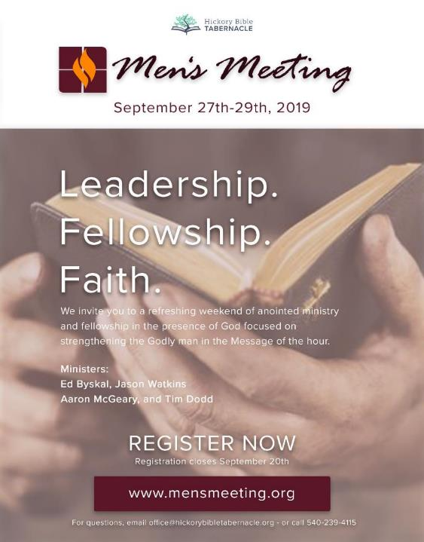
Ministers:
Bro. Tim Dodd
Bro. Ed Byskal
Bro. Aaron McGeary
Bro. Jason Watkins

Slide 4
Birthdays & Anniversaries
Sept. 19th Sarah Coffey
Sept 23rd Cindy Walters
Sept. 24th Gabrielle Walters
Se3pt. 25th Ethan Pritchard, Rebekah Irish
Sept 26th Sue Sheppard
Andy & Jennifer Irish

Slide 5
Your Social Life & The Failure of the Social Gospel
II TIMOTHY 3:1-5
This know also, that in the last days perilous times shall come. 2 For men shall be lovers of their own selves, covetous, boasters, proud, blasphemers, disobedient to parents, unthankful, unholy, 3 Without natural affection, trucebreakers, false accusers, incontinent, fierce, despisers of those that are good, 4 Traitors, heady, highminded, lovers of pleasures more than lovers of God; 5 Having a form of godliness, but denying the power thereof: from such turn away (shun).

Slide 6
ENTICING.SPIRITS
51 Give me a preacher; give me a Christian; a housewife that's a Christian; a farmer or a factory worker that'll put God first in everything, I'll show you a man that'll be successful in the spite of all the devil can put on him. He seeks God first.
55-0724

Slide 7
WHAT.HEAREST.THOU.ELIJAH
24 We Pentecostal people have gotten to such a place, if we go to a service and every-body's not running the aisles, speaking with tongues, jumping over the seats, we didn't have any meeting. It would pay us to set still till we hear something from heaven: a still small Voice.
We need apostolic teaching, apostolic power. That apostolic power is not altogether noise; it's the Holy Spirit and the love of God that makes us wanting Christ Jesus.
59-0609

Slide 8
JOHN 16:16-19
A little while, and ye shall not see me: and again, a little while, and ye shall see me, because I go to the Father. 17 Then said some of his disciples among themselves, What is this that he saith unto us, A little while, and ye shall not see me: and again, a little while, and ye shall see me: and, Because I go to the Father? 18 They said therefore, What is this that he saith, A little while? we cannot tell what he saith. 19 Now Jesus knew that they were desirous to ask him, and said unto them, Do ye enquire among yourselves of that I said, A little while, and ye shall not see me: and again, a little while, and ye shall see me?

Slide 9
I THES. 4:13-17
But I would not have you to be ignorant, brethren, concerning them which are asleep, that ye sorrow not, even as others which have no hope. 14 For if we believe that Jesus died and rose again, even so them also which sleep in Jesus will God bring with him 15 For this we say unto you by the word of the Lord, that we which are alive and remain unto the coming of the Lord shall not prevent them which are asleep. 16 For the Lord himself shall descend from heaven with a shout, with the voice of the archangel, and with the trump of God: and the dead in Christ shall rise first: 17 Then we which are alive and remain shall be caught up together with them in the clouds, to meet the Lord in the air: and so shall we ever be with the Lord.

Slide 10
I THES. 5:6-9
Therefore let us not sleep, as do others; but let us watch and be sober. 7 For they that sleep sleep in the night; and they that be drunken are drunken in the night. 8 But let us, who are of the day, be sober, putting on the breastplate of faith and love; and for an helmet, the hope of salvation. 9 For God hath not appointed us to wrath, but to obtain salvation by our Lord Jesus Christ, 10 Who died for us, that, whether we wake or sleep, we should live together with him.

Slide 11
LUKE 11:11, 13
If a son shall ask bread of any of you that is a father, will he give him a stone? or if he ask a fish, will he for a fish give him a serpent? 13 If ye then, being evil, know how to give good gifts unto your children: how much more shall your heavenly Father give the Holy Spirit to them that ask him?
THE.GREATEST.BATTLE.EVER.FOUGHT
339 …This helmet? It's a protection. What is a helmet made out of? Brass, salvation, knowing "And my healing comes from God. My salvation comes from God. My experience matches His Word, not the churches idea, the Word!" Helmet of salvation, deliverance. 62-0311

Slide 12
DESPERATIONS
14 The Lutherans allowed it to, "Accepting the Word; accepting Christ as personal Saviour." The Methodists, “When you get happy enough….” The Pentecostal, "Speak in tongues..." And we find out that all of it was wrong.
The Token is the Token. It's you and Christ as persons together. It's the Holy Spirit, His Life in you, working His Own Life through you.
63-0901

Slide 13
TOKEN
77 But… under this covenant, there is a difference between the Blood and the Life. The Token for the believer today is the Holy Ghost; not blood (chemistry) but It is the Holy Spirit of God. The Token that God requires of the Church today. God must see this Token in every one of us.
18 Now, just not no certain evidence. Say, “[How] will I know?“ Look, what were you, and what are you? There is how you know. What was you before this Token was applied and after It's applied? What was your desires before, and after? Then you know whether the Token is applied or not. And these other things just automatically go with That. 63-0901

Slide 14
THE.UNPARDONABLE.SIN
145 And when you've got the baptism of the Holy Ghost, with the power of God working in your life, and make you live humbly and peaceful in this present world, day after day, week after week, year after year, they know where you're standing.
David said, "It'll be like a tree that's planted by the rivers of water. Whatever he does will prosper. He will not wither in a drought, because he's planted by the rivers of water.“
54-1024

Slide 15
TOKEN.THE
131 You see men wearing pink shoes... That's a disgrace. I like to see men again that's absolutely men. Looks like there's a power that drives them to do it; it's the devil and the pressure of this day... Let men be men. Let women be feminish; be ladies.
When the Token's applied, they turn back to that. God made them different, and they are different. Men wants to look like women; women wants to look like men.

Slide 16
HEBREWS. 3
40 Paul had an experience. How many believes experience comes by conversion? Sure. If it hasn't, I would doubt the conversion. A conversion brings experience.
And you can't lot it to anything now. Sometimes it might be shouting. Sometimes it might be speaking with tongues. Sometimes it might be weeping… groaning. You don't know what it is, so don't try to lot it. Because, every one of you has proved to be wrong in it…

Slide 17
42 So, that's all up to God. He makes a choice. He brings things together, that's the way it is. If your spirit is bearing record with His Spirit, that you're sons and daughters of God... All the old evil has dropped away, everything has become new, and you're living in love, got peace, and grace, you're getting pretty close to the Kingdom then. Because, the Life that's in you is producing that kind of a life.
57-0901

Slide 18
II CORINTHIANS 5:17
Therefore if any man be in Christ, he is a new creature: old things are passed away; behold, all things are become new.
LIFE
59 I asked a man on the West Coast; "Sir, are you a Christian?“ He said, "I'm an American."
I said, "That don't have one thing to do with it, not a thing.“ Walking through a pig pen don't make you a pig. You've got to be born again, then your habits are different. 58-0519

Slide 19
The Cruelty Of Sin…
74 But, brother, unless a man is born again, he’ll perish. He’s got to be born again. Now, the Golden Rule is all right; that, a moral man can do that. But it’s got to be all in the supernatural line. And you’ll see what God had to do in order that we could be supernaturally born.
75 Now “religion” means “covering.” This coat is a moral religion to me, because it covers my being.

Slide 20
And your clothes is the same way. Notice Adam, his fig leaves were all right as long as he didn’t have to face God. But when he had to face God, he realized his fig leaves was no good.
And now, friend, you might think you’re a pretty good person, see, and you might be. But when you come to face God, if you haven’t accepted God’s provided Sacrifice for you, you’re lost and you’ll know it.
53-0403

Slide 21
God's Provided Way"
22 Brethren, there’s no big me, little you then, when you come by the way of the Door. (wedding garment) He come in some other way besides of the door. And Jesus said, “Friend, what are you doing here?” And he was speechless.
You try to climb up your own moral step-ladder or by some creed, some church, you’re going to find yourself the same way. Every man that comes by the Door is going to get the same robe. And that robe is the baptism of the Holy Ghost. Every man pays the same price.
53-0613

Slide 22
QUESTIONS & ANSWERS.2
281. Dear Bro. Branham, I have been baptized in Jesus' Name. The Word says you shall receive the gift of the Holy Ghost. Does this mean the baptism, the Holy Spirit, or does it mean I should receive a definite experience with the baptism? I am anxious to be filled with the Spirit.
64-0823

Slide 23
Now, there's a good question. The baptism with the Holy Spirit is a definite experience that a person must receive. Now let me kinda clear that up. I speak of not believing the initial evidence of the Holy Ghost is speaking with tongues (I do not accept that) 'cause the speaking in tongues is a gift of the Holy Ghost… Divine healing is a gift of the Holy Ghost, and here Beatles are doing it. Satan can impersonate any of those gifts.

Slide 24
Now, that's no evidence of the Holy Ghost. You can't rely upon that. You can't rely upon the fruit of the Spirit, because the first fruit of the Spirit is love. And the Christian Science exercise more love than anybody I know of, and they even deny Jesus Christ being Divine.
There's only one evidence of the Holy Spirit that I know of, and that is a genuine faith in the promised Word of the hour… not the Word for the day of Moses; day of Noah, not the day of Elijah, etc.

Slide 25
Same thing repeats. That's the evidence of the Holy Ghost, when God reveals to you and you see it, THUS SAITH THE LORD and accept it. Not what you are, you was, it's what God has done for you now. There's the evidence. Jesus give us the evidence of the Holy Ghost, John 14, "I have many things to tell you. I haven't got time to do it, but when the Holy Ghost comes, He will tell you, bring to your memory the things that I told you about, and will also show you things that is to come." There's the evidence.

