Slide 1
Your Social Life & The Failure of the Social Gospel 2
I JOHN 2:15
Love not the world, neither the things that are in the world. If any man love the world, the love of the Father is not in him.
II TIMOTHY 3:1,5
This know also, that in the last days perilous times shall come. 5 Having a form of godliness, but denying the power thereof: from such turn away (shun).

Slide 2
BEHOLD.I.STAND.AT.THE.DOOR & KNOCK
35 We need a cleaning up all the way from the pulpit plumb to the janitor. No wonder this Laodicean Church, lukewarm... There's something wrong, or we'd have a revival sweeping the world right now. Something went wrong. If Satan can't come in one way, he will another.
"I stand at the door and knock." "Don't fool with my private life." And some of you women, card-playing, out here in these... And some of the men even taken a little social drink, why, it's a disgrace.
58-0617

Slide 3
A.BLUSHING.PROPHET
10 Why, my dear brother and sister, the morals of this nation has become so low till it would make a dog ashamed, make a hound blush... The [things] that the nation has done, the people has done, it's all the lack of _______________.

Slide 4
A.BLUSHING.PROPHET
10 Why, my dear brother and sister, the morals of this nation has become so low till it would make a dog ashamed, make a hound blush... The [things] that the nation has done, the people has done, it's all the lack of prayer.
The church that used to didn't believe in picture shows. They would shun picture shows. They have the picture show in their own house. Every house has a television.

Slide 5
In the place where they used to think it was wrong to drink beer, in a place where they used to think, John Barleycorn, what a great ornery fellow he was... Today sixty percent of so-called Christians take a social drink at least once a year. Then they get on a big spree around Christmas when they have their celebration. Because they have adopted education to take the place of salvation. It'll never do it. What we need is a revival.
56-1125

Slide 6
PAINTED.FACE.JEZEBEL
46 Now, it ain't paint [makeup], scissors that cuts your hair that bothers you. It's that spirit in you that makes you go get it. Max Factor could make all of it he wanted to and lay it over there, and if you was a Christian you'd never touch it.
I mean if you was baptized with the Holy Ghost, living where you ought to live, and your pastor preach the truth and let you know about it. You wouldn't even care a bit.
56-1005

Slide 7
CONFERENCE.WITH.GOD
80 A stranger... First thing, you're seeking salvation. You're an alcoholic. You're not from this city… it's Newcastle… I condemn that devil in you that makes you drink alcohol.
Go home in the Name of Jesus Christ and never drink again, be baptized in His precious Name, taking away sins. And I condemn the devil, may he pass from you. Amen. Go home. Your sins are forgiven now. Go, and sin no more.
59-1220

Slide 8
PROVERBS 23:19
Hear thou, my son, and be wise, and guide thine heart in the way. 20 Be not among winebibbers (given to wine, a wino); among riotous eaters of flesh: 21 For the drunkard and the glutton shall come to poverty: and drowsiness shall clothe a man with rags.

Slide 9
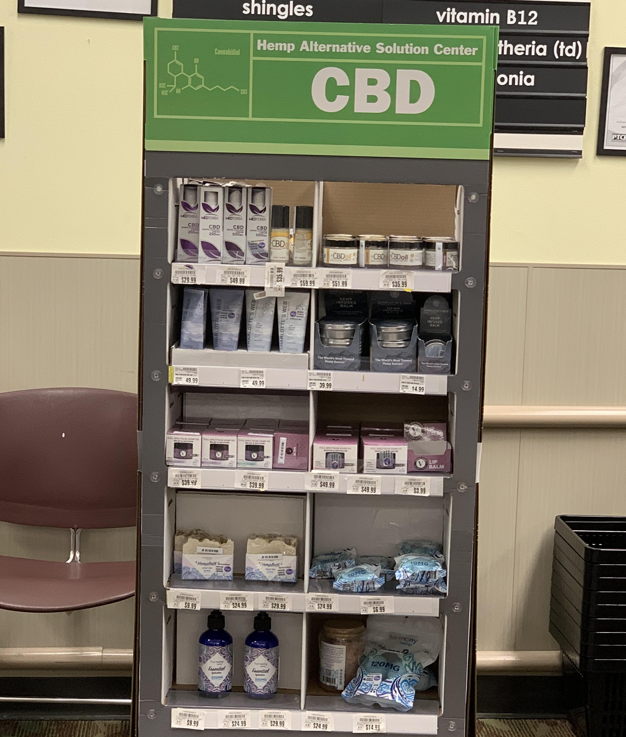

Slide 10
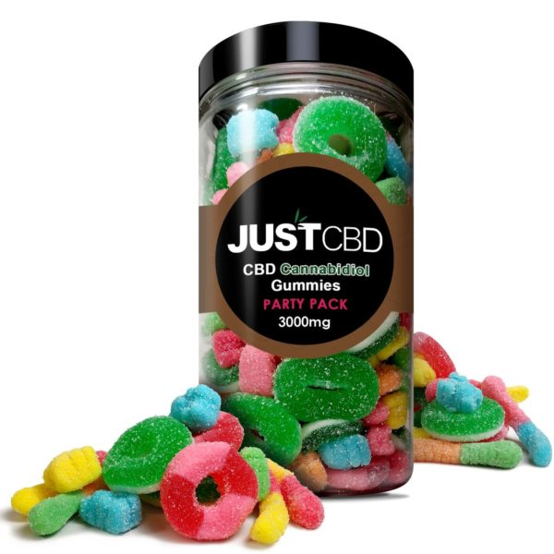

Slide 11
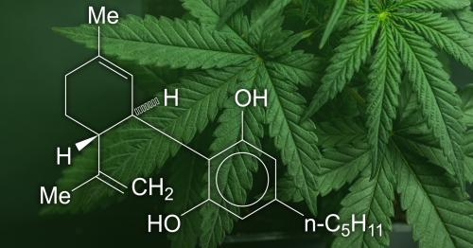
What You Need to Know (And What We’re Working to Find Out) About Products Containing Cannabis or Cannabis-derived Compounds, Including CBD
The U.S. FDA recognizes the significant public interest in cannabis and cannabis-derived compounds, particularly CBD. However, there are many unanswered questions about the science, safety, and quality of products containing CBD. The Agency is working on answering these questions through ongoing efforts including feedback from a recent FDA hearing and information and data gathering through a public docket.

Slide 12
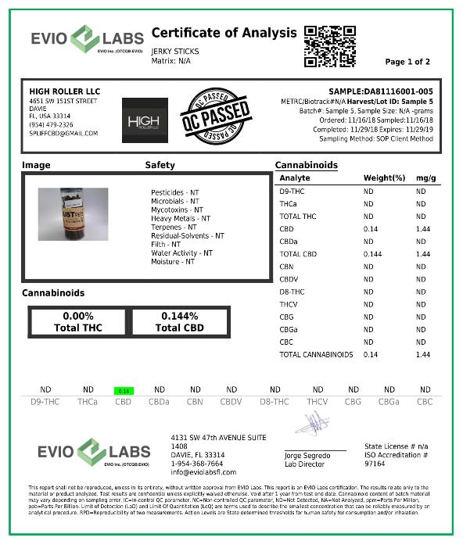
Corporate Office:
Kaycha Labs &
The Hemp Institute
(Owners of Evio Labs)
4101 SW 47th Ave, Suite 105 Davie, FL 33314

Slide 13
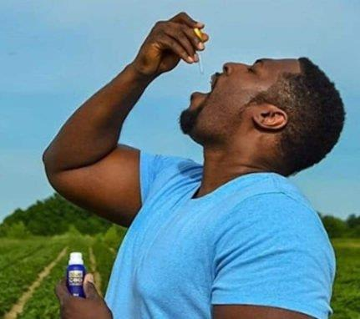
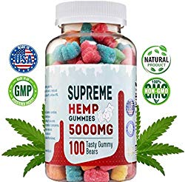
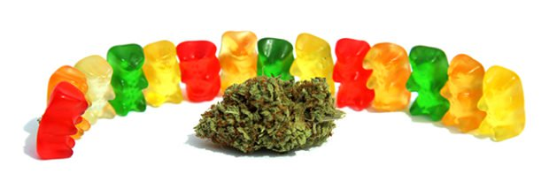
“CBD gummies are candies that have a specific amount of CBD oil in them. Some of the ingredients are sugar, flavor, corn syrup, cane juice, and preservatives.
Normally, there are zero traces of THC and are not going to affect your brain and they do not alter your mind.”

Slide 14
FDA Warns Company Marketing Unapproved Cannabidiol Products With Unsubstantiated Claims To Treat Cancer, Alzheimer’s Disease, Opioid Withdrawal, Pain & Pet Anxiety
Agency is expediting work to evaluate regulatory policies related to cannabis and cannabis-derived ingredients like CBD
Today, the U.S. FDA announced that it has issued a warning letter to Curaleaf Inc., (Wakefield, MA), for illegally selling unapproved products containing CBD online with unsubstantiated claims that the products treat cancer, Alzheimer’s disease, opioid withdrawal, pain and pet anxiety, among other conditions or diseases.

Slide 15
“As we examine potential regulatory pathways for the lawful marketing of products containing cannabis and cannabis-derived compounds (CBD), protecting and promoting public health remains our top priority. Selling unapproved products with unsubstantiated therapeutic claims — that CBD products can treat serious diseases — can put patients and consumers at risk by leading them to put off important medical care. Additionally, there are many unanswered questions about the science, safety, effectiveness and quality of unapproved products containing CBD,” Acting FDA Comm. Sharpless, M.D.

Slide 16
Other than one prescription human drug product to treat rare, severe forms of epilepsy, FDA has not approved any other CBD products, there is very limited information for other marketed CBD products, which likely differ in composition from the FDA-approved product and not evaluated for potential adverse effects on the body.
Unlike drugs approved by the FDA, the manufacture of these products has not been subject to FDA review as part of the drug approval process, and there has been no FDA evaluation of whether these products are effective for their intended use, what the proper dosage is, how they could interact with FDA-approved drugs, or whether they have dangerous side effects or other safety concerns.

Slide 17
JOURNAL ARTICLE: Religious Traditions, Parents, & Peers as Determinants of Alcohol & Drug Use among College Students
H. Wesley Perkins/ Review of Religious Research/ Vol. 27, No. 1 (Sep., 1985), pp. 15-31
Relationships between religions and drinking/ drug use among college students are examined in the context of family backgrounds and peer relations using data from a survey of an entire undergraduate college population… For both alcohol consumption and other drug use, friendship environments are the primary influences, while parental attitudes appear to play little direct part in student behavior. Amid peer influences, a relatively strong faith commitment to a Judeo-Christian tradition remains as a significant moderating influence on alcohol/other drug use.
https://www.jstor.org/stable/3511935?seq=1#page_scan_tab_contents

Slide 18
QUESTIONS.AND.ANSWERS.4
390 Bro. Branham, what activities should our preteen children participate in. Also, how should we go about helping them select their associates?
Keep them in Christian company as long as you possibly can. If it's a girl, keep her with Christian girls; Christian boys, vice versa. If she's old enough to go with a boy, see that she keeps with the right kind of boy.

Slide 19
Discourage her to any boy otherwise, or boy to a girl. If she's going with an unbeliever, try to encourage her to go with a believer, and vice versa. Make your home nice. Make your home a place where your daughter or son will not be ashamed to bring their company before their father and mother, and into their house; and make home so happy that they'll be pleased in their home to stay there. 64-0830

Slide 20
CHURCH.AGE.BOOK
47-2 Oh, that people might come unto Him and find that rest. There is a cry in all hearts for that rest but the majority don't know the answer. So they try to still the cry by a religious process of keeping certain days or accepting creeds and dogmas. Failing that, many try drinking, carousing, and every physical excess, thinking that by worldly pleasures there can be satisfaction. But in such there is no rest. They smoke and take pills to quiet their nerves. But there is no rest in earthly potions. They need Jesus. They need the heavenly remedy, the rest of the Spirit.

Slide 21
A.DOOR.IN.A.DOOR
142 First, as you go into the human heart, on the right side as you go in, there's a little door there, called "my private life." Now, you don't want nobody fooling in that private life, we want our own private life. "If we want a social drink with the neighbor, that's our business. If we women would want to cut our hair… That's our own American privilege. If we want to wear shorts, that's our business."

Slide 22
Well, that's true. "If we men want to take a sociable drink, and if we want to let our wife do that, you ain't got no business saying one word to us.“
But the Gospel said, "Don't do it." Now, whose word is right? God's Word is right. 63-0223

Slide 23
CHRIST.IS.THE.MYSTERY
387 "By one Spirit we are baptized into this Body," born of His Spirit, then we belong to a Kingdom. And our lives are not Americans, not Germans, we're not nothing; we are Christians. We are settled, and walk in the Spirit, a love-slave, from the things of the world.
And our rights to the world, we've sold out and bought this Pearl of Great Price, and walk and letting the Holy Spirit manifest Itself. That's what His real Church is.
63-0728

Slide 24
What is the “Social Gospel”?

Slide 25
II TIMOTHY 3:1-5
This know also, that in the last days perilous times shall come. 2 For men shall be lovers of their own selves, covetous, boasters, proud, blasphemers, disobedient to parents, unthankful, unholy, 3 Without natural affection, trucebreakers, false accusers, incontinent, fierce, despisers of those that are good, 4 Traitors, heady, highminded, lovers of pleasures more than lovers of God; 5 Having a form of godliness, but denying the power thereof: from such turn away (shun).

Slide 26
ANOINTED.ONES.AT.THE.END.TIME
This know also, that in the last days...
Underline that, "last days." That's when it's going to happen.
...perilous times shall come. (We're in it.)
For men shall be lovers of their own selves, covetous, boasters, proud, blasphemers, disobedient to parents, unthankful, unholy,
65-0725

Slide 27
WHO.IS.GOD
4 I'm happy tonight to know that people still believe in the Blood, the Blood of Christ. And I do not believe in this social gospel they have today, these cults that go around saying, "Well, there's no such a thing as the Blood, and the Holy Spirit." You're not a Christian when you do that. You can't be. You can't be a Christian without being borned again. You can't be, no matter what you try to profess.
50-0815

Slide 28
THE.INVISIBLE.UNION
51 Today, we see the church natural, in your intellectual gospel, going further and further away from the Word, in social gospel; we find that the women of the world, on the streets, members of such, is carrying themselves in the same atmosphere. You can't tell them.
They've lost all sense of common decency, the people have. And that's the way the church has… And there she is. That's her behavior.
65-1125

Slide 29
LIFE
17 I was talking to a woman here not long ago... I don't call people's religions out, but... they claim they believe in healing, but they don't believe that Jesus was no more than just a philosopher. And that's a social gospel. They said, "He's a good man.
58-0519

Slide 30
ROMANS 13:11-14
And that, knowing the time, that now it is high time to awake out of sleep: for now is our salvation nearer than when we believed. 12 The night is far spent, the day is at hand: let us therefore cast off the works of darkness, and let us put on the armour of light. 13 Let us walk honestly, as in the day; not in rioting and drunkenness, not in chambering and wantonness, not in strife and envying. 14 But put ye on the Lord Jesus Christ, and make not provision for the flesh, to fulfil the lusts thereof.

Slide 31
LOOKING.AT.THE.UNSEEN
15 Now, if God can come on the control tower... "My sheep know My voice." Well, if all these strange voices in the world of this social Gospel that just belong to church and that's all is necessary, why hasn't it done something? It's done nothing but confuse the people. What we need tonight is a unified church, filled with the Holy Ghost and power from on high, led by the Spirit of the living God on the control tower…
59-0410

Slide 32
PROVERBS 23:29
Who hath woe? who hath sorrow? who hath contentions? who hath babbling? who hath wounds without cause? who hath redness of eyes? 30 They that tarry long at the wine; they that go to seek mixed wine. 31 Look not thou upon the wine when it is red, when it giveth his colour in the cup, when it moveth itself aright. 32 At the last it biteth like a serpent, and stingeth like an adder. 33 Thine eyes shall behold strange women, and thine heart shall utter perverse things.

Slide 33
GALATIANS 5:19
Now the works of the flesh are manifest, which are these; Adultery, fornication, uncleanness, lasciviousness, 20 Idolatry, witchcraft, hatred, variance, emulations, wrath, strife, seditions, heresies, 21 Envyings, murders, drunkenness, revellings, and such like: of the which I tell you before, as I have also told you in time past, that they which do such things shall not inherit the kingdom of God.

Slide 34
Revellings: (Gr.) komos
A nocturnal and riotous procession of half drunken and frolicsome fellows who after supper parade through the streets with torches and music in honour of Bacchus or some other deity, and sing and play before houses of male and female friends; hence used generally of feasts and drinking parties that are protracted till late at night and indulge in revelry.

Slide 35
I PETER 4:1
Forasmuch then as Christ hath suffered for us in the flesh, arm yourselves likewise with the same mind: for he that hath suffered in the flesh hath ceased from sin; 2 That he no longer should live the rest of his time in the flesh to the lusts of men, but to the will of God. 3 For the time past of our life may suffice us to have wrought the will of the Gentiles, when we walked in lasciviousness, lusts, excess of wine, revellings, banquetings, and abominable idolatries:

Slide 36
THE.WORLD.IS.FALLING.APART
224 I said, "it's not juvenile delinquency. It's parent delinquency. The parents is the delinquents, that's right, letting their kids do like that." You put a True Story magazine on your table, instead of the Bible. Instead of prayer meetings, you had to run out somewhere and do something else. That's what's the matter with the world today, with our so-called Christians; dancing, parties, social drinking, everything. It's parent delinquency, not child delinquency. 63-0412

Slide 37
ENTICING.SPIRITS
165 All the diseases here in this building, diseased people, knowing that they're devils too, God, as Your servant, I rebuke them in Jesus' Name… And may every unclean person that's got unclean thoughts, vulgar, lusts, men and women alike, God, take it out of them. All these here trying to get rid of cigarettes, and little social drinks, little parties, and selfish things. God stimulate their heart with the Holy Ghost in such a way that those things don't have any desire no more.

Slide 38
It'll have no room; you're so full of the Holy Ghost from now on.
God make this little church a burning bush. Make it a Holy Ghost place; make it a burning fire that the world might turn aside to see the glory of God. God, start with this little handful of people, of a couple of hundred here this morning, grant it, Lord.
55-0724

Slide 39
LOOKING.AT.THE.UNSEEN
34 I'm told that the eye of a snake is so powerful that when it catches the eye of a bird, it charms him, lures him right into the snake… come right straight to the snake's mouth. And they say that little bird will flutter, coming down, if it don't quickly start raising its head, shaking from that snake, start looking upward, it'll never free itself. And that's the way it is tonight with some of the little birds of this country.

Slide 40
They've been lured by the things of the world, by a social Gospel, by saying “joining church is all's necessary”, and the days of miracles is past, until it's charmed them.
The only thing you can do is flutter your wings, and look upward quickly, and see Jesus, not the things of the world. Don't look the things the world's a luring you to, big places and our societies and so forth, but look up and see Jesus.
59-0410

