Slide 1
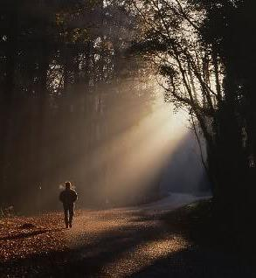
Living in Agreement with God
II CORINTHIANS 6:14-18
And what agreement hath the temple of God with idols? for ye are the temple of the living God; as God hath said, I will dwell in them, and walk in them; and I will be their God, and they shall be my people.

Slide 2
Birthdays Anniversaries Events
Nov. 5th Ben Pritchard,
Pierce Jackson,
Morgen Cockman
Nov. 6th Madison Powell
Nov. 7th Amber McCall
David & Karen Mourglea
Nov. 8th Melody Cross
Nov. 11th Ayden Stevens
Nov. 12th Bill Walters
Nov. 13th Julia Clayville
Nov. 14th Peggy Haney
Josiah Mayl
Dec. 14th
Annual End of the Year Dinner

Slide 3
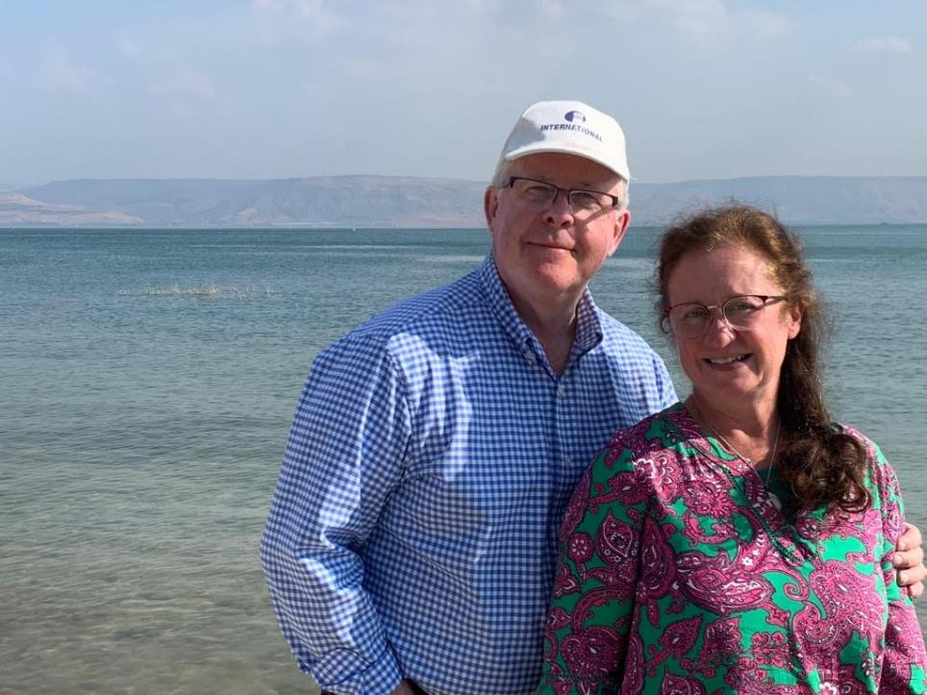
Israel 2019

Slide 4
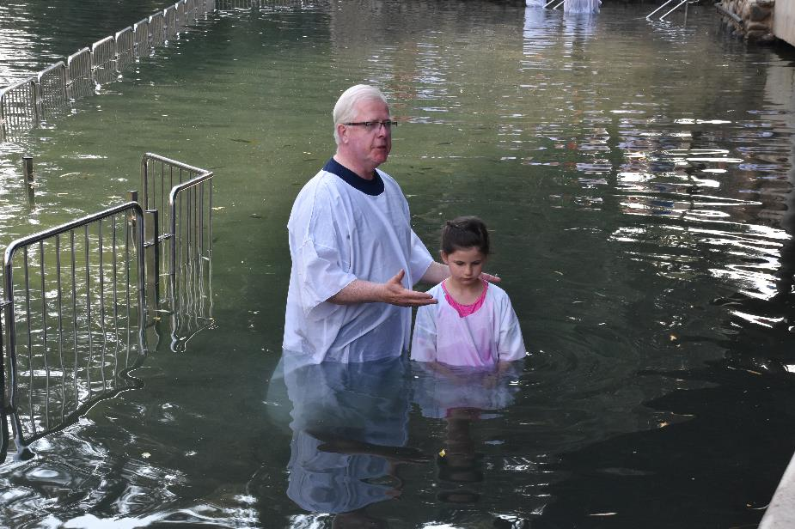

Slide 5
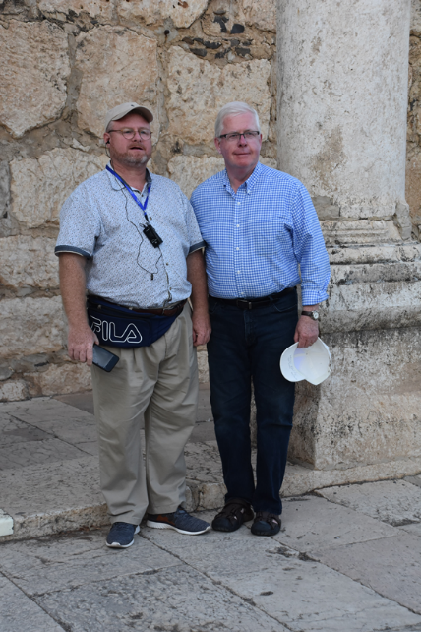
Jordan River

Slide 6
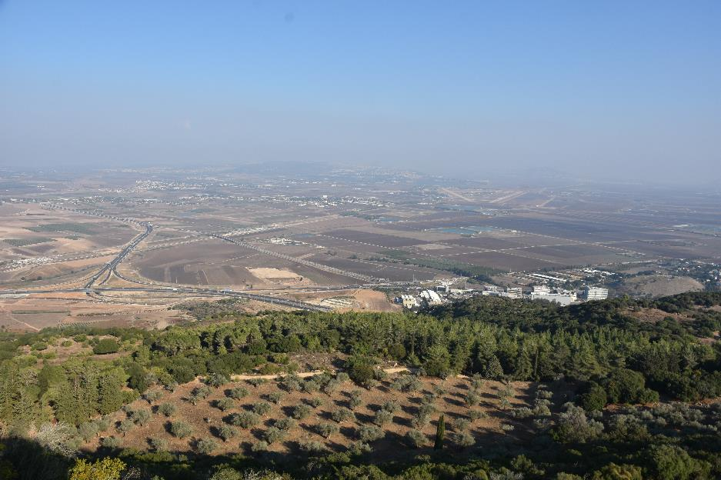

Slide 7
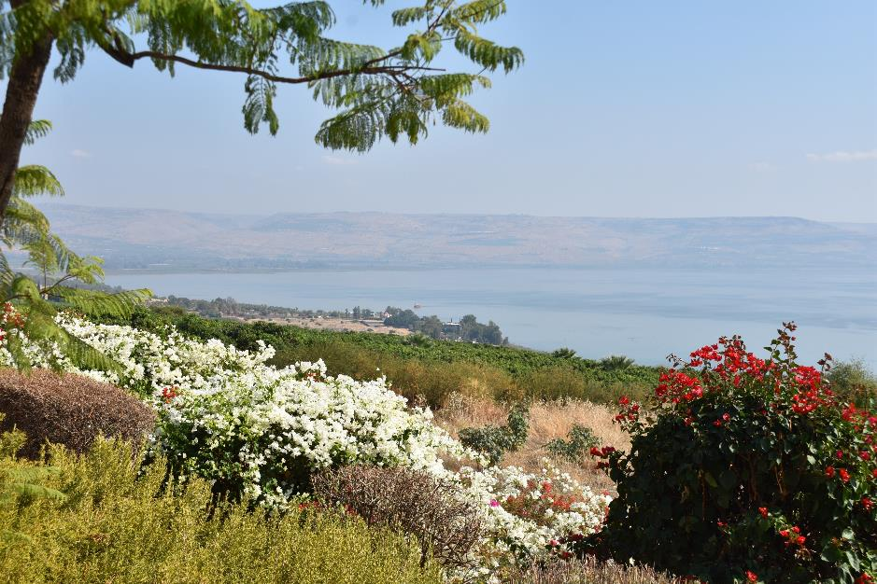

Slide 8
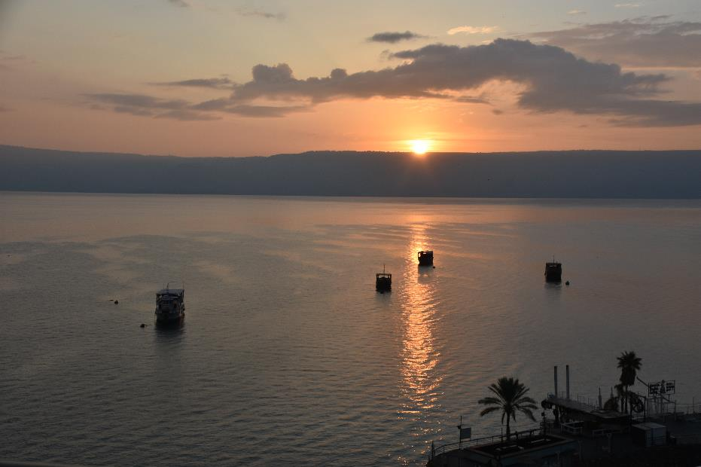

Slide 9
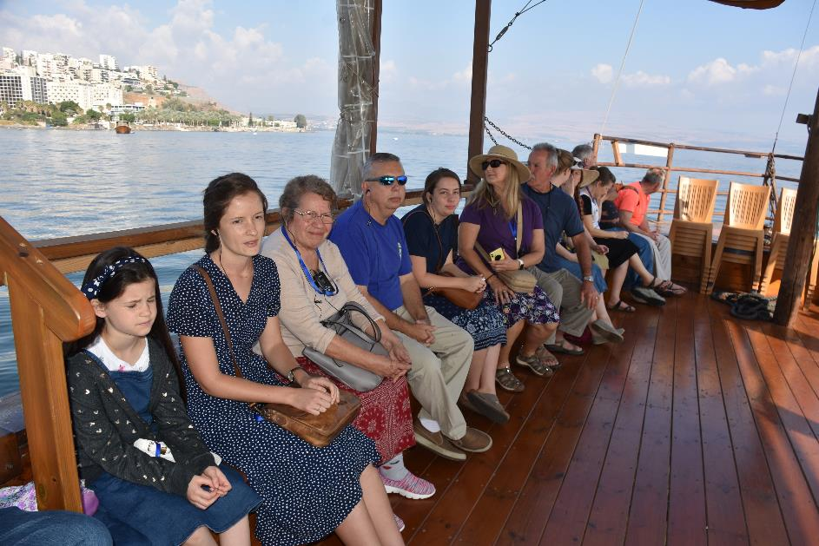

Slide 11
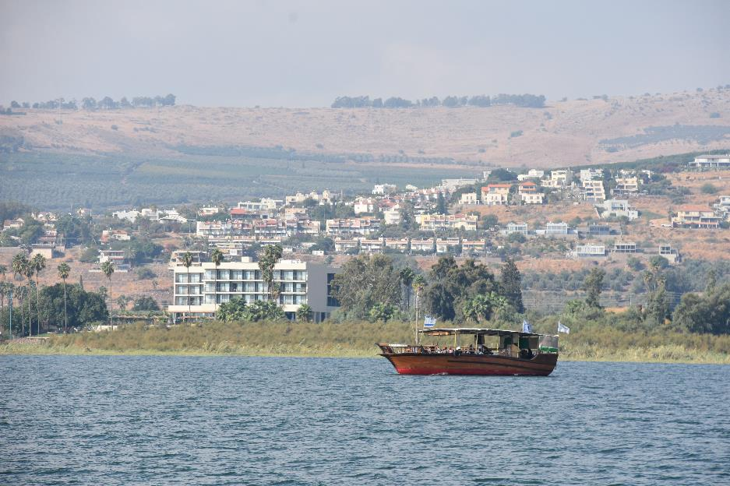

Slide 12
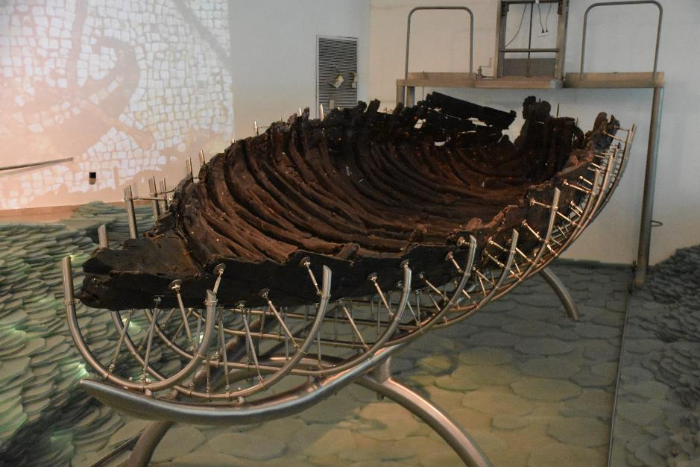

Slide 13
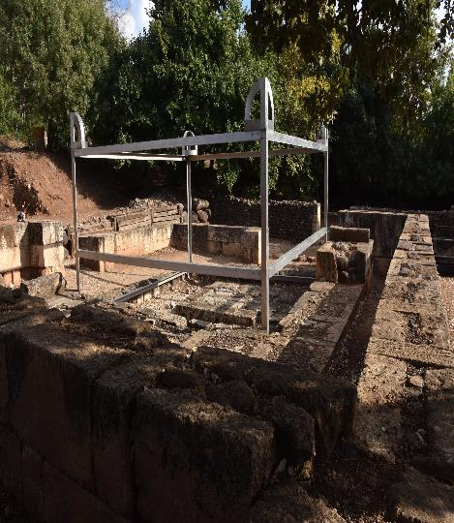
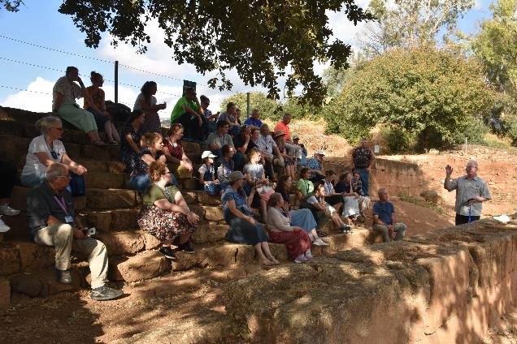

Slide 14
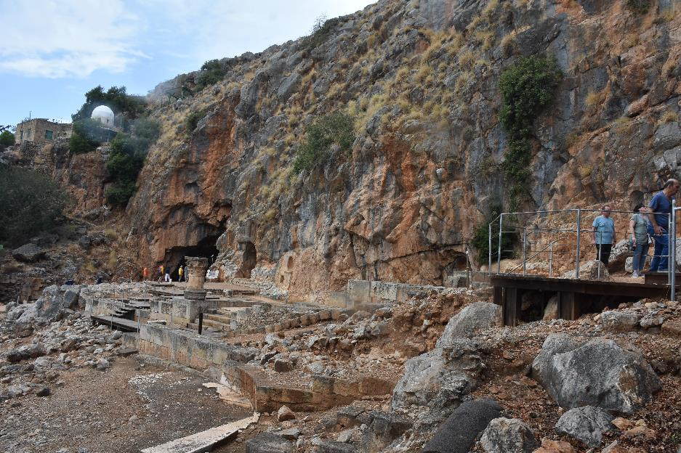

Slide 15
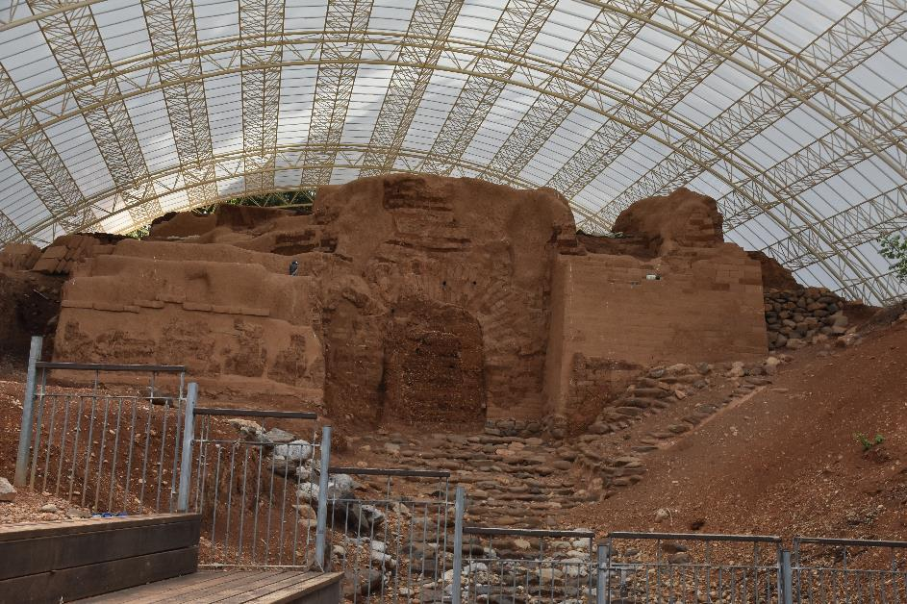

Slide 16
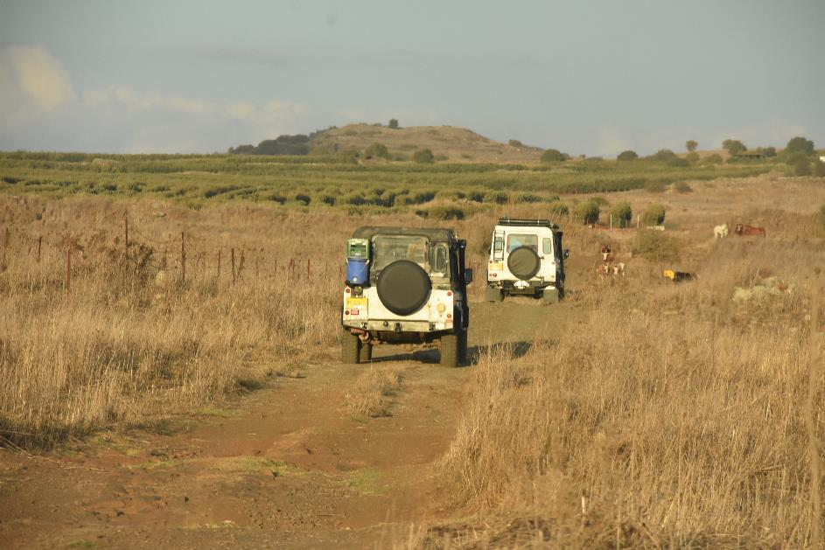
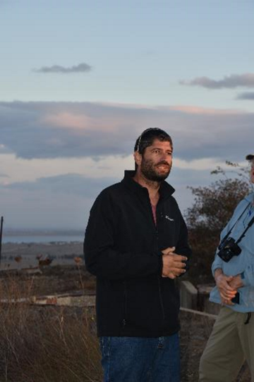

Slide 17
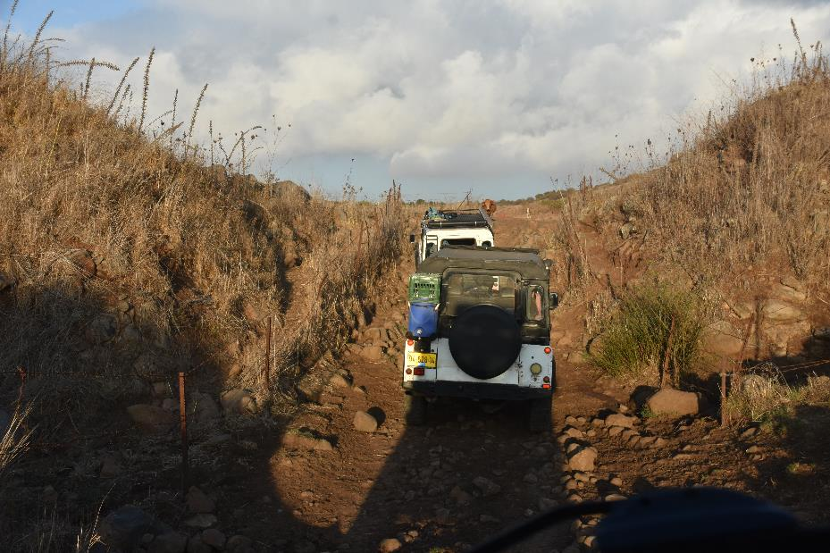

Slide 18
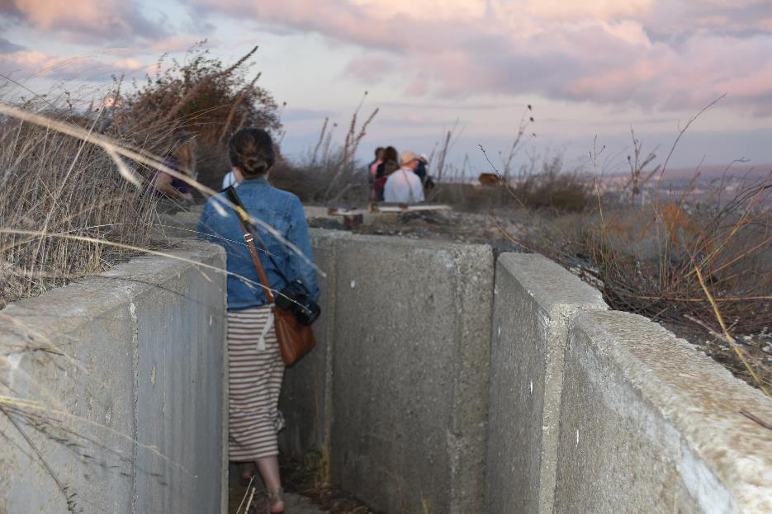

Slide 19
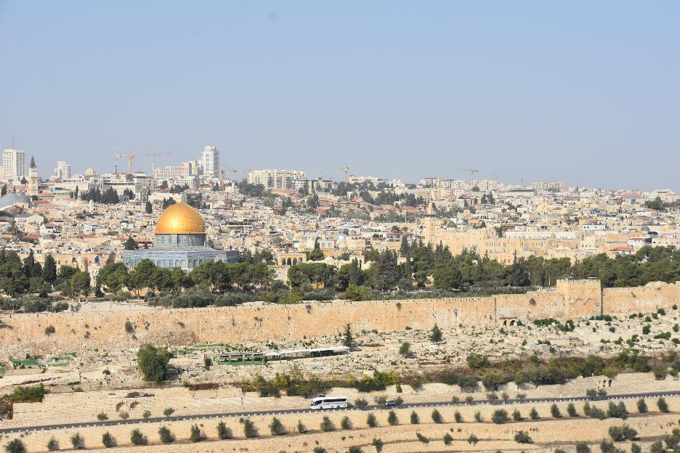

Slide 20
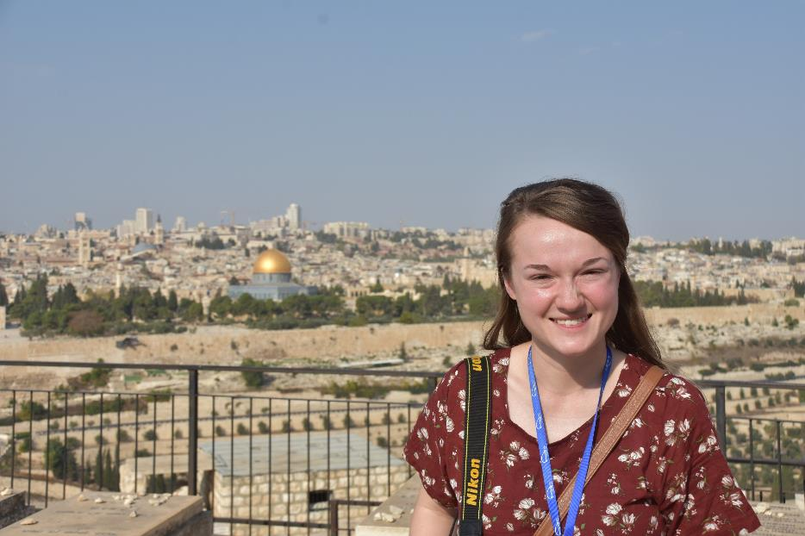
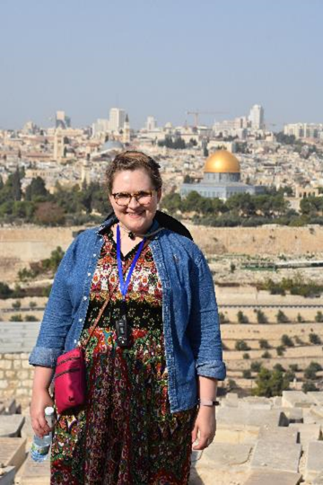

Slide 21
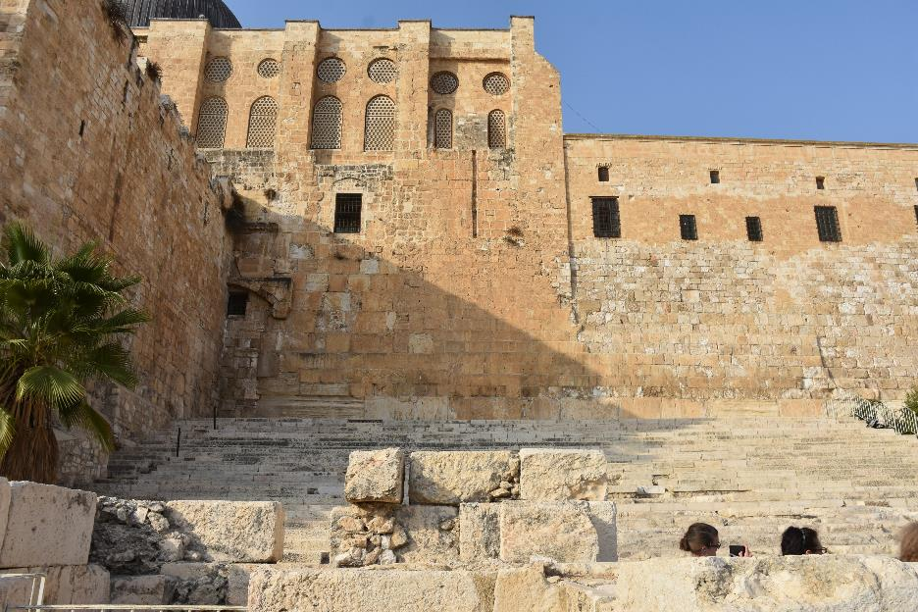

Slide 22
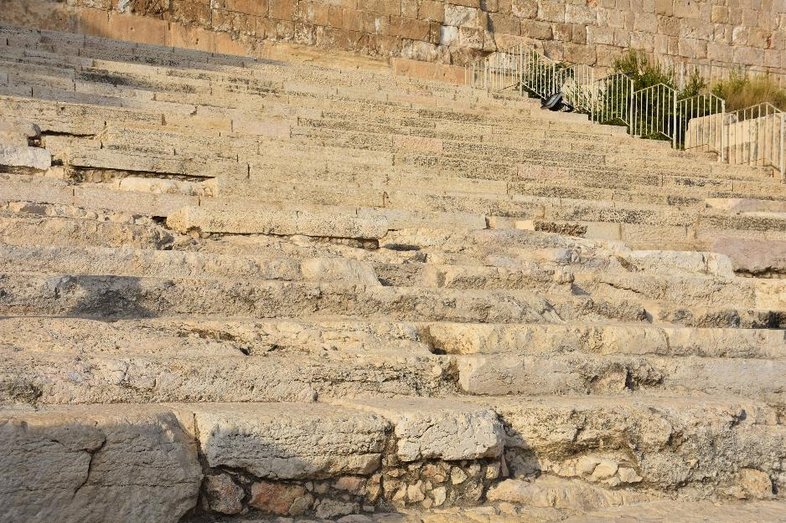
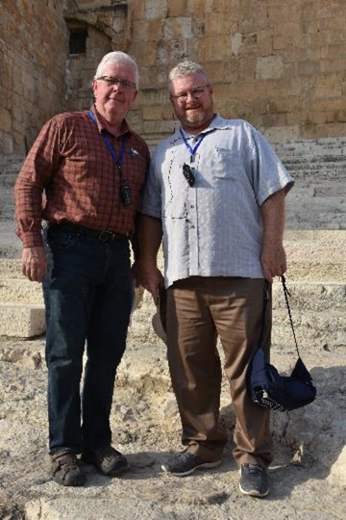

Slide 23
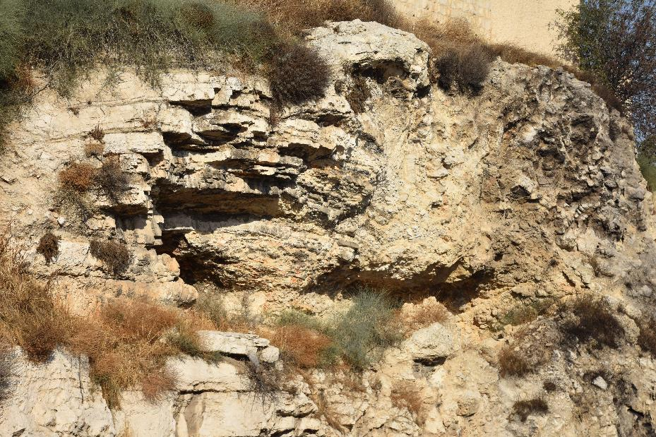

Slide 24
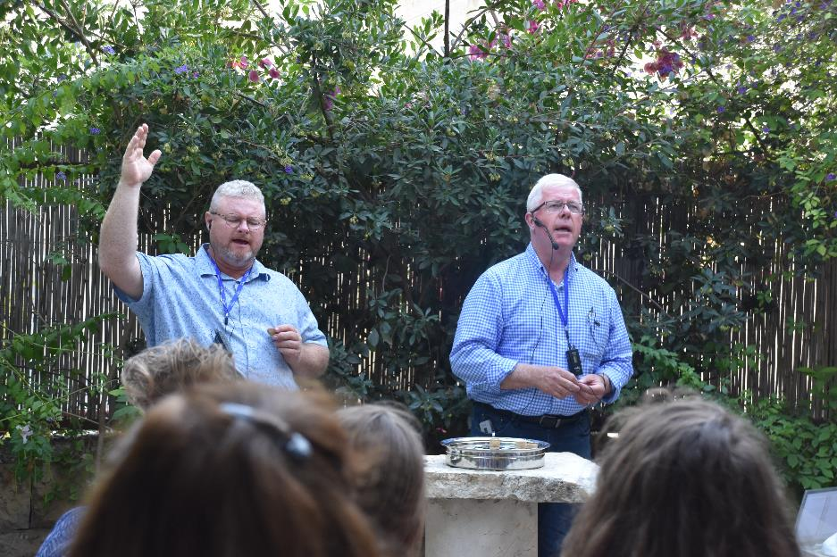

Slide 25
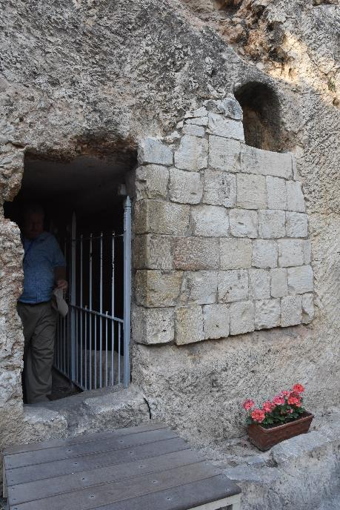
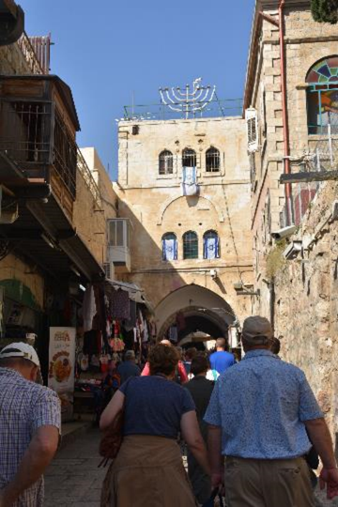

Slide 26
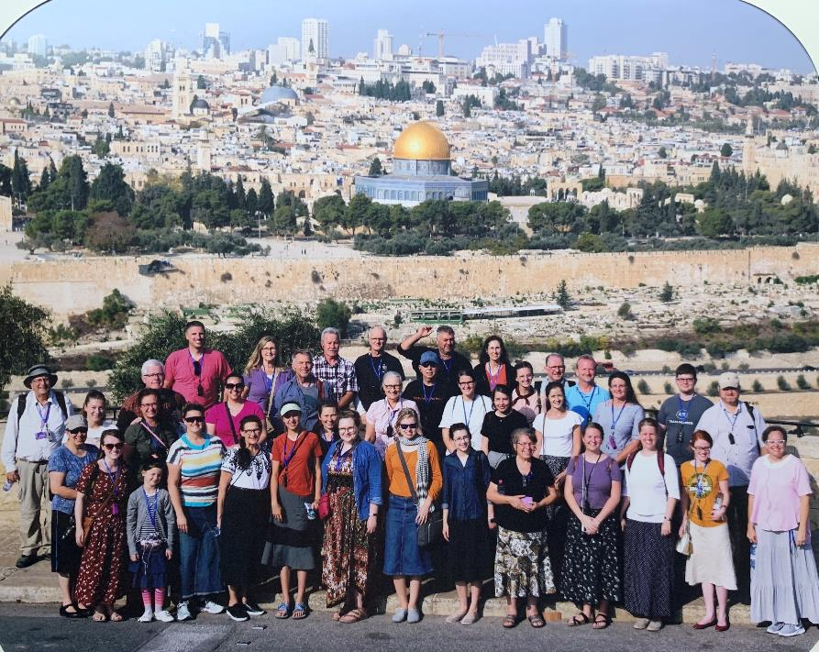

Slide 27
Agreement
(Gr.) sugkatathesis
A putting together or joint deposit; hence approval, assent, agreement.

Slide 28
MATTHEW 18:18-20
Verily I say unto you, Whatsoever ye shall bind on earth shall be bound in heaven: and whatsoever ye shall loose on earth shall be loosed in heaven. 19 Again I say unto you, That if two of you shall agree on earth as touching any thing that they shall ask, it shall be done for them of my Father which is in heaven. 20 For where two or three are gathered together in my name, there am I in the midst of them.

Slide 29
Agree
(Gr.) sumphoneo Agree with; Agree together.
ACTS 15:12-23
Then all the multitude kept silence, and gave audience to Barnabas and Paul, declaring what miracles and wonders God had wrought among the Gentiles by them. 13 And after they had held their peace, James answered, saying, Men and brethren, hearken unto me: 14 Simeon hath declared how God at the first did visit the Gentiles, to take out of them a people for his name. 15 And to this agree the words of the prophets…

Slide 30
Daniel 1:5,8
And the king appointed them a daily provision of the king's meat, and of the wine which he drank: so nourishing them three years, that at the end thereof they might stand before the king.
⁸ But Daniel purposed in his heart that he would not defile himself with the portion of the king's meat, nor with the wine which he drank: therefore he requested of the prince of the eunuchs that he might not defile himself.

Slide 31
PARADOX
52 If we could just like a great symphony, we would just follow the beats as the Composer is beating It out... Now, we come to this thought, that the hour that we're living, we have come to the spot to where we're watching for God.
53 When you brethren first started, speaking in tongues come into the church, God restoring gifts back into the church. It was hard to pull away from Prebysterian, Lutheran, Baptist in that reformation. The Nazarenes were their bloom in them times, Pilgrim Holiness; they rejected your message. What happened to them? You see where they're at today? Now, we can do the same thing. 64-0206

Slide 33
PRESUMING
72 Now that's where the trouble comes. Honest-thinking people believe that if they are brought into a certain condition, a certain place, a certain pledge, that that's all God requires. Live by the ten commandments, something like that, some good deed, social turn, give the neighbor something. They presume that that's religion, and that's all they have to have. But how wrong that is.
62-0117

Slide 34
I JOHN 1:5-7
This then is the message which we have heard of him, and declare unto you, that God is light, and in him is no darkness at all. 6 If we say that we have fellowship with him, and walk in darkness, we lie, and do not the truth: 7 But if we walk in the light, as he is in the light, we have fellowship one with another, and the blood of Jesus Christ his Son cleanseth us from all sin.

Slide 35
Deuteronomy 17:18-20
And it shall be, when he sitteth upon the throne of his kingdom, that he shall write him a copy of this law in a book out of that which is before the priests the Levites: ¹⁹ And it shall be with him, and he shall read therein all the days of his life: that he may learn to fear the Lord his God, to keep all the words of this law and these statutes, to do them: ²⁰ That his heart be not lifted up above his brethren, and that he turn not aside from the commandment, to the right hand, or to the left: to the end that he may prolong his days in his kingdom, he, and his children, in the midst of Israel.

Slide 36
EZEKIEL 36:25-28
Then will I sprinkle clean water upon you, and ye shall be clean: from all your filthiness, and from all your idols, will I cleanse you. 26 A new heart also will I give you, and a new spirit will I put within you: and I will take away the stony heart out of your flesh, and I will give you an heart of flesh. 27 And I will put my spirit within you, and cause you to walk in my statutes, and ye shall keep my judgments, and do them. 28 And ye shall dwell in the land that I gave to your fathers; and ye shall be my people, and I will be your God.

Slide 37
COLOSSIANS 2:6-12
As ye have therefore received Christ Jesus the Lord, so walk ye in him: 7 Rooted and built up in him, and stab-lished in the faith, as ye have been taught, abounding therein with thanksgiving. 8 Beware lest any man spoil you through philosophy and vain deceit, after the tradition of men, after the rudiments of the world, and not after Christ. 9 For in him dwelleth all the fulness of the Godhead bodily. 10 And ye are complete in him, which is the head of all principality and power: 11 In whom also ye are circumcised with the circumcision made without hands, in putting off the body of the sins of the flesh by the circumcision of Christ 12 Buried with him in baptism, wherein also ye are risen with him through the faith of the operation of God, who hath raised him from the dead.

Slide 38
GOD'S.WRAPPED.GIFT
Rahab the harlot, she being a young girl that was turned on the street by a heathen father and mother, that put her on the street because she was beautiful, to bring an income to them on prostitution.
And yet, down in this immoral girl, she had heard that there was a God Who answered prayer. And the first opportunity that she got to accept that God, or do something for Him, she did it. And God spared her life, and saved her father, mother, and her family. She fell in love with a general in the army of Israel, and married this general. And their courtship was wonderful.

Slide 39
A.HIDDEN.LIFE.IN.CHRIST
53 On the outside [of the Tabernacle], what light did they have? They had light of the stars at night, the light of the moon. They had the light of the sun. Any kind of a cloud could come over and upset the whole thing. They couldn't see how to walk.
That's the way the experience is out yonder. Little trouble comes up, you backslide, go from one church to another, pack your paper one place to another. "I won't go to the Baptist no more, because I tell you; I just don't like it over there."

Slide 40
Methodist mistreat you, you run over to the Pentecostal, then the Nazarene. You're living in the outer courts. Well, say, "No, I've come farther than that, Bro. Branham. I've tasted of the Lord. I know He's good." That's good. All right, you're here at the first altar then, at the holy place.
But remember, they had light too. But it was artificial. They had a seven-point lamp to give light. Them lights sometimes got low. Sometimes they smoked up. You know what a light is; sometimes it went out.

Slide 41
And that's the way it is in that kind of light. When you're just living out here, "Well, I believe but I just can't go all the way with this... and if my church don't teach it, well, I couldn't accept it."
Least little thing comes along, your chimney gets all smoked up, first thing the light goes out. But the man that once went in there... Every earthly light, artificial light was shut off from him. Under the wings of the Cherubim, was Shekinah Light, a real soft holy Light that never went out. I don't care what the sun did, lamps did; he that lived in that Presence walks in the Light day and night.

Slide 42
55 That's where we need to be. No matter what your experience is... If heartaches, troubles, upsets, you're still walking in the Light of God. You're living in the Shekinah Glory, living there where Jesus is in His Presence, that "all things work together for good to them that love God." And you'll love Him, and you're walking in that mellow, soft, humble Christian life. Wouldn't you like to walk like that?
There's not a person here but wants to live in there. And, friends, that's where you should live.
55-1110

Slide 43
JEHOVAH.JIREH
37 Abraham, God said, "Now, separate yourself from all of your kindred. Come out, be with Me and I will bless you. (That’s wonderful?) But there's where the trouble come.
People don't want to separate themselves from their card parties, things of the world. You try to bring that right into church with them. You have to separate yourself from unbelievers. Don't yoke yourself up with unbelievers. "Come out, and be separated," saith the Lord. The world's looking for mixers.
61-0209

Slide 44
WHO.DO.YOU.SAY.THIS.IS
23 Years ago, it was very easy when I started out; the signs, message, preaching. Everywhere an arm open, "Come! Come! Come!" But see, every genuine sign from God has a Message, a Voice. It follows it. God don't give anything like that just for the fun of giving it. He sends something forth to attract attention to what He's fixing to say.
25 And the world is just like that, friends.. They feel that as long as it don't bother them, why, they'll do it. But when it comes time that they've got to change their ideas about things, that's when the trouble comes. 64-1227

Slide 45
VICTORY.DAY
75 God Himself moves upon the scene, saying, "This is it. These signs shall follow them that believe. A little while, and the world won't see Me no more; yet you'll see Me, for I'll be with you, even in you."
76 And instead of saying, "Well, wonderful. We see God in the midst of the people, working. Let's do that"? No, sir. With greed and jealousy, same thing that Cain has, he requires the blood of his brother. He tries to wipe him out of the way, get rid of him.

Slide 46
"They're nothing but a bunch of holy-rollers. They're little." You know what I mean. That's what starts the trouble. There's where trouble begins.
That's where the broken vows. There's where broken fellowship separates. That's the thing that breaks up homes. That's the thing that starts the wheel moving towards divorces. That's the very thing that breaks the fellowship.
63-0421

