Slide 1
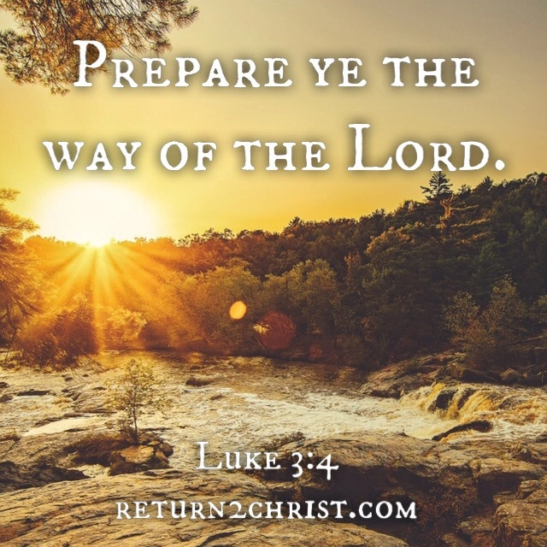
Prepare the Way of the Lord
The voice of him that crieth in the wilderness, Prepare ye the way of the LORD, make straight in the desert a highway for our God.

Slide 2
Birthdays & Anniversaries
Dec. 16th Kim Ward
Dec. 21st Lucas Walters
Ben McCafferty

Slide 3
RUTH 3:16-18
And when she came to her mother
in law, she said, Who art thou, my daughter? And she told her all that
the man had done to her. 17 And
she said, These six measures of
barley gave he me; for he said to
me, Go not empty unto thy
mother in law. 18 Then said she,
Sit still, my daughter, until thou
know how the matter will fall: for
the man will not be in rest, until he
have finished the thing this day.

Slide 4
1. BE.NOT.AFRAID.IT.IS.I
55 When God is called on the scene... Now, you Bible studiers, listen to this. Put your faith in the Word of God, for when God is ever called on the scene to make a decision, He cannot make any other decision but what He has to stay with His first decision. How many knows that? 'Cause He's infinite; every decision's perfect. 61-0123

Slide 5
ISAIAH 40:3-5
The voice of him that crieth in the wilderness, Prepare ye the way of the LORD, make straight in the desert a highway for our God. 4 Every valley shall be exalted, and every mountain and hill shall be made low: and the crooked shall be made straight, and the rough places plain: 5 And the glory of the LORD shall be revealed, and all flesh shall see it together: for the mouth of the LORD hath spoken it.

Slide 6
“…Prepare ye the way of the LORD,”
Prepare: panah
To turn toward/from/away;
To put out of the way, make clear;
To make a turn, show signs of turning.
EXODUS 32:15
And Moses turned, and went down from the mount, and the two tables of the testimony were in his hand: the tables were written on both their sides; on the one side and on the other were they written.

Slide 7
MATTHEW 3:7-12
But when he saw many of the Pharisees and Sadducees come to his baptism, he said unto them, O generation of vipers, who hath warned you to flee from the wrath to come? 8 Bring forth therefore fruits meet for repentance:

Slide 8
2. ACCEPTING.GOD'S.PROVIDED.WAY.AT.THE.END
238 The world needed a Saviour one day, and God provided His Son. When He come, He was not recognized, not wanted. They said they wanted a Saviour. They asked for a king; God give them a Baby. They wanted a mighty man to stomp Rome. God give them a little, crying Baby in a barn. But it was God's provided way. But they didn't want it the way God wanted to send it. They want it the way they wanted it. So, therefore, they went into chaos because they didn't accept His way. There was some that did.
63-0115

Slide 9
MOSES 50-0110
17 When the time of the promise drew nigh, God sent this Moses down there. People said, "Who made you a ruler over us? You think you're someone great."
That wasn't Moses' attitude. He was sent a deliverer, knowing the time was there. And he thought, surely, the people had been reading their Scriptures and things, and they would know that the

Slide 10
time of the promise was near, or been reading the promise of Abraham…
18 Usually Satan works right in there with their understanding and makes them dull of understanding. And there they miss God nine times out of ten.

Slide 11
MATTHEW 2:1-6
Now when Jesus was born in Bethlehem of Judaea in the days of Herod the king, behold, there came wise men from the east to Jerusalem…
4 And when he had gathered all the chief priests and scribes of the people together, he demanded of them where Christ should be born. 5 And they said unto him, In Bethlehem of Judaea: for thus it is written by the prophet, 6 And thou Bethlehem, in the land of Juda, art not the least among the princes of Juda: for out of thee shall come a Governor, that shall rule my people Israel.

Slide 12
A Saviour: (Is. 10-11, 29-31)
EXODUS 2:16 Now the priest of Midian had seven daughters: and they came and drew water, and filled the troughs to water their father's flock. 17 And the shepherds came and drove them away: but Moses stood up and helped them, and watered their flock. 18 And when they came to Reuel their father, he said, How is it that ye are come so soon to day? 19 And they said, An Egyptian delivered us out of the hand of the shepherds, and also drew water enough for us, and watered the flock.

Slide 13
EXODUS 14:30
Thus the LORD saved Israel that day out of the hand of the Egyptians; and Israel saw the Egyptians dead upon the sea shore.
yasha' To be liberated, be saved, be delivered in battle; victorious;
To save from moral troubles.

Slide 14
HANDWRITING.ON.THE.WALL
10 …God has to act the same every time. He cannot act one way at a certain time, and that same kind of a crisis rise, His action on the first has to be on the second the same way, or He acted wrong when He acted in the first place.
58-0618

Slide 15
WHAT.IS.THE.HOLY.GHOST
27 Now, there is a vast difference between just a Christian and a Holy Ghost filled Christian. And now, we're going to get this from the Scripture and place it just exactly in the Scripture.
59-1216

Slide 16
WHAT.IS.THE.HOLY.GHOST?
51 It's your Assurance; your Protection; Witness; your Seal; It's your Sign, that I'm heaven bound. Don't care what the devil says. He gave It to me. He sealed me into His Kingdom, and I'm Glory bound. Let the winds blow; let Satan do what he wants to; God's done sealed me till the day of my redemption. Oh, you should want It; I couldn't go on without It.
52 (John 14) …What did He come in me for? Was to continue the works of God.… The Jesus that sends you goes with you and is in you. And if that Spirit living in Jesus Christ made Him do and act the way He did, you'll have some general idea how It'll do when It's in you; 'cause that Life cannot change.

Slide 17
What is the Holy Ghost? It's an Advocate. It has mercy; It stands in your place; It does things that you can't do; It's a propitiation for your sins. It's your Righteousness; It's your healing; It's your Life; It's your Resurrection…
62 Sometimes when we got the Holy Ghost, we ignorantly stagger into something. The Holy Spirit's there to make advocate for us; He's our Attorney... We don't plead for ourself, because the Holy Ghost in us pleads for us.

Slide 18
We're walking in a dark world full of enemies, full of sin, full of traps. Don't be afraid. We have an Advocate. Amen. Oh, He stands by us; He's in us, and makes intercessions for us…
65 …They didn't have It in that day; they just had a seal in their flesh as a token and a sign, believing It was coming. And they walked by the shadow of the law, which they were circumcised by flesh. Today… we walk by the power of the Spirit Who is our true Seal, true Advocate, true Comforter, true Sign that we have been born from above, peculiar, taking God at His Word, calling everything else wrong.
59-1216

Slide 19
MARRIAGE.AND.DIVORCE
16-1 One interruption spoils the entire program. Now, when human beings was running in continuity with God, with one man and one woman, this woman sinned.
And it throwed the whole earthly program out of continuity with God. Therefore, one word added to this Book or one word taken from It throws a Christian out of continuity with God, throws the church out of continuity with God, throws a family out of continuity with God.

Slide 20
Every believer can be throwed out by not accepting every Word of God.
Then it was the woman that caused the separation of the lovely home. It was not a Cherubim that bothered the earth. It was not Adam that throwed the home out. It was a woman: Eve.
… She broke the covenant because why? She stepped across the borders of God's Word.

