Slide 1
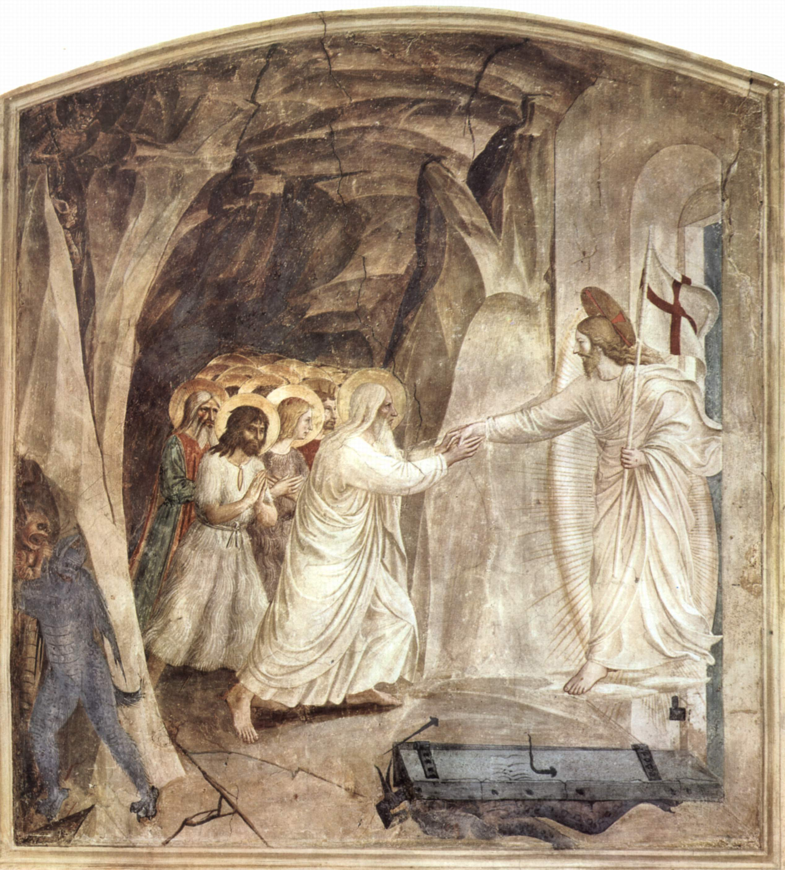
The Harrowing of Hell

Slide 2
Matthew 16:18:
And I say also unto thee, That thou art Peter, and upon this rock I will build my church; and the gates of hell shall not prevail against it.

Slide 3
Gates: Location of deliberation and council, seat of power.
2 Samuel 19:8
So the king got up and sat in the gate, and all the people were told: “Behold, the king is sitting in the gate.” So they all came before the king.
(Lot, Boaz, husband of virtuous woman)

Slide 4
Isaiah 38:10
I (Hezekiah) said in the cutting off of my days, I shall go to the gates of the grave: I am deprived of the residue of my years.
Job 8:16-17
Hast thou entered into the springs of the sea? or hast thou walked in the search of the depth? Have the gates of death been opened unto thee? or hast thou seen the doors of the shadow of death
Psalms 107:18
Their soul abhorreth all manner of meat; and they draw near unto the gates of death.

Slide 5
63-0728 - Christ Is The Mystery Of God Revealed
“Flesh and blood never revealed it to you. But upon this revelation, called-out group, I’ll build My Church in them. And all the gates of hell will never be able to withstand it.” “Not one hair of your head shall perish. You are Mine! I’ll raise you up in the last day, give unto him Eternal Life, and raise him up at the last days.”

Slide 6
54-1212 - He Swore By Himself
And He bore our—our Divine judgment, and took my penalty, taking your sins, and your guilt, and your ticket to hell, and your ticket to torment. And took it upon Himself, and died in our stead, and was sent to hell in my place. Amen. And God was not willing that He should stay there, but rose Him up on the third day, for our justification. To look there, and say, “I am…God has absolutely proved me, that I am justified, because He raised up His Son, Christ Jesus. Therefore, I am resurrected with Him, sitting in Heavenly places.” That’s right. Settled it! See?

Slide 7
55-0227A - The Position Of A Believer In Christ
God wouldn’t have sent Him to—to hell pure. He had to send Him to hell condemned (See?), because He took our sins. And Christ died, not righteous; Christ died a sinner. See? Christ never sinned Himself, but He took our sins on Him.

Slide 8
Gen 22:15-18
And the angel of the LORD called unto Abraham out of heaven the second time, And said, By myself have I sworn, saith the LORD, for because thou hast done this thing, and hast not withheld thy son, thine only son: That in blessing I will bless thee, and in multiplying I will multiply thy seed as the stars of the heaven, and as the sand which is upon the sea shore; and thy seed shall possess the gate of his enemies; And in thy seed shall all the nations of the earth be blessed; because thou hast obeyed my voice.

Slide 9
62-0121M - And Thy Seed Shall Possess The Gate Of His Enemy
238 He ascended on High. What did He do? He cut a hole, a gate, that, the prayer of this Seed of Abraham. Why? Why? If we be the Body of Christ, if we are dead, we reckon ourself dead and buried in Christ, and raised with Him in resurrection. He is the Head of the Body. Where the Head is, the Body is with It. And then, this morning, where every one that’s did that, “is seated with Him in heavenly places,” with the Royal Seed. Praise God.

Slide 10
Luke 23:42-43
And he said unto Jesus, Lord, remember me when thou comest into thy kingdom. 43And Jesus said unto him, Verily I say unto thee, To day shalt thou be with me in paradise.

Slide 11
2 Corinthians 12:2-4
I knew a man in Christ above fourteen years ago, (whether in the body, I cannot tell; or whether out of the body, I cannot tell: God knoweth;) such an one caught up to the third heaven. And I knew such a man, (whether in the body, or out of the body, I cannot tell: God knoweth;) How that he was caught up into paradise, and heard unspeakable words, which it is not lawful for a man to utter.
Rev 2:7
He that hath an ear, let him hear what the Spirit saith unto the churches; To him that overcometh will I give to eat of the tree of life, which is in the midst of the paradise of God.

Slide 12
Acts 2
24 Whom God hath raised up, having loosed the pains of death: because it was not possible that he should be holden of it. 25 For David speaketh concerning him: 27... thou wilt not leave my soul in hell, neither wilt thou suffer thine Holy One to see corruption...(PSALMS 16:10)

Slide 13
Acts 2 continued 31 He seeing this before spake of the resurrection of Christ, that his soul was not left in hell, neither his flesh did see corruption. 32 This Jesus hath God raised up, whereof we all are witnesses.

Slide 14
Daniel 10:13
But the prince of the kingdom of Persia withstood me one and twenty days: but, lo, Michael, one of the chief princes, came to help me; and I remained there with the kings of Persia.

Slide 15
1 Peter 3:18-20
For Christ also hath once suffered for sins, the just for the unjust, that he might bring us to God, being put to death in the flesh, but quickened by the Spirit: By which also he went and preached unto the spirits in prison; Which sometime were disobedient, when once the longsuffering of God waited in the days of Noah, while the ark was a preparing, wherein few, that is, eight souls were saved by water.

Slide 16
58-0406E - The Evidence Of The Resurrection
30 After the death of Jesus, the Bible tells us, that, “He went and preached to the souls that were in prison, that repented not in the longsuffering of the days of Noah.” And to bring to their remembrance that Noah, and Enoch, and the great prophets of their days, witnessed that there was coming a Messiah, and they rejected the Message.

Slide 17
Matthew 27:52-53
And the graves were opened; and many bodies of the saints which slept arose, And came out of the graves after his resurrection, and went into the holy city, and appeared unto many.

Slide 18
I Corinthians 15:50-57
Now this I say, brethren, that flesh and blood cannot inherit the kingdom of God; neither doth corruption inherit incorruption. Behold, I shew you a mystery; We shall not all sleep, but we shall all be changed, In a moment, in the twinkling of an eye, at the last trump: for the trumpet shall sound, and the dead shall be raised incorruptible, and we shall be changed.

Slide 19
I Corinthians 15:50-57 continued
For this corruptible must put on incorruption, and this mortal must put on immortality. So when this corruptible shall have put on incorruption, and this mortal shall have put on immortality, then shall be brought to pass the saying that is written, Death is swallowed up in victory. O death, where is thy sting? O grave, where is thy victory? The sting of death is sin; and the strength of sin is the law. But thanks be to God, which giveth us the victory through our Lord Jesus Christ.

Slide 20
Isaiah 25:8
He will swallow up death in victory; and the Lord GOD will wipe away tears from off all faces; and the rebuke of his people shall he take away from off all the earth: for the LORD hath spoken it.
Hoseah 13:14
I will ransom them from the power of the grave; I will redeem them from death: O death, I will be thy plagues; O grave, I will be thy destruction: repentance shall be hid from mine eyes.

Slide 21
Rev 19:7-8
Let us be glad and rejoice, and give honour to him: for the marriage of the Lamb is come, and his wife hath made herself ready. And to her was granted that she should be arrayed in fine linen, clean and white: for the fine linen is the righteousness of saints.

Slide 22
Revelation 19:11-16
And I saw heaven opened, and behold a white horse; and he that sat upon him was called Faithful and True, and in righteousness he doth judge and make war. His eyes were as a flame of fire, and on his head were many crowns; and he had a name written, that no man knew, but he himself. And he was clothed with a vesture dipped in blood: and his name is called The Word of God.

Slide 23
Revelation 19:11-16 continued
And the armies which were in heaven followed him upon white horses, clothed in fine linen, white and clean. And out of his mouth goeth a sharp sword, that with it he should smite the nations: and he shall rule them with a rod of iron: and he treadeth the winepress of the fierceness and wrath of Almighty God. And he hath on his vesture and on his thigh a name written, KING OF KINGS, AND LORD OF LORDS.

Slide 24
61-0730M - Gabriel's Instructions To Daniel
Then, at the end, in the 19th chapter, here She comes with Her Bridegroom. Hallelujah! “King of king, and Lord of lords; vesture dipped in Blood, and the Heavenly host riding on white horses, coming with Him. There She comes, to take Her place for the Millennium. Amen!

Slide 25
Ephesians 6:10-17
Finally, my brethren, be strong in the Lord, and in the power of his might. Put on the whole armour of God, that ye may be able to stand against the wiles of the devil. For we wrestle not against flesh and blood, but against principalities, against powers, against the rulers of the darkness of this world, against spiritual wickedness in high places.

Slide 26
Ephesians 6:10-17 continued
Wherefore take unto you the whole armour of God, that ye may be able to withstand in the evil day, and having done all, to stand. Stand therefore, having your loins girt about with truth, and having on the breastplate of righteousness; And your feet shod with the preparation of the gospel of peace; Above all, taking the shield of faith, wherewith ye shall be able to quench all the fiery darts of the wicked. And take the helmet of salvation, and the sword of the Spirit, which is the word of God:

Slide 27
Revelation 19:19-20
And I saw the beast, and the kings of the earth, and their armies, gathered together to make war against him that sat on the horse, and against his army. And the beast was taken, and with him the false prophet that wrought miracles before him, with which he deceived them that had received the mark of the beast, and them that worshipped his image. These both were cast alive into a lake of fire burning with brimstone.

Slide 28
Rev 20:10
And the devil that deceived them was cast into the lake of fire and brimstone, where the beast and the false prophet are, and shall be tormented day and night for ever and ever.
Rev 20:14-15
And death and hell were cast into the lake of fire. This is the second death. And whosoever was not found written in the book of life was cast into the lake of fire.

